Slide 1
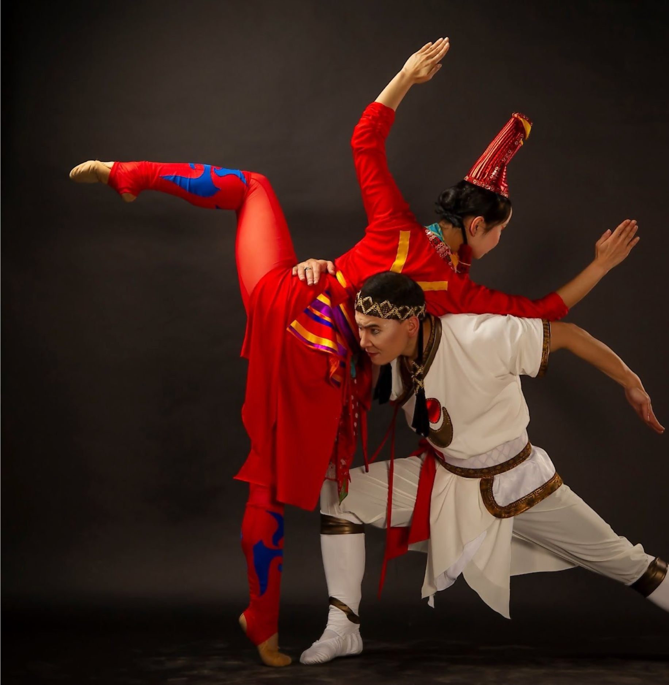
"Dance of Children of Heaven"
“From Cave Paintings to Innovation”

Slide 2
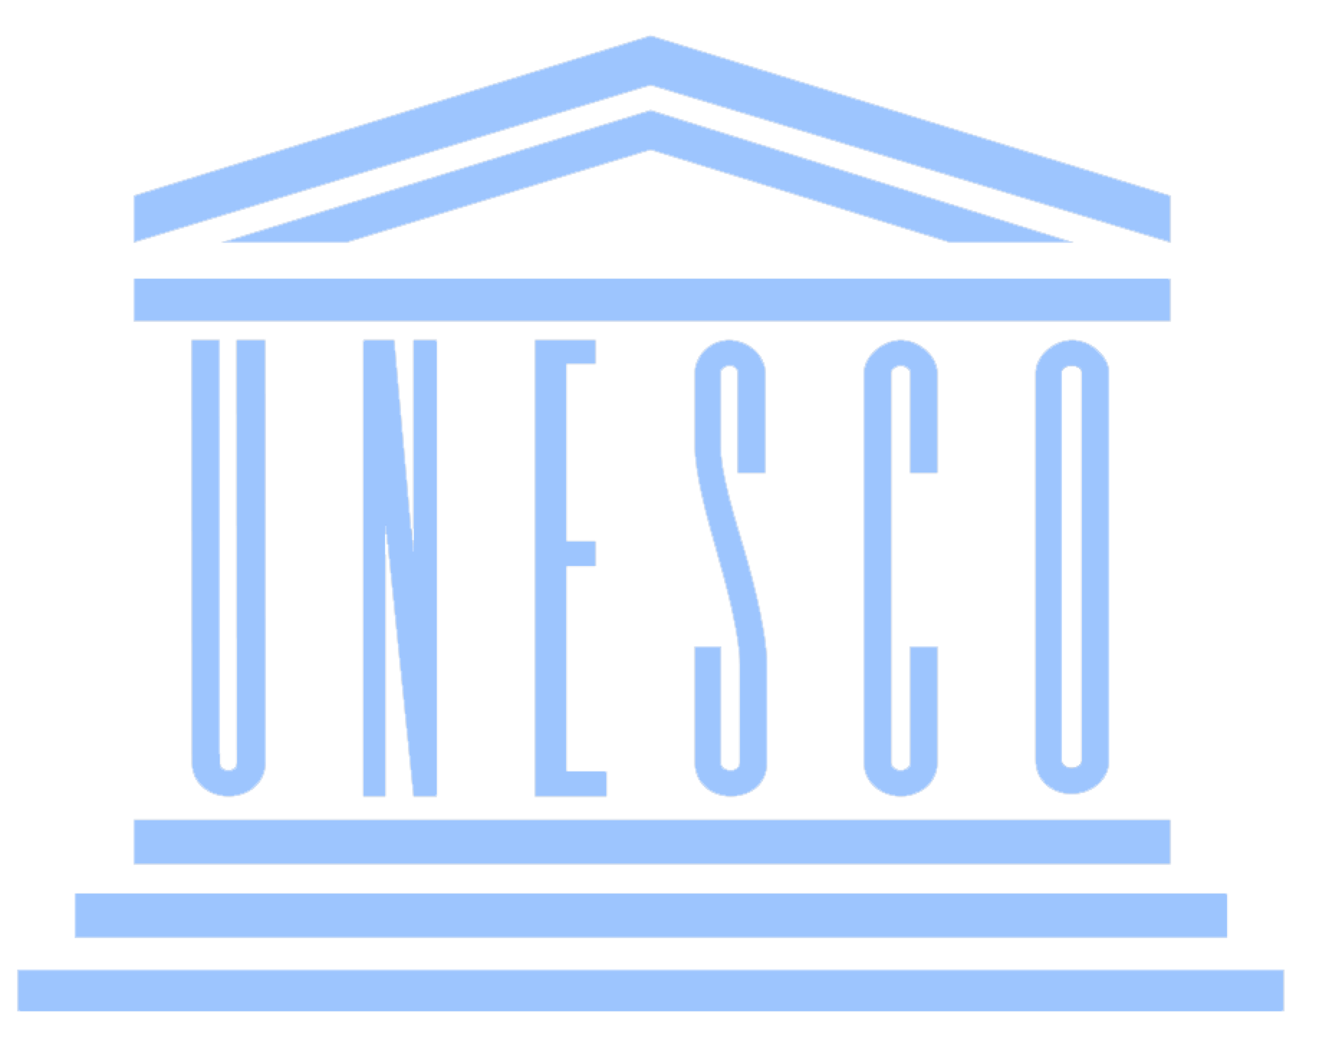
500
65K
NUMBER OF COMPLEXES OF CAVE PAINTINGS
NUMBER OF CAVE PAINTINGS
3
40,000
100,000
REGISTERED IN UNESCO
ANCIENT CAVE PAINTING IS OVER 100,000 YEARS OLD
YEARS OF HISTORY ARE PRESERVED

Slide 3
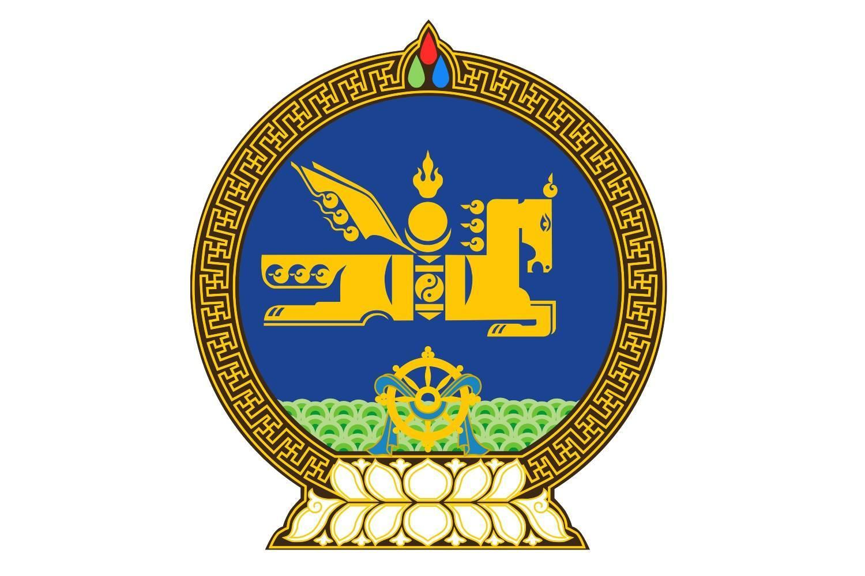
Decree No. 181 of the President of Mongolia "The protection, study, and support of cave paintings".
"National Stone Culture Heritage Program"
The historical, cultural, scientific and intellectual heritage of the Mongolian people is protected by the state.
Constitution of Mongolia 7.1
Preserving, protecting and nurturing the national history, language, culture, heritage, and customs is the foundation and vital immunity of the Mongolian nation.
Concept of National Security of Mongolia 1.6.6
Sustainable development goals 11.4
Enhance measures to preserve and protect the world's cultural and natural heritage
Law on the Protection of Cultural Heritage

Slide 4
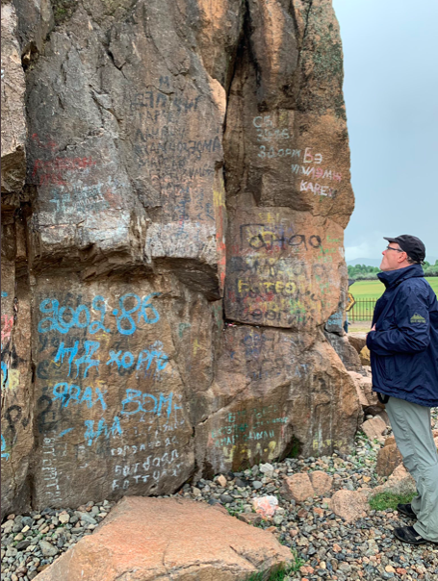
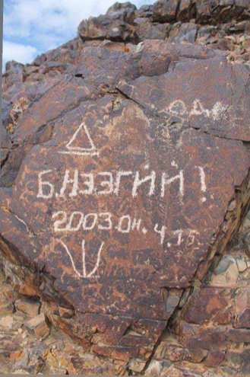
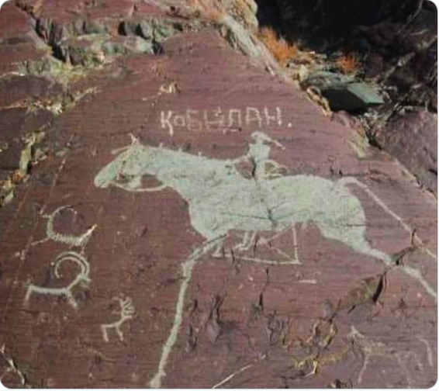
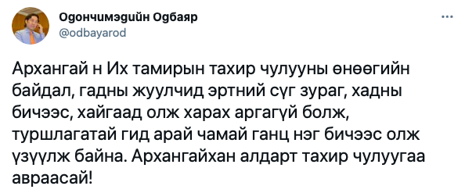
InnoWeek 21 Gray Theme

Slide 5
Combining ancient cultural heritage with modern art
Research-based innovation artwork
Combining the senses of sight and hearing
Engage with the public, youth, and local communities to advocate for the significance and conservation of cultural heritage
Providing support for young artists and fostering the arts and culture industry
Promoting the development of cultural heritage-based tourism

Slide 6
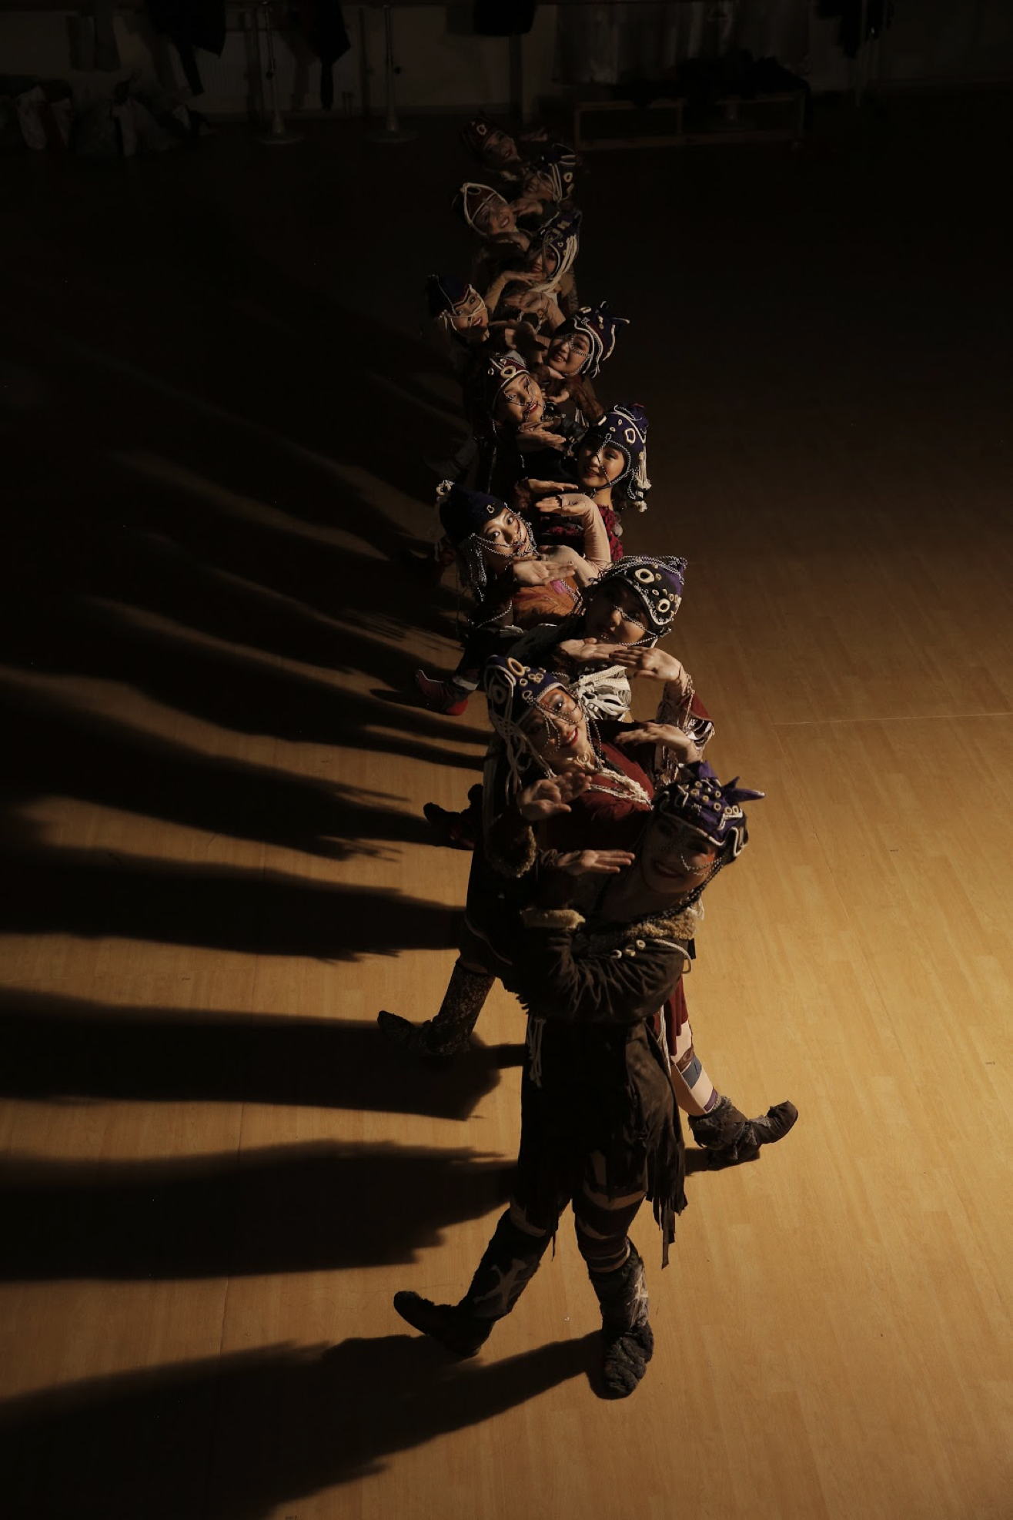
1
INVERTED TRIANGLE
ETHNO MODERN DANCE PERFORMANCE
2016
DANCE STAMPER
ETHNO DANCE PERFORMANCE
2017
2
5000+
AUDIENCE
VERTICAL WHITE TRIANGLE
DANCE PERFORMANCE
2021
3

Slide 7
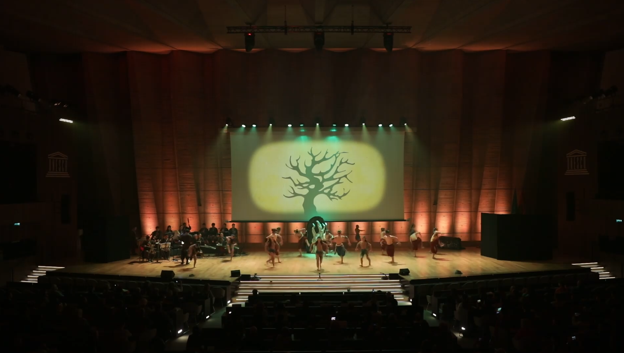
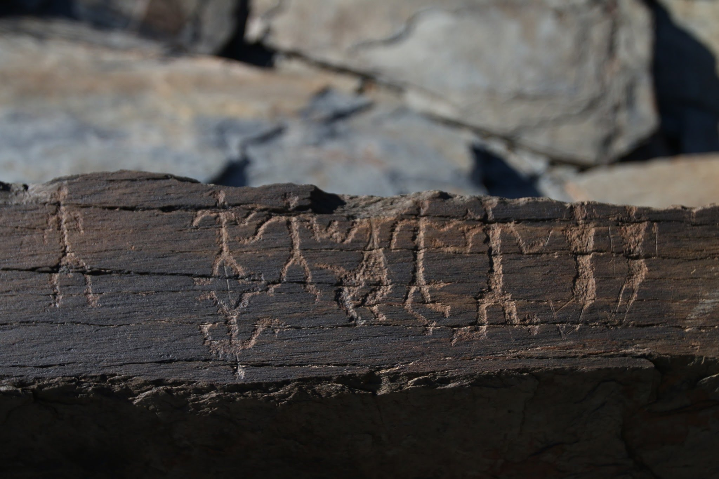
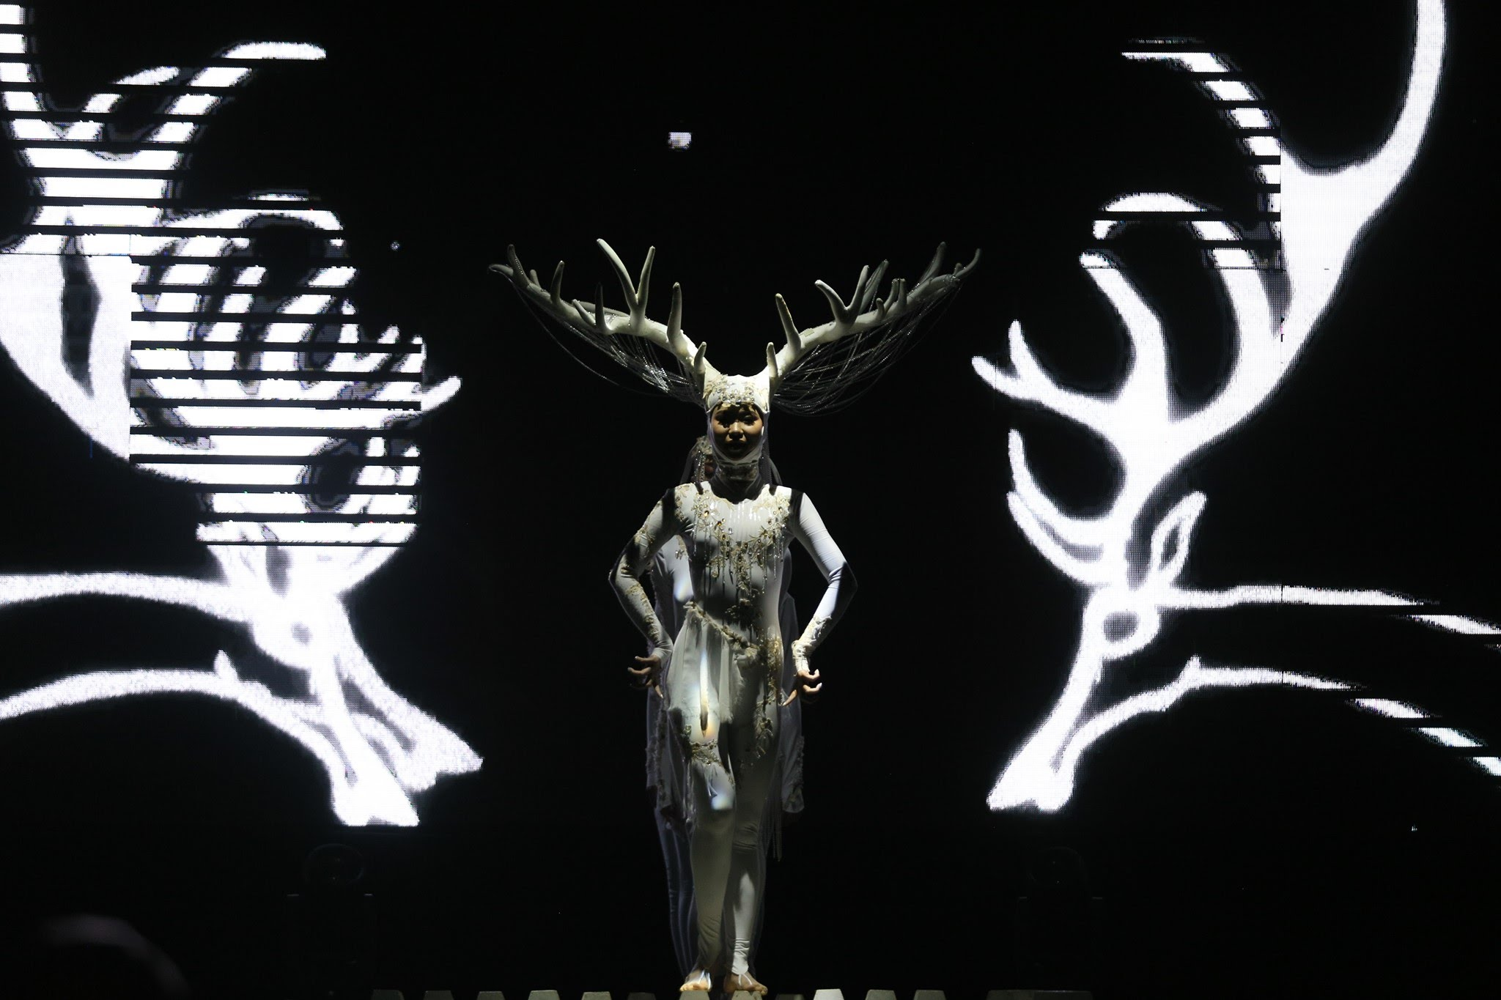
“INVERTED TRIANGLE” Ethno dance performance 2019 at UNESCO
A cave painting titled "32 people" adorns the wall of a square tomb from the Bronze Age, located along the edge of Del Mountain in Ulziit Sum, Dundgobi Province.

Slide 8
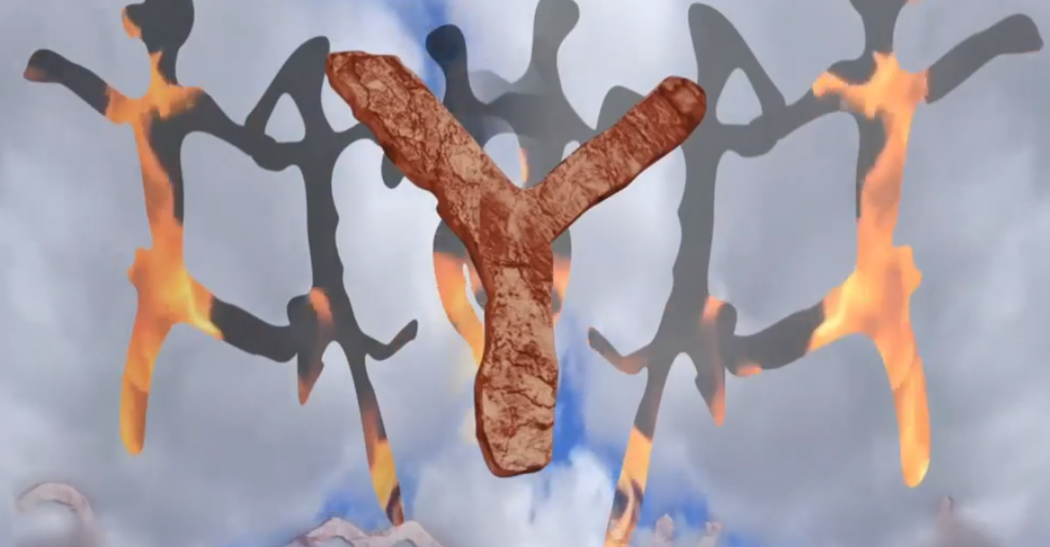
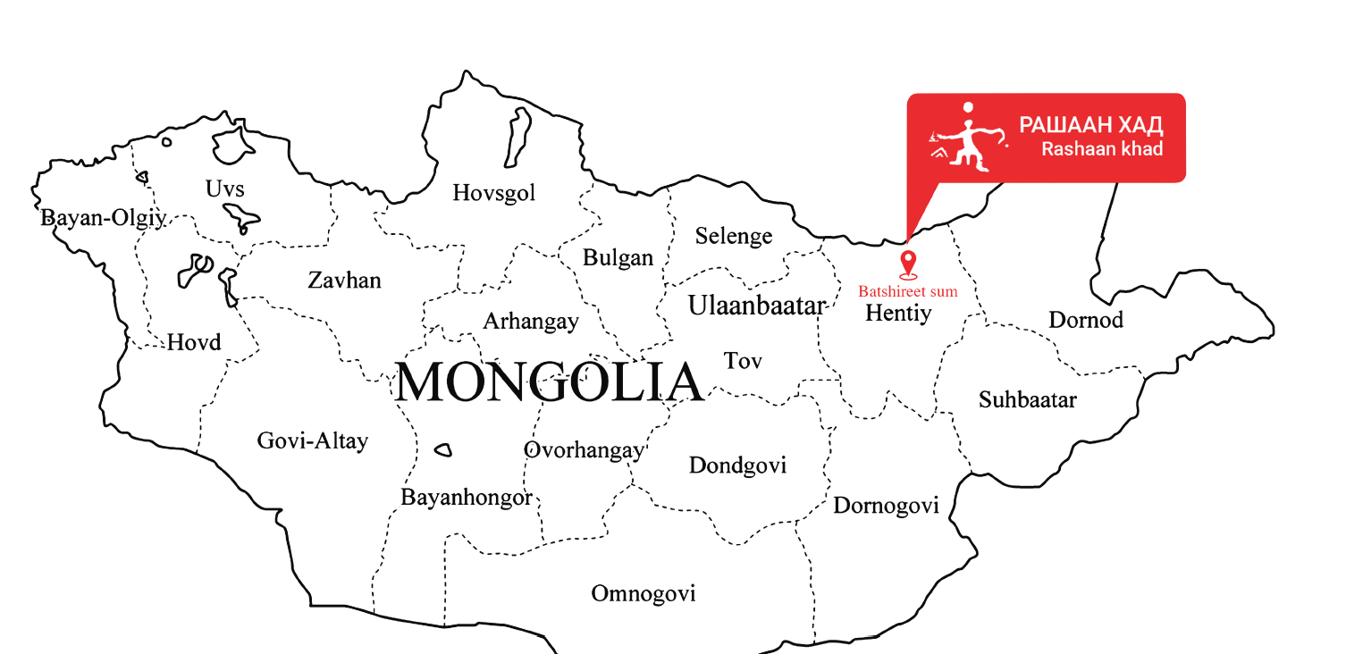
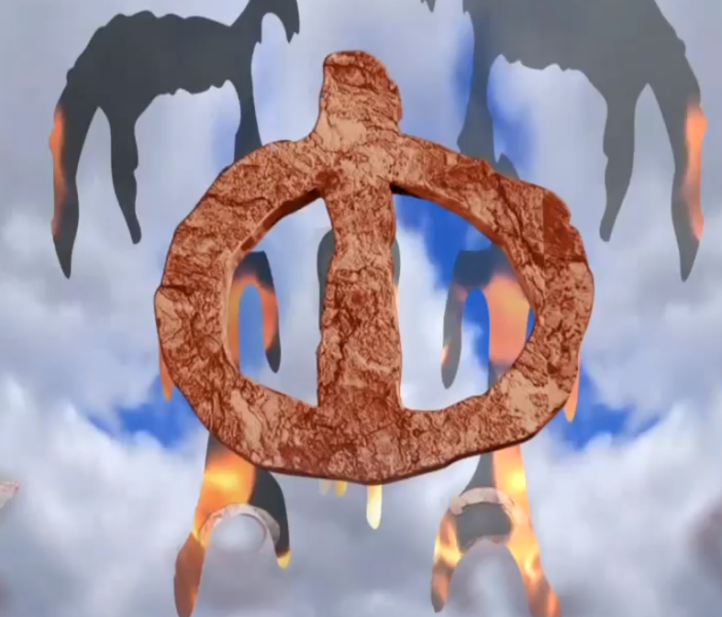
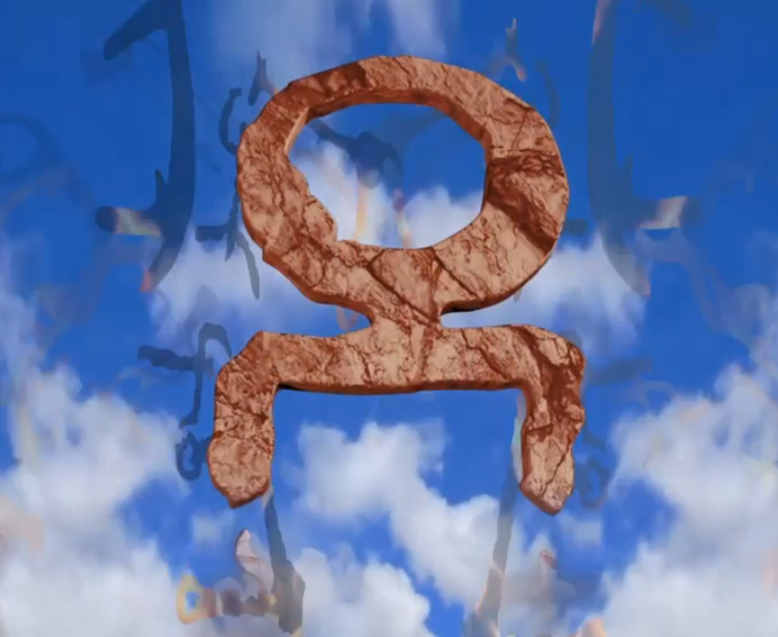
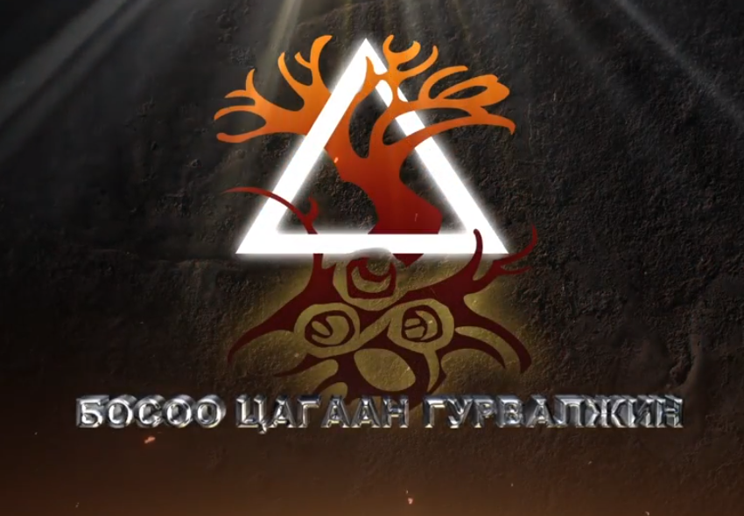
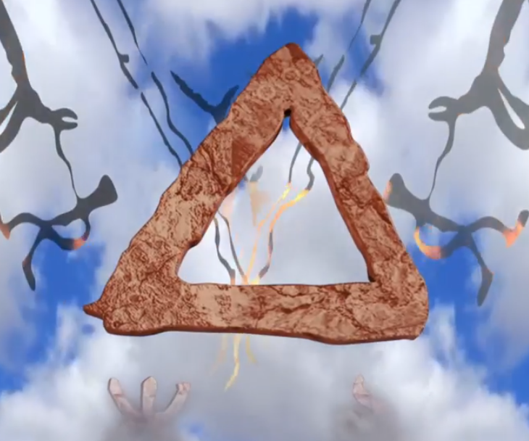
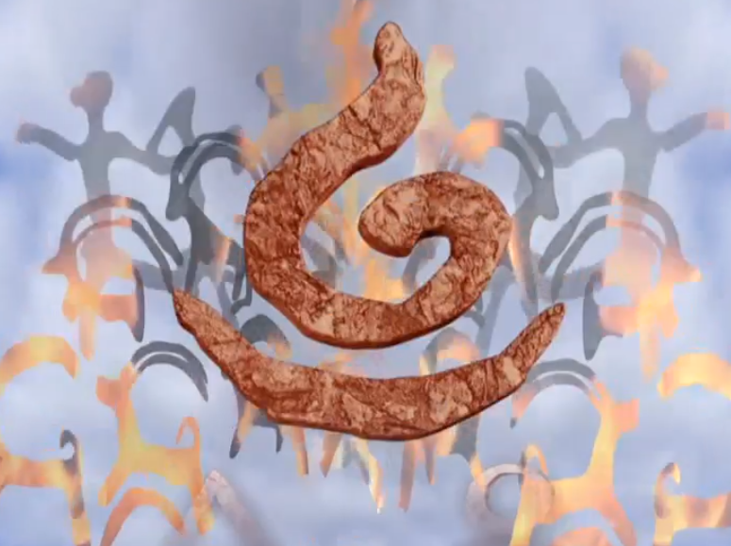
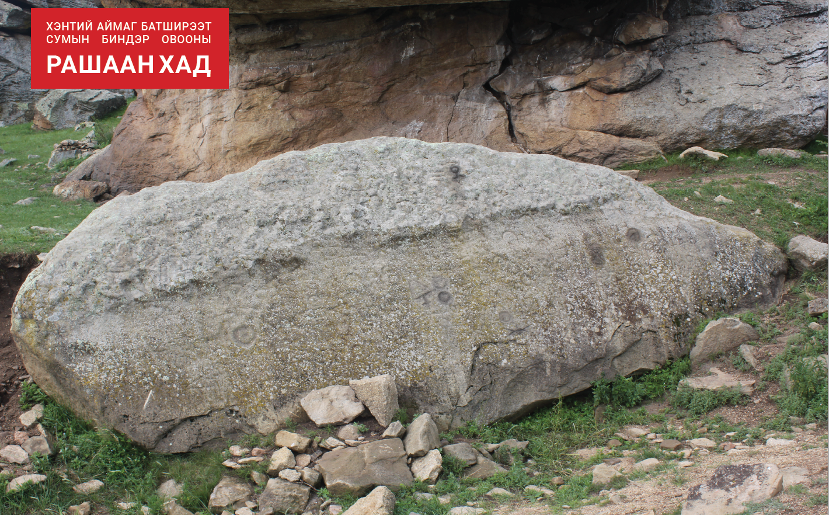
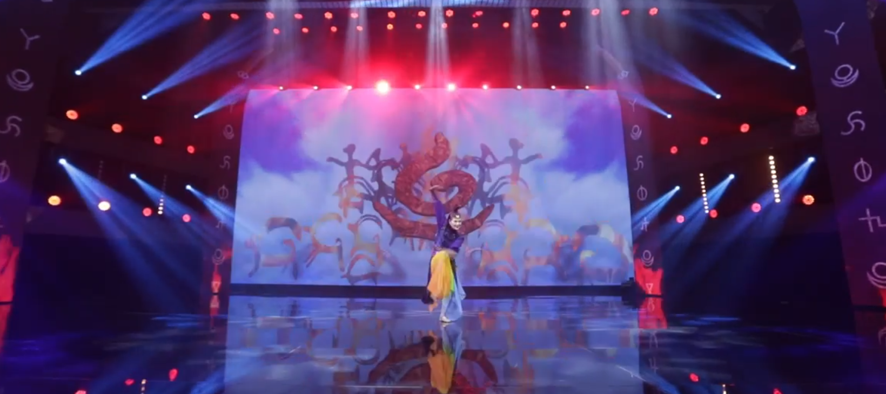
“VERTICAL WHITE TRIANGLE”
ethno dance performance
2021

Slide 9
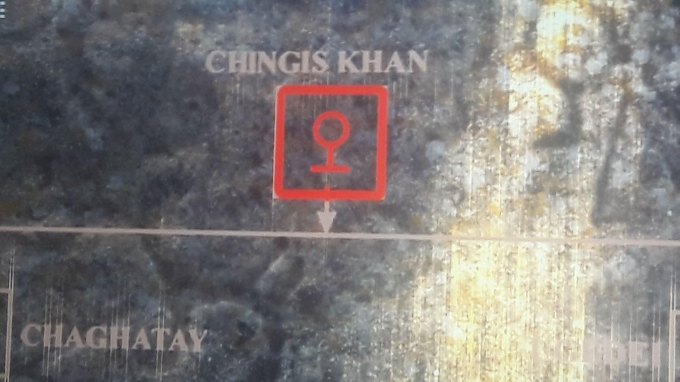
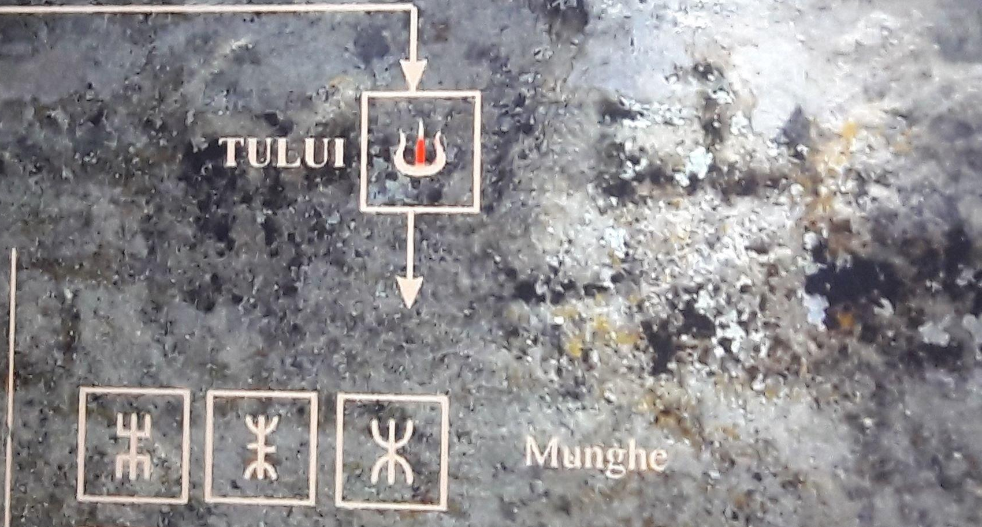
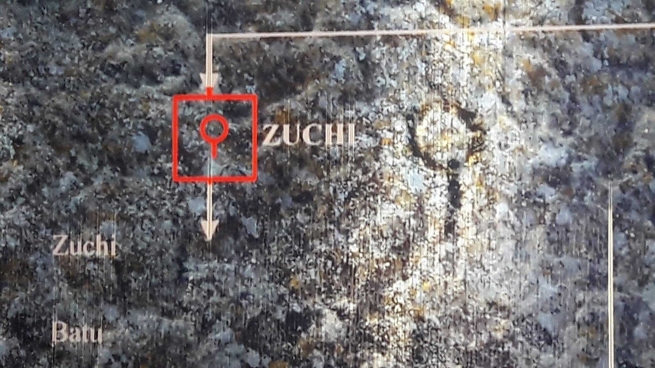
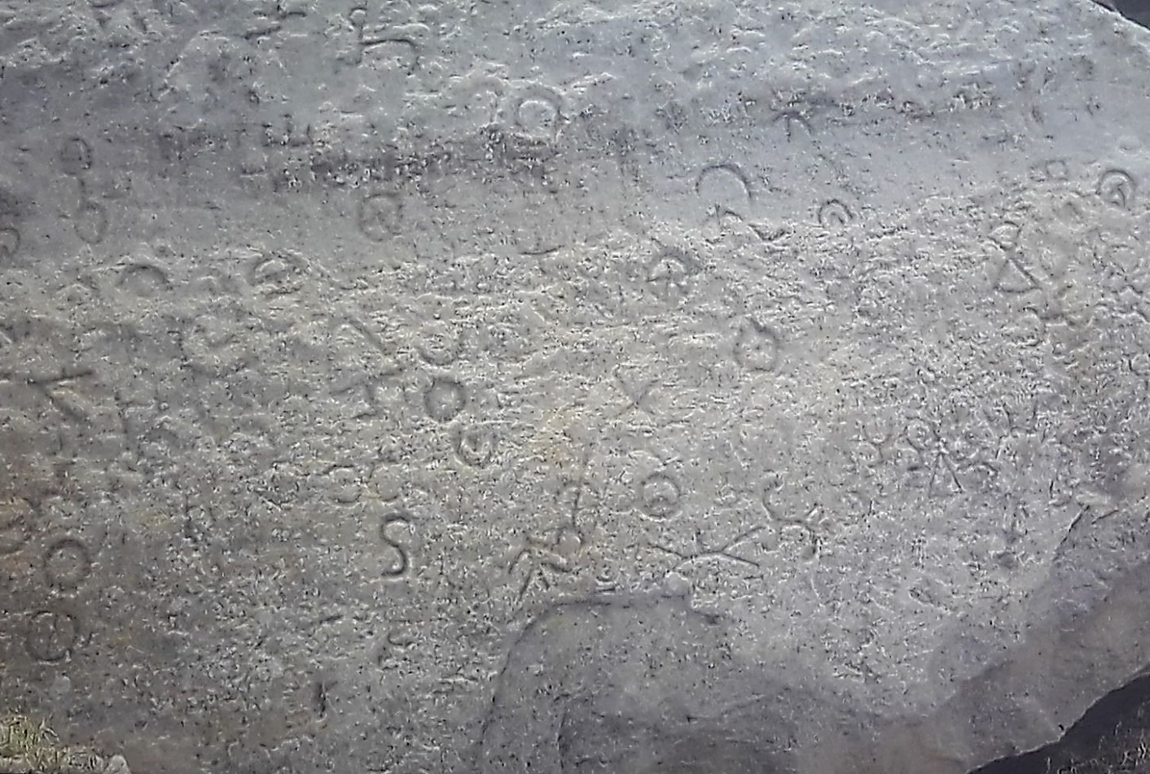
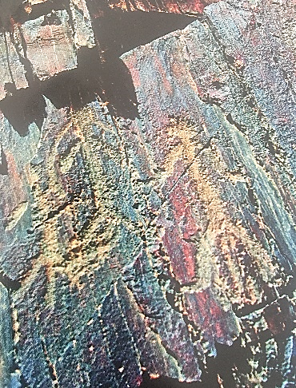
БҮТЭЭЛИЙН ОНЦЛОГ, ДАВУУ ТАЛ
Rashaan Khad in Binder Sum, Khentii province
Picture of Del mountain in Ulziit sum of Dundgobi province, Zuun in Arkhangai province, Rock of Baruun Tsakhir, Chuluut Rock, Paaluu cave painting in Uvurkhangai province
Bulgan Province
Cave painting of Father-Mother-Son holding hands

Slide 10
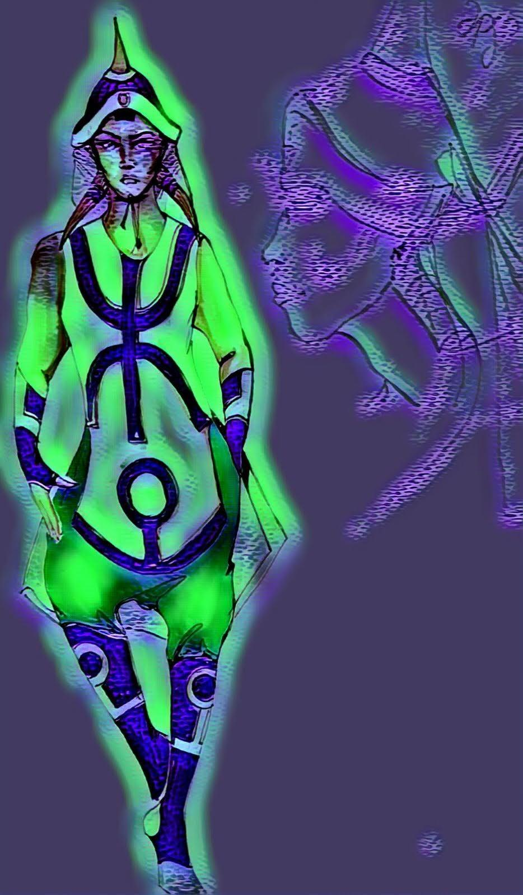
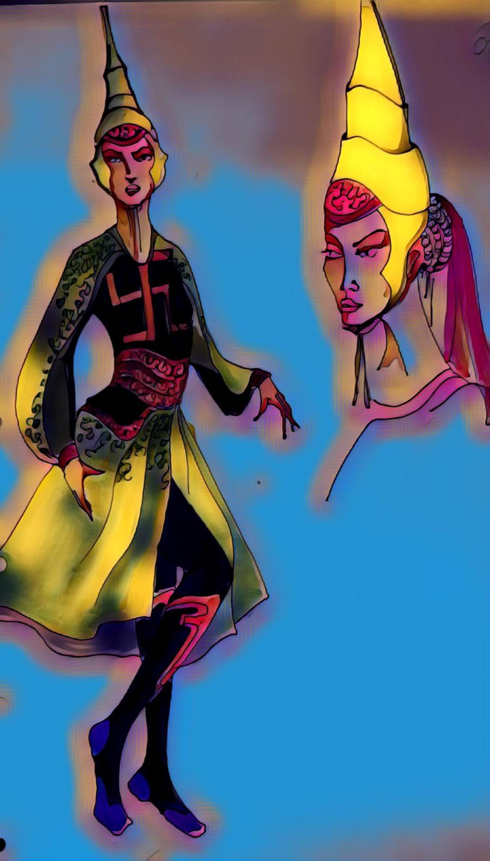
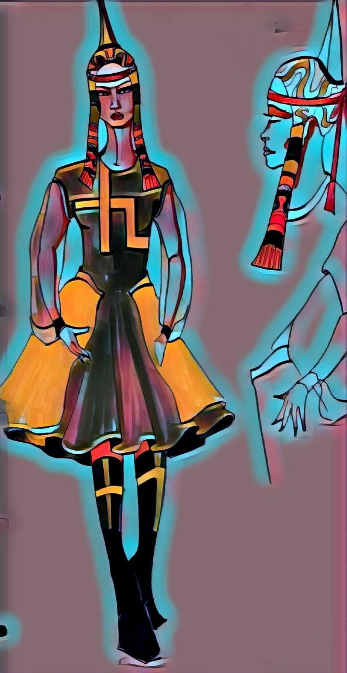
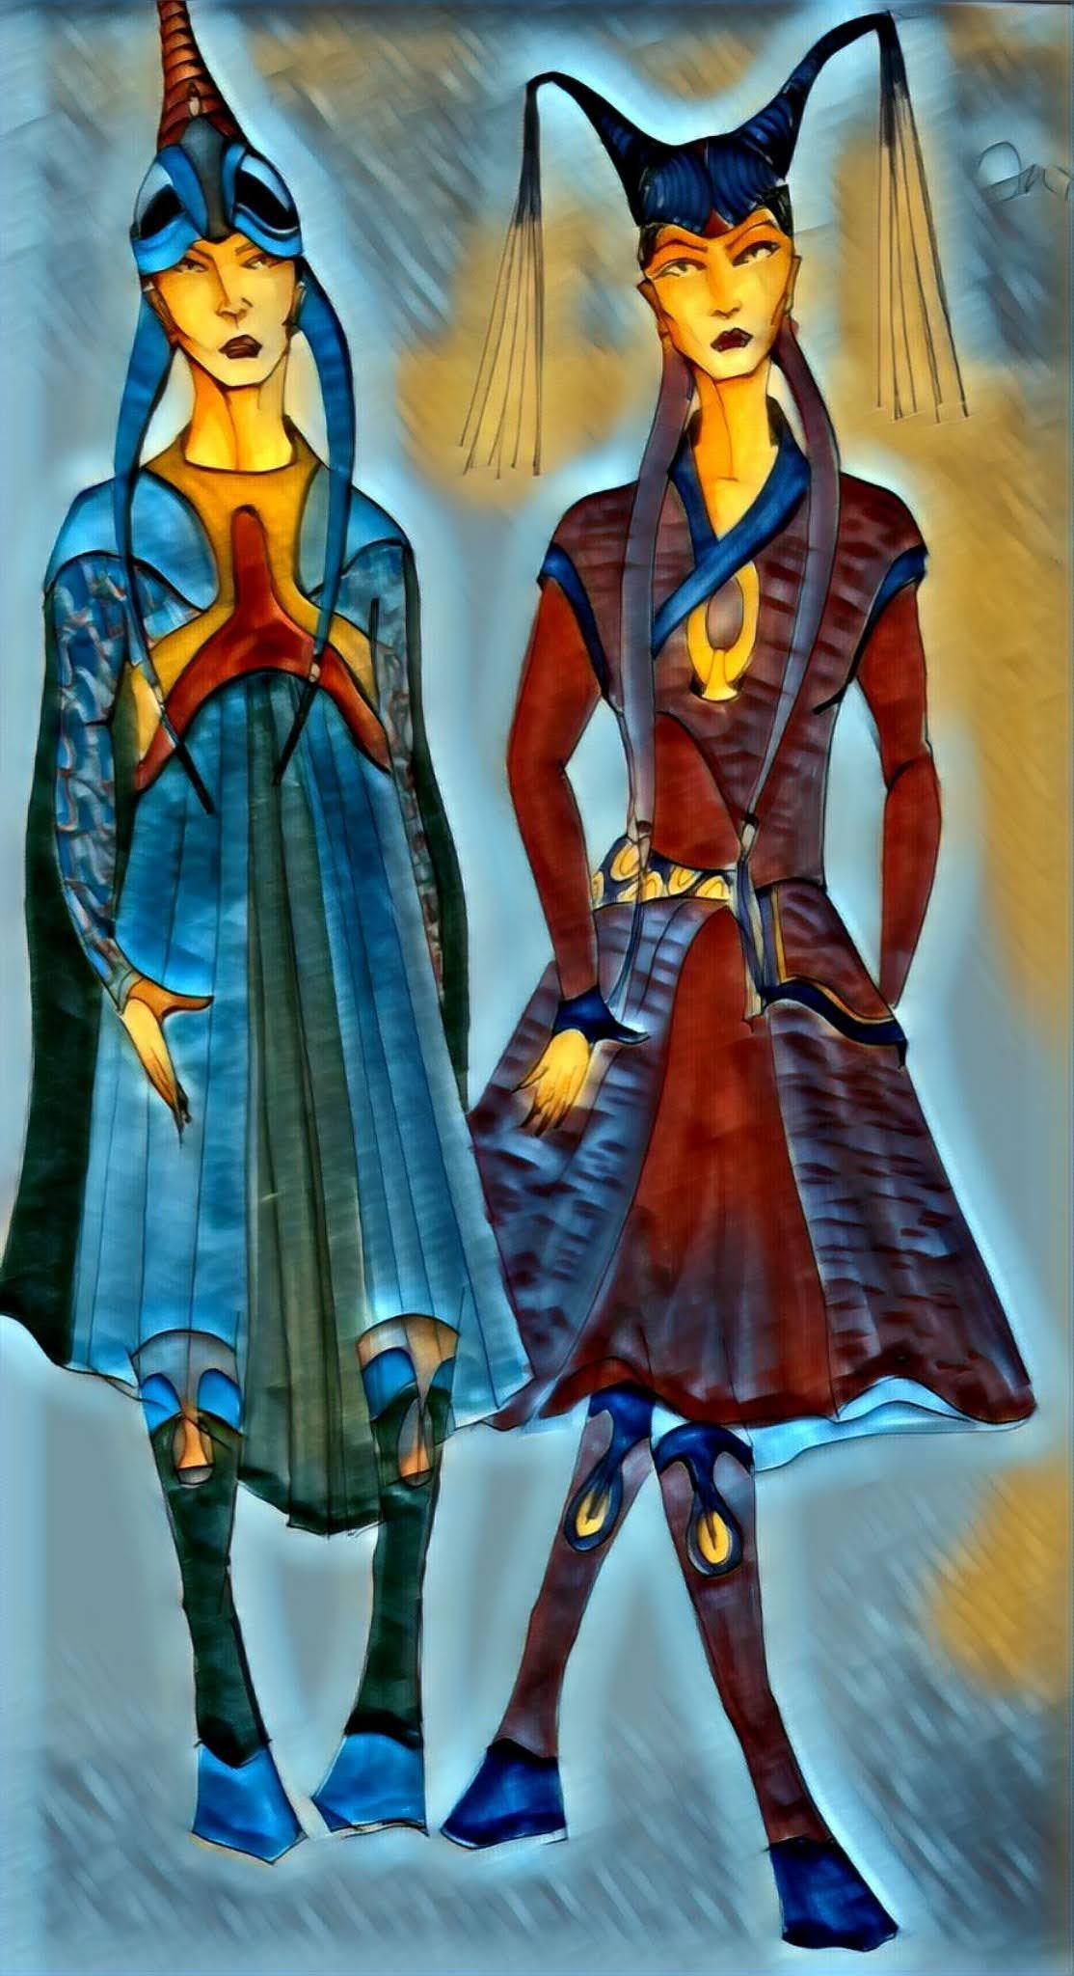
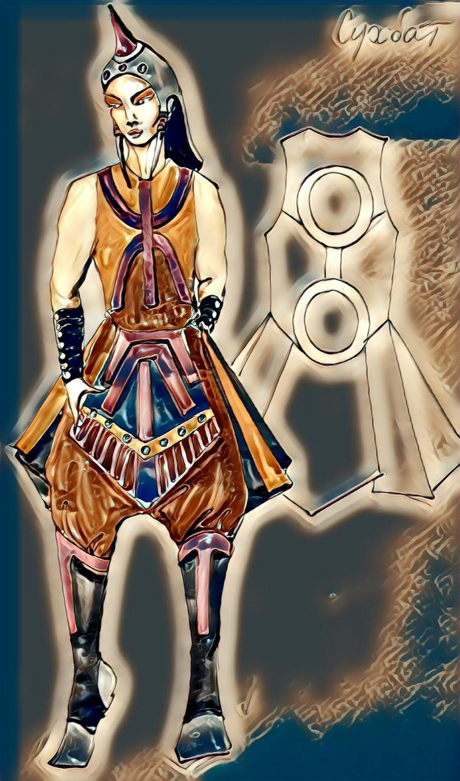
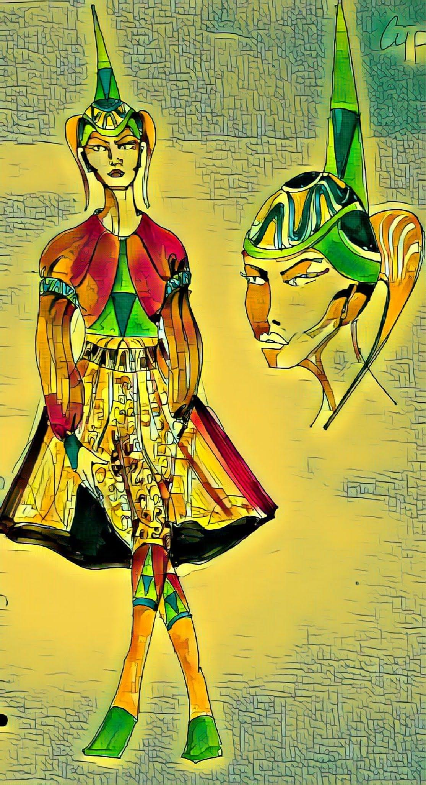
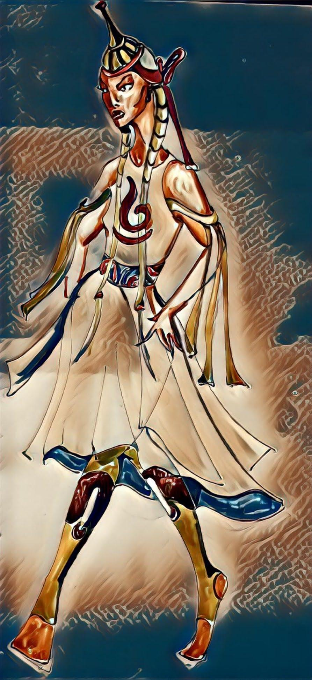
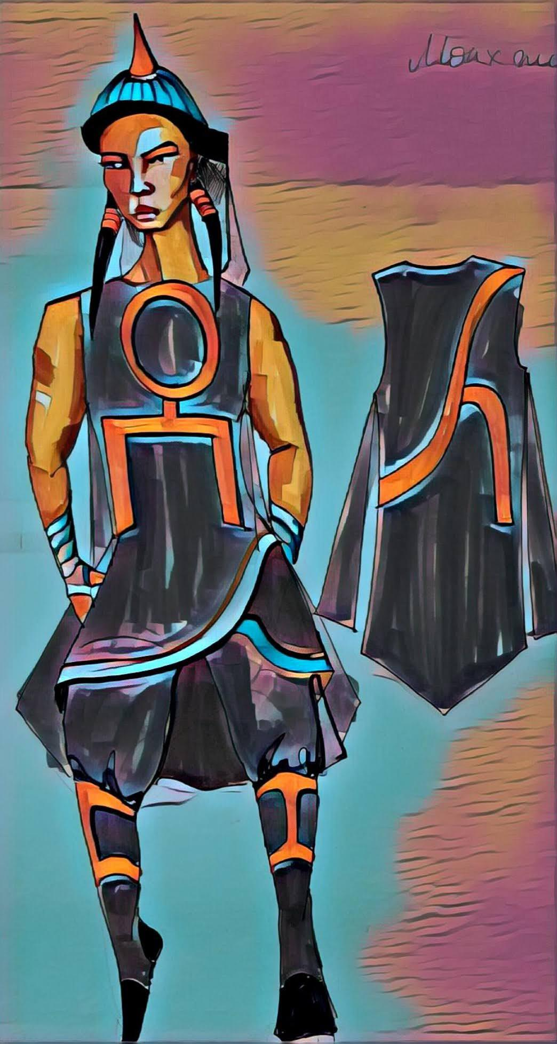
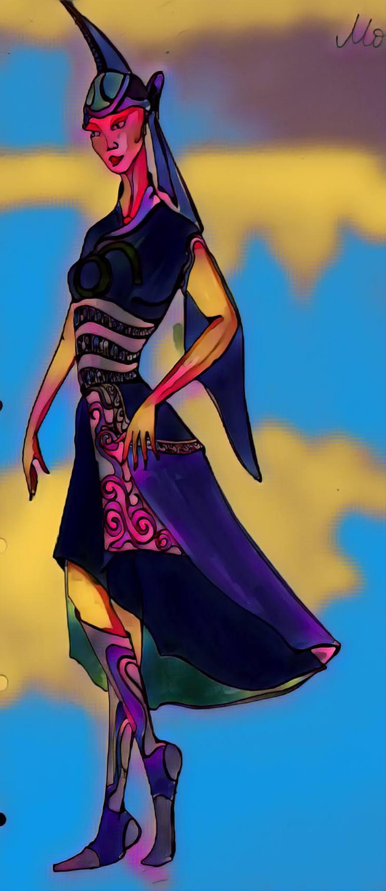
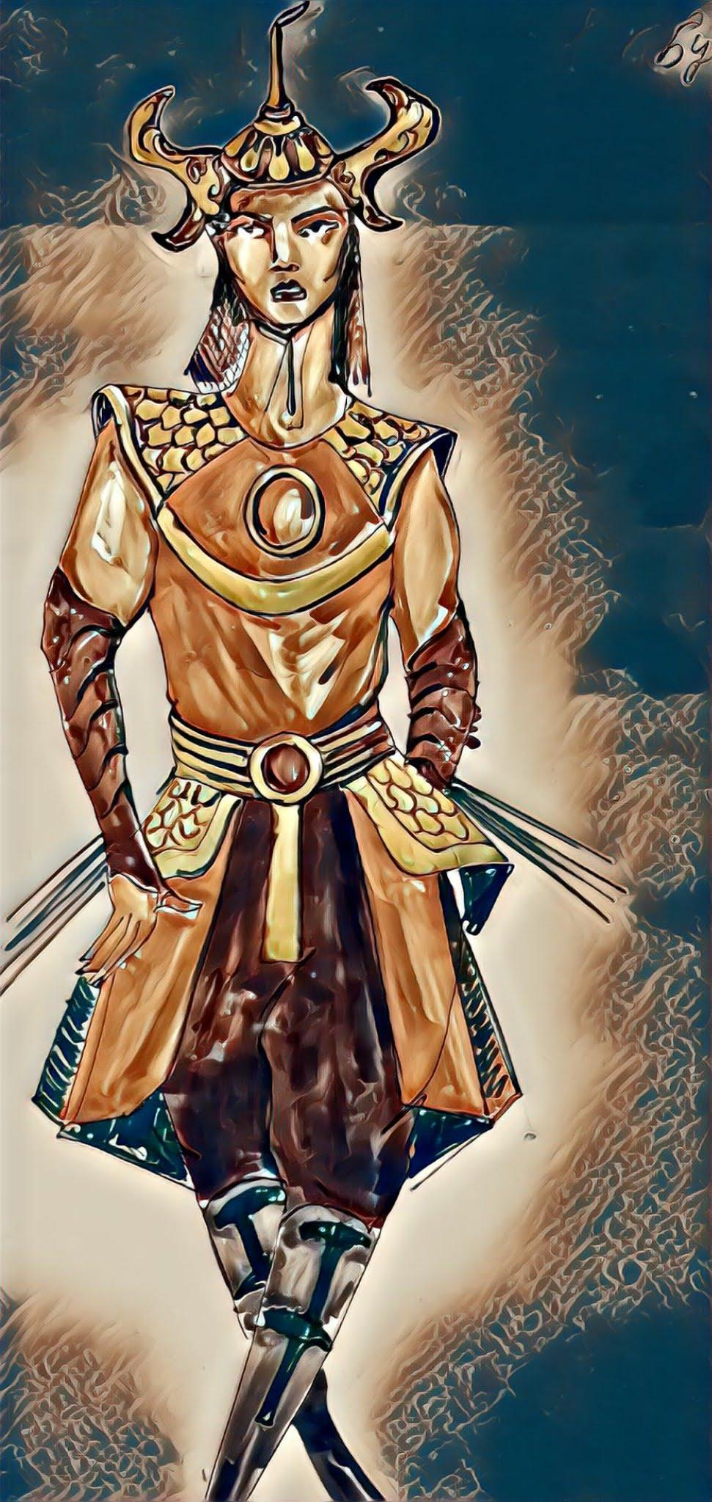
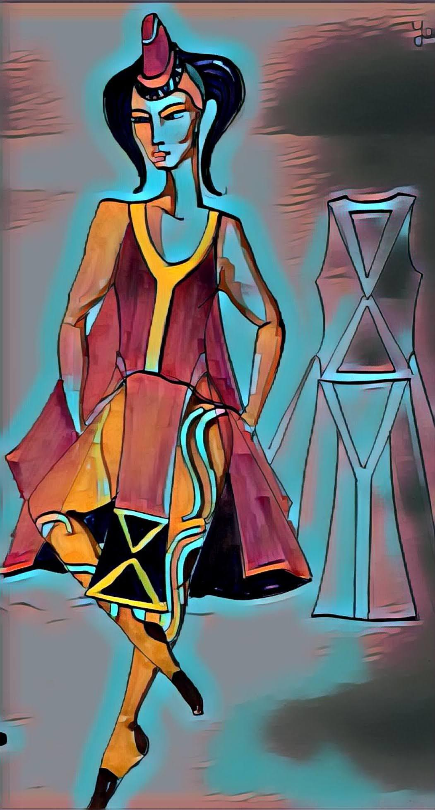
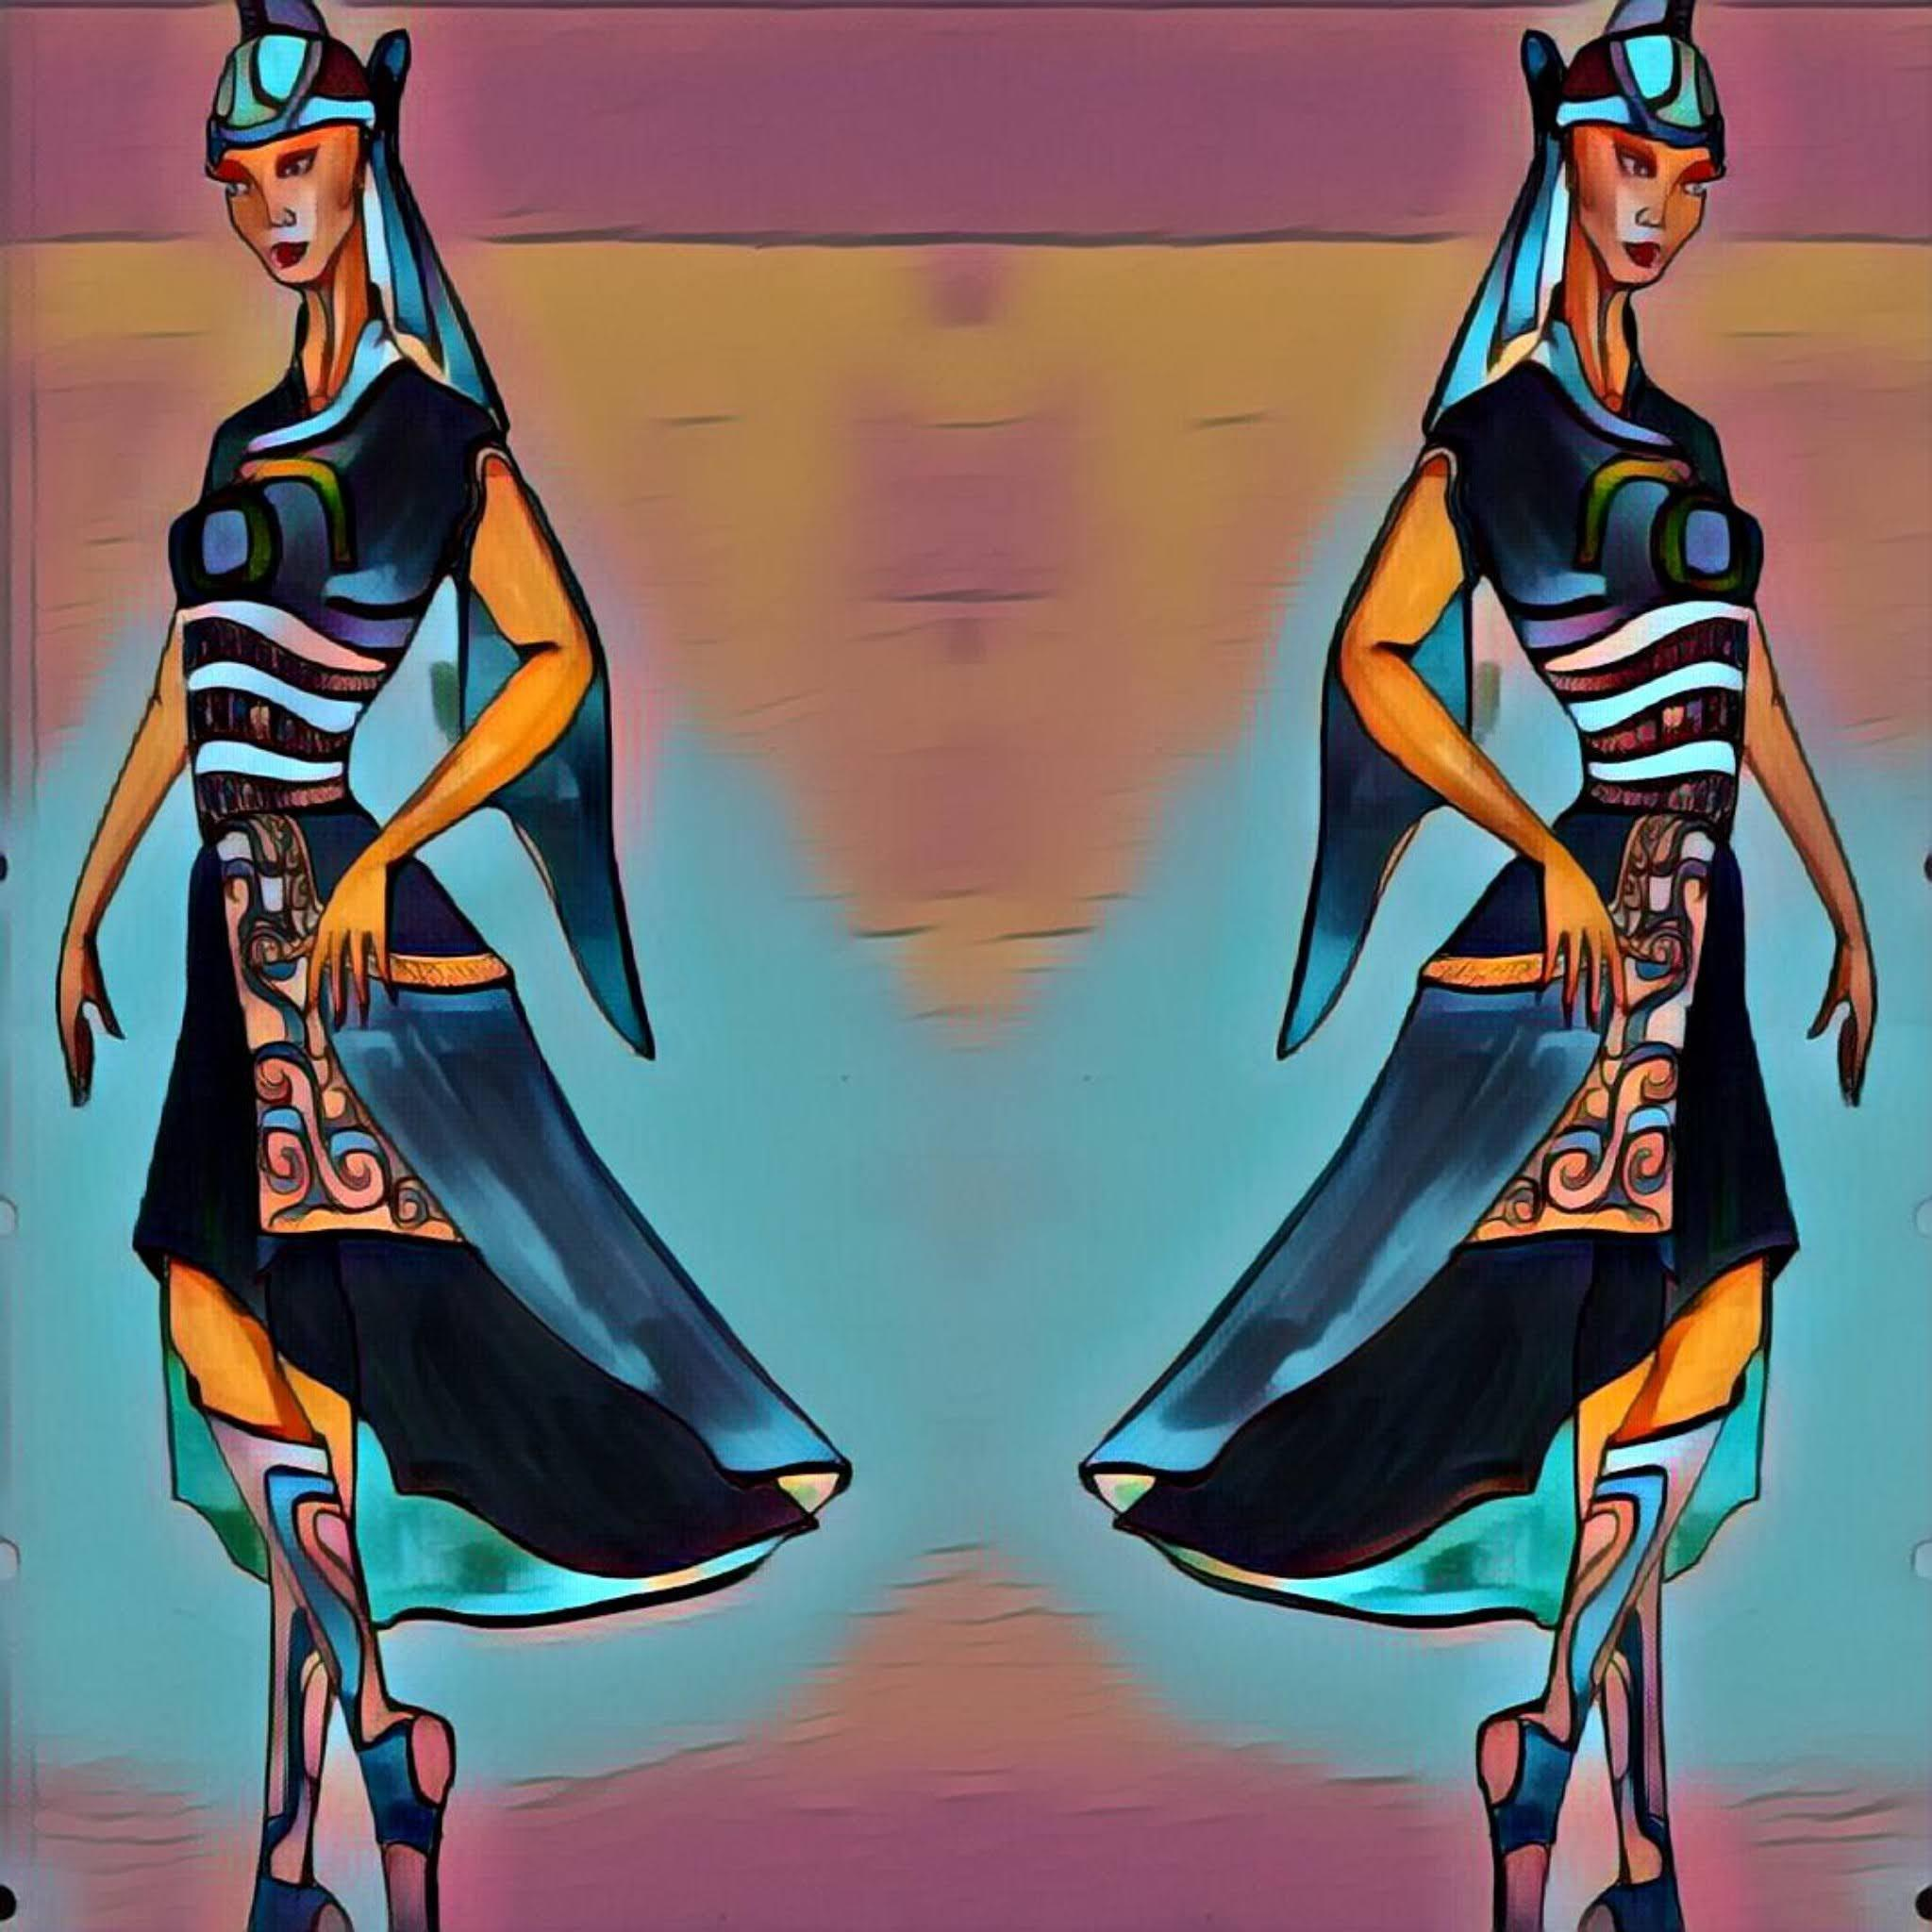
The Morin Khuur, hummingbird, and long song are registered on the UNESCO list of Intangible Cultural Heritage of Humanity. Furthermore, there is a list of intangible cultural heritage in urgent need of safeguarding, including the closed breath of the flute, echoes, and more.
It is distinguished by the utilization of modern technical solutions, such as 3D graphics and animation, to bring natural rock paintings and seals to life. This approach effectively showcases the explicit meaning and content of the dance.
FROM TRADITIONAL DESIGN TO MODERN SOLUTIONS

Slide 11
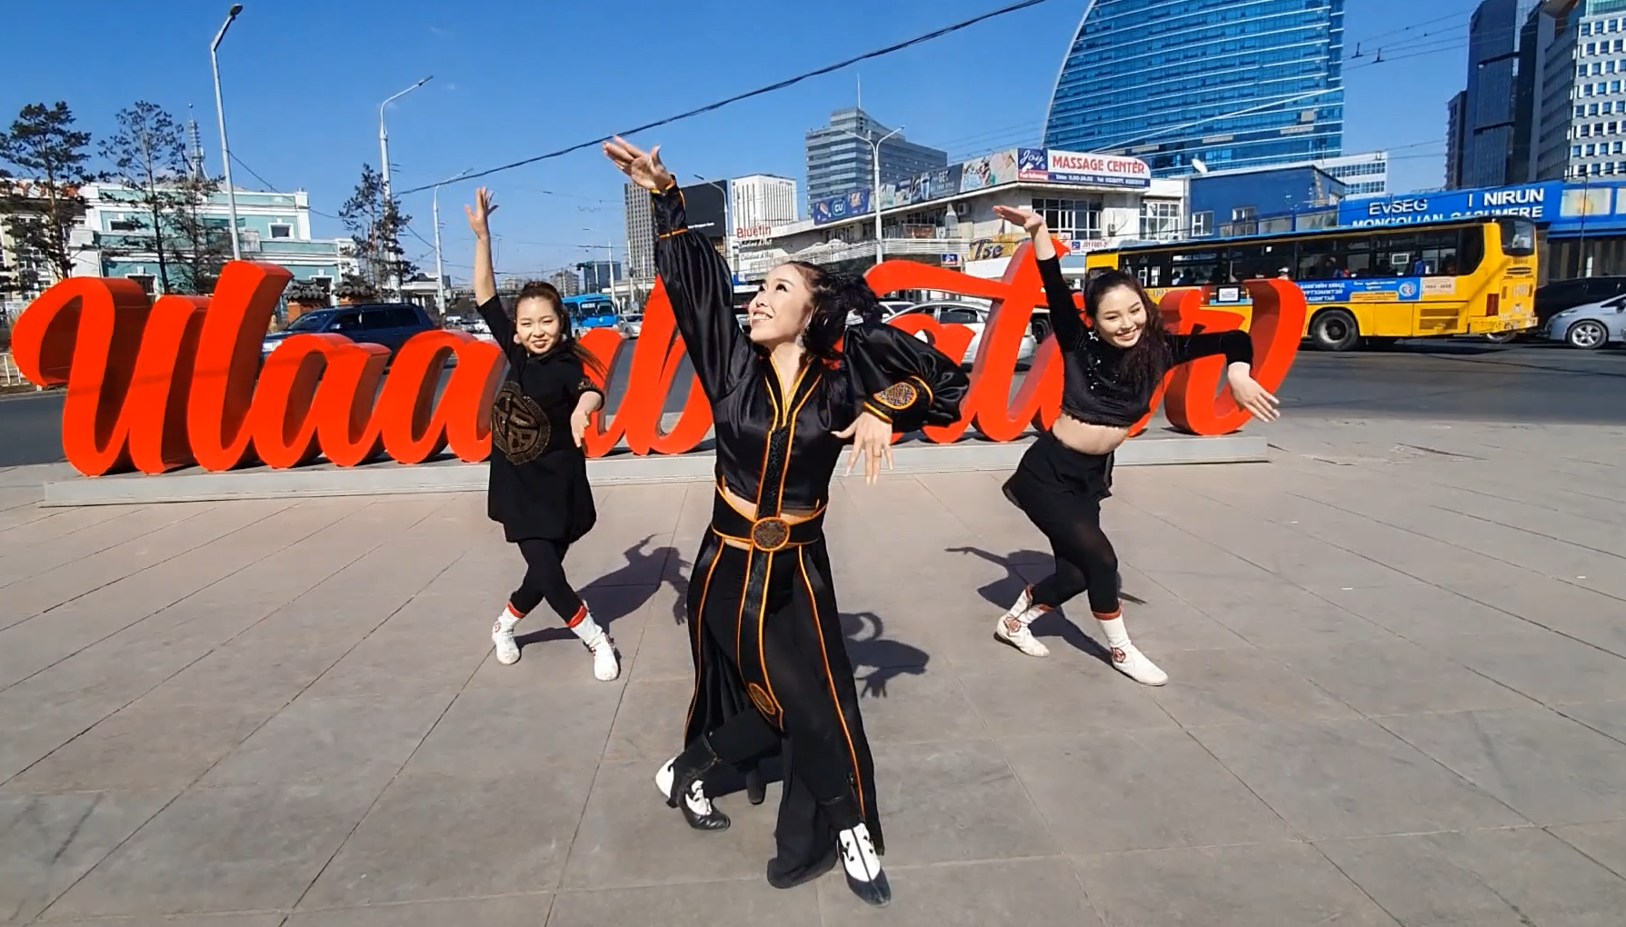
Research-based innovation artwork
Implementing comprehensive advertising campaigns that demonstrate the preservation and advancement of national heritage in conjunction with modern art
To instill a sense of pride in the national heritage among the youth
There will be opportunities to promote national culture through plays abroad.
Fostering cultural tourism and cultivating a national brand rooted in cultural heritage.

Slide 12
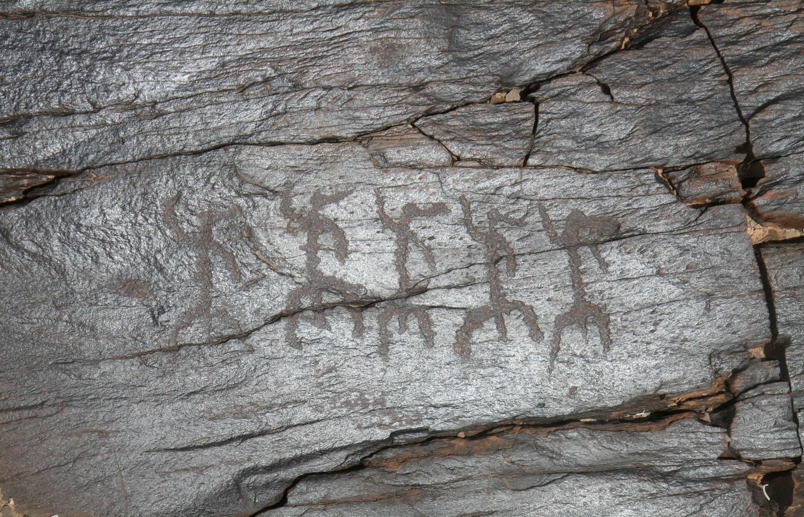
"Rashaan Khad" is not only a cherished symbol for Mongolians but has also captured the interest of people from around the world. Hence, it should be recognized as a "World Cultural Heritage" to reflect its universal significance.
M. Takashi
THANKS FOR PAYING ATTENTION

