Slide 1
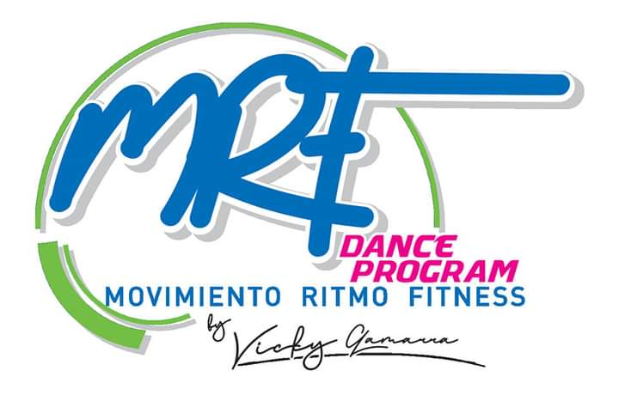
MRF DANCE PROGRAM: FITNESS RHYTHM MOVEMENT
MRF DANCE PROGRAM: FITNESS RHYTHM MOVEMENT
A NEW CONCEPT OF FITNESS DANCE FOR EVERYONE
By: Victoria Elizabeth Gamarra Chávez - Lima, Peru - July, 2023

Slide 3
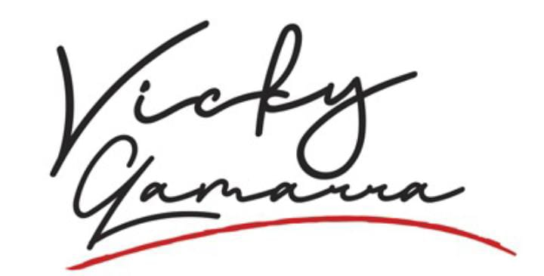
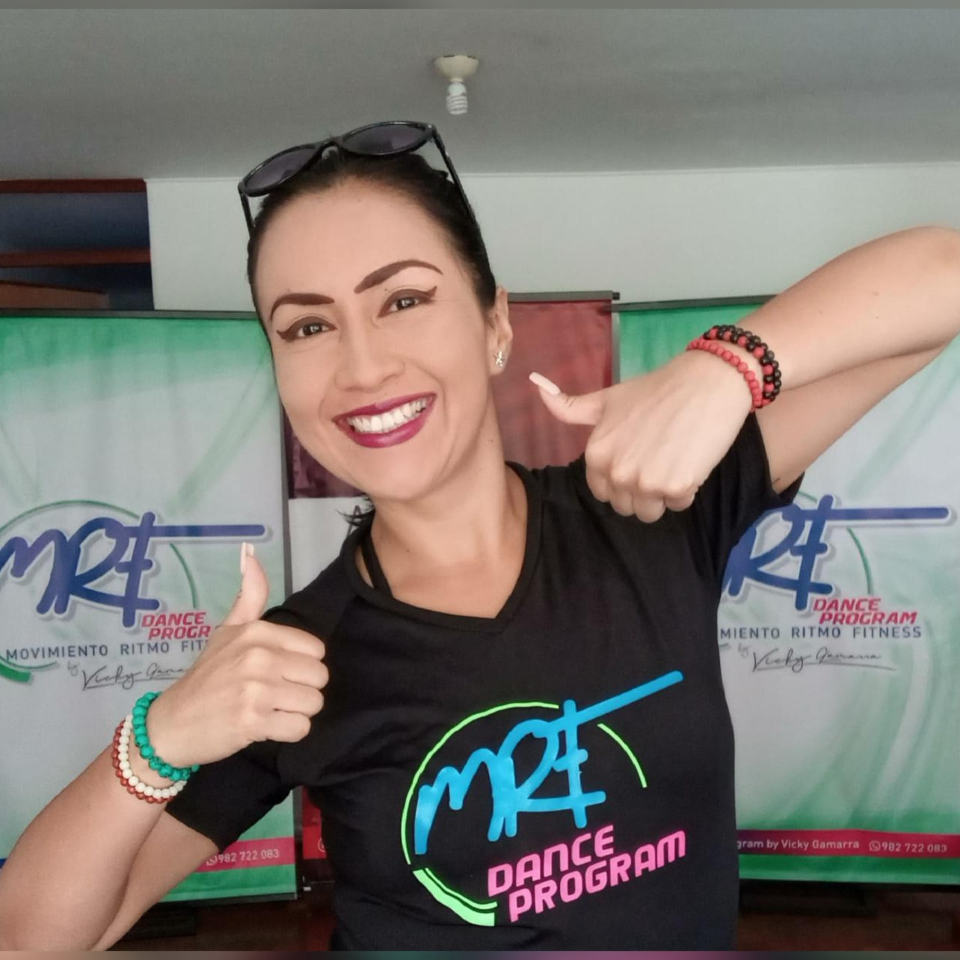
Resumé
Dance teacher and choreographer with 25 years of teaching experience as a professor at universities, institutes and instructor at gyms and some organizations related to dance and arts.
PhD in University Education, Master Degree in University Education Teaching and Research at San Martin de Porres University, a degree in Communication Sciences, Diploma in Dance Pedagogy at Pontificia Universidad Católica del Perú and a Foreign Language Professor at USMP University.
Diploma in Dance Teaching at Malvina Acosta Studio in Argentina and Certification at Center for Higher Studies in Performing Arts in Mexico.
Creator and Director of DANZANT and MOVIMIENTO RITMO FITNESS DANCE PROGRAM. Full-time teacher, national and international speaker, Master Trainer, Fitness Dance Instructor and a Choreography Dance Teacher in different workshops and master classes in Peru and around the world.

Slide 4
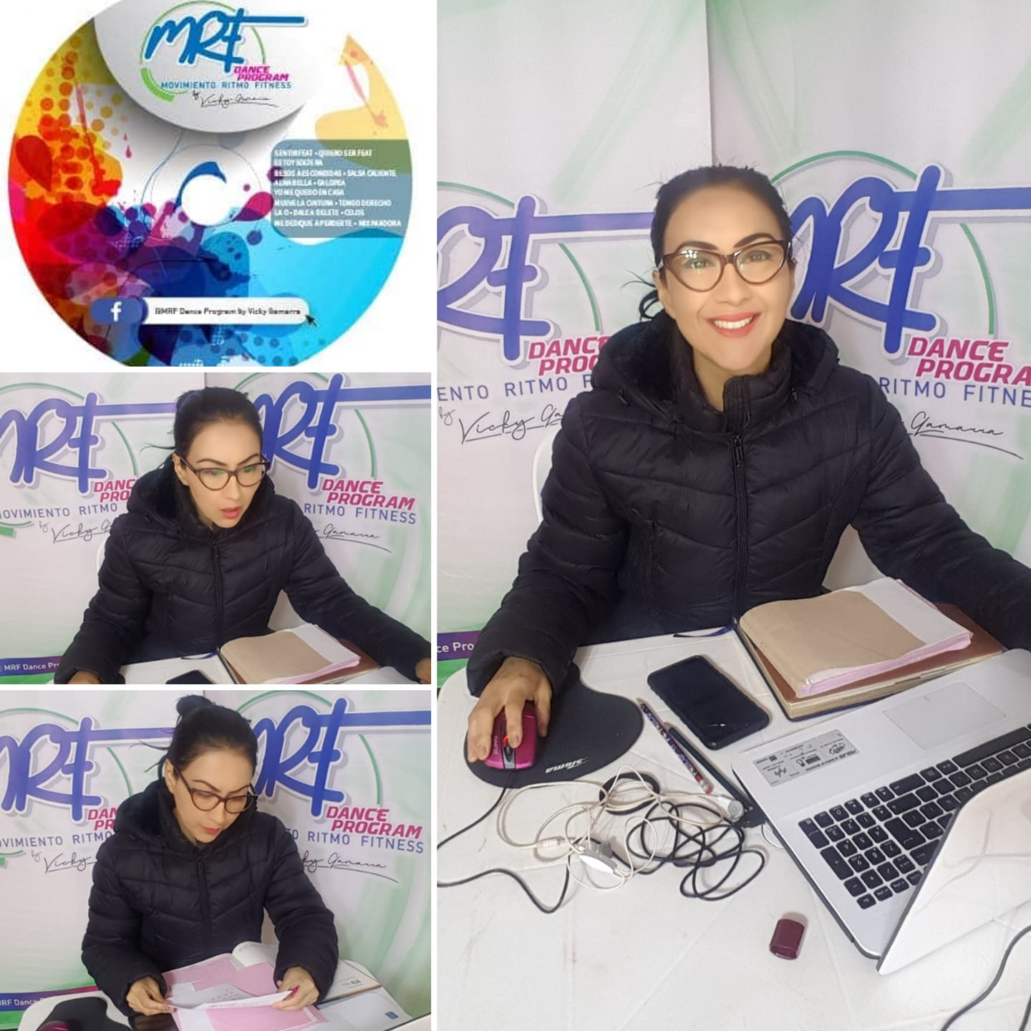
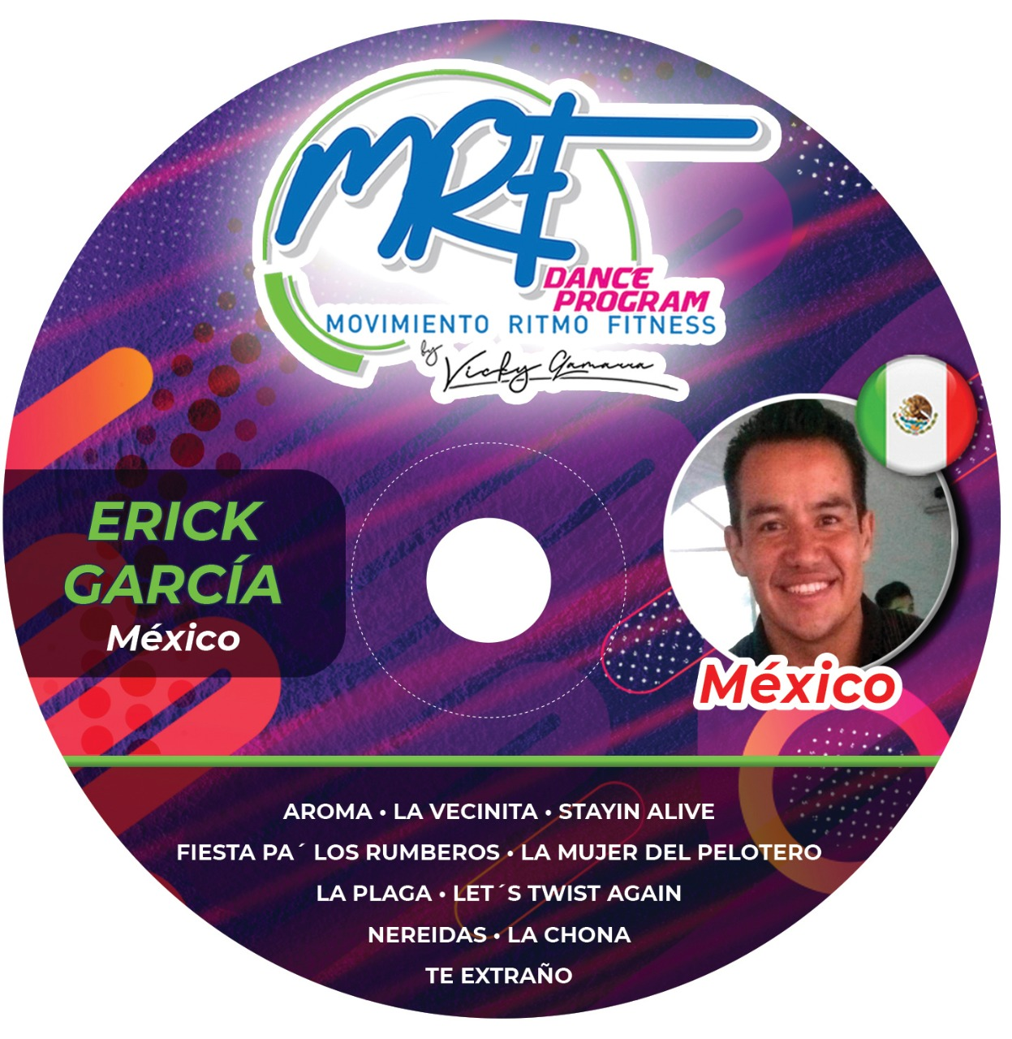
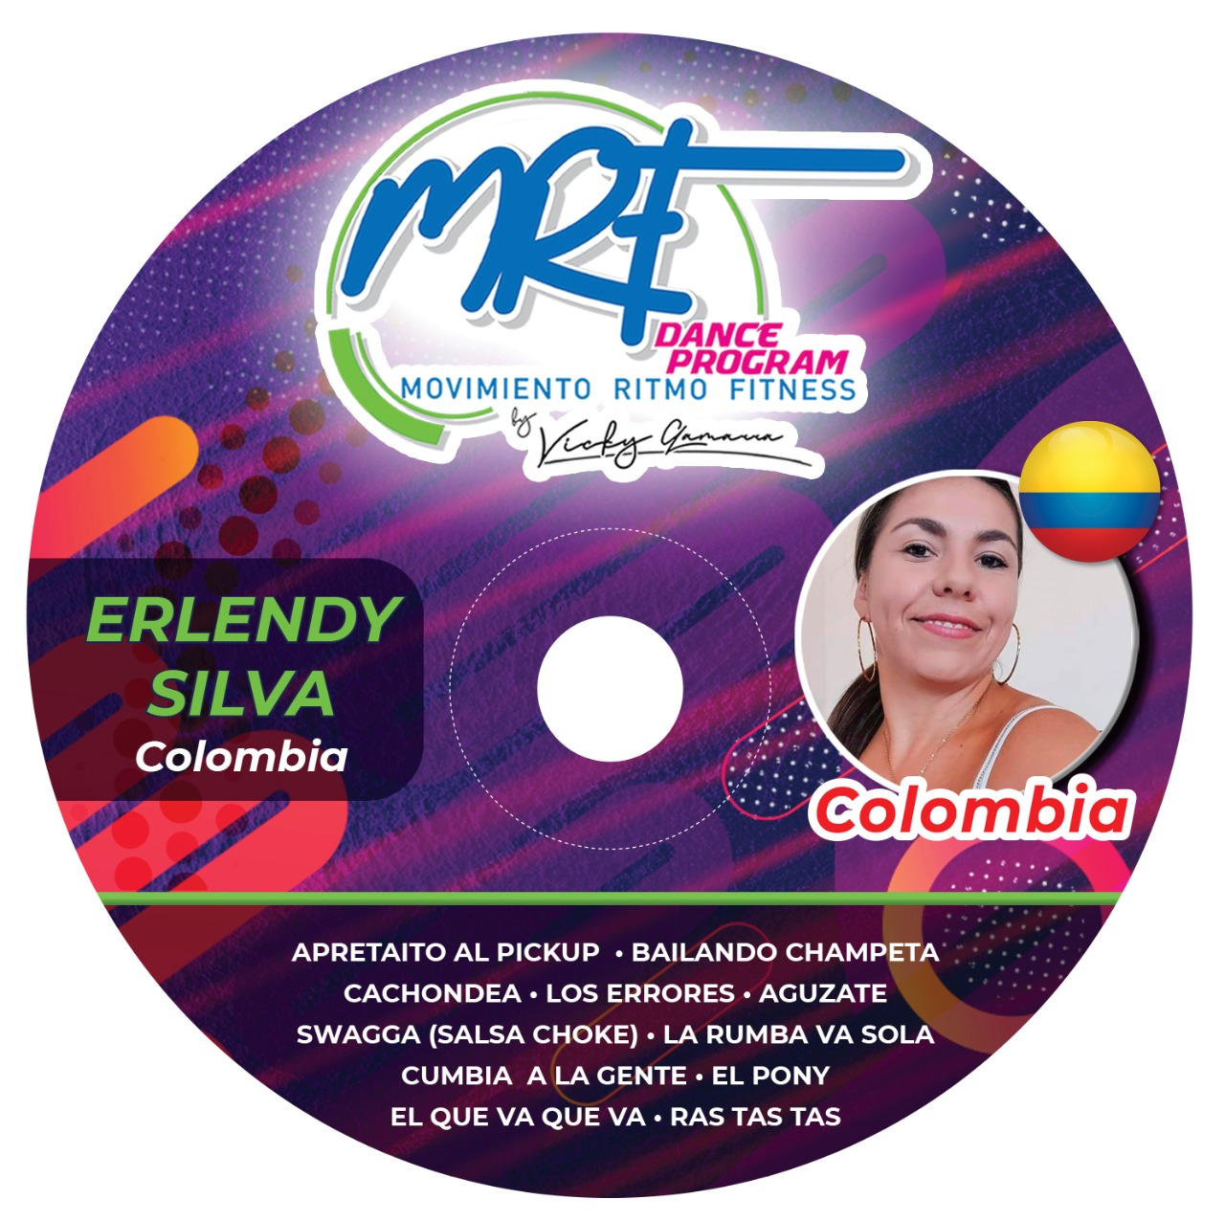
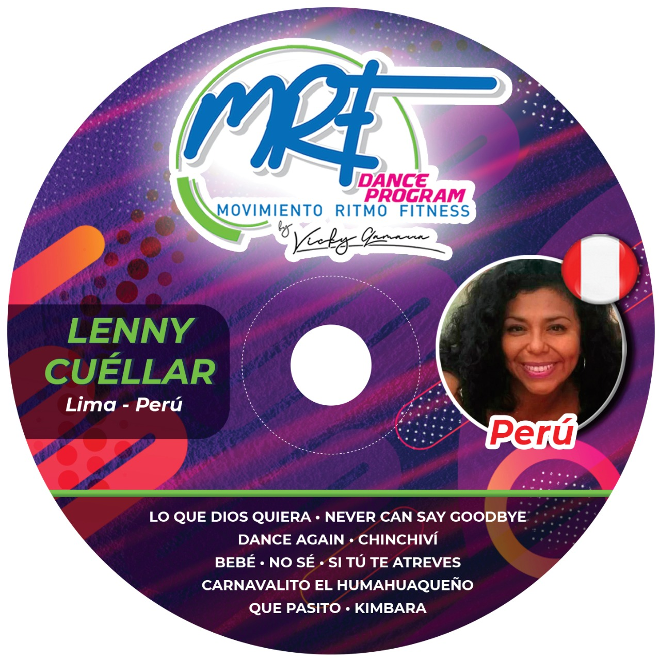
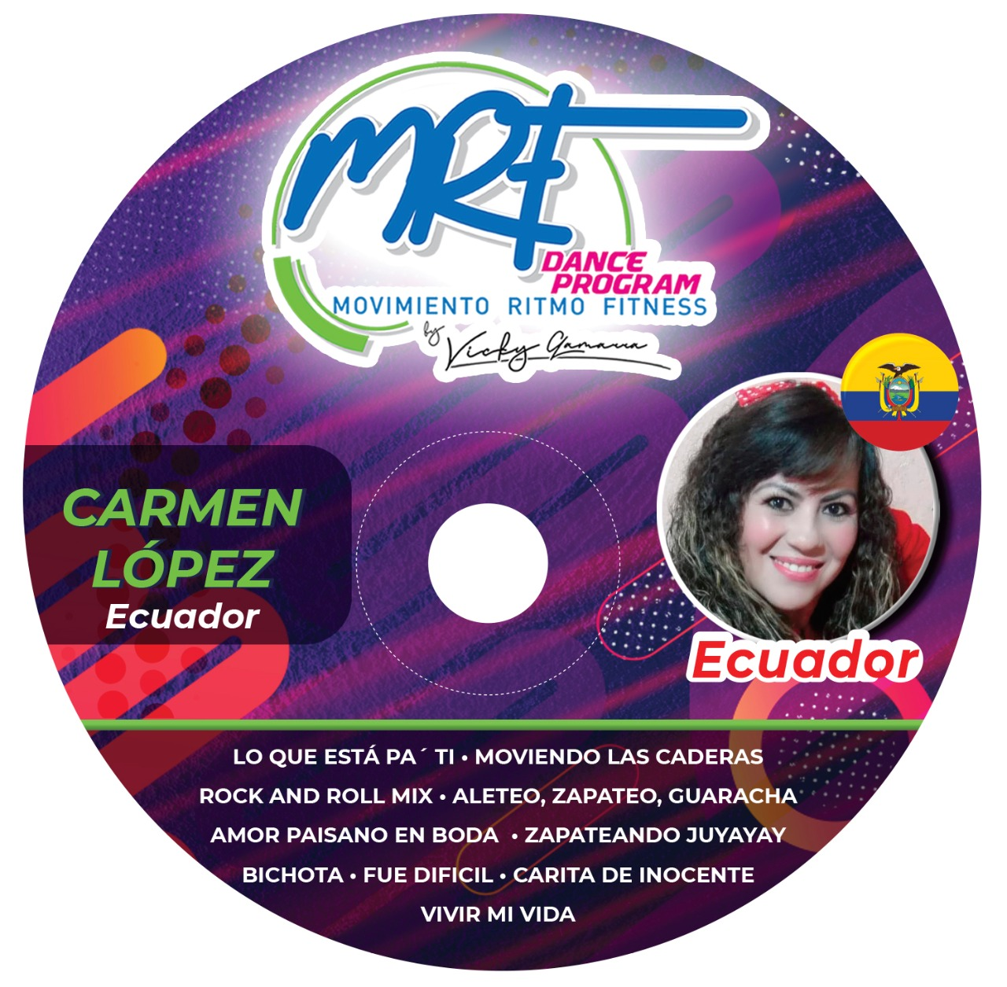
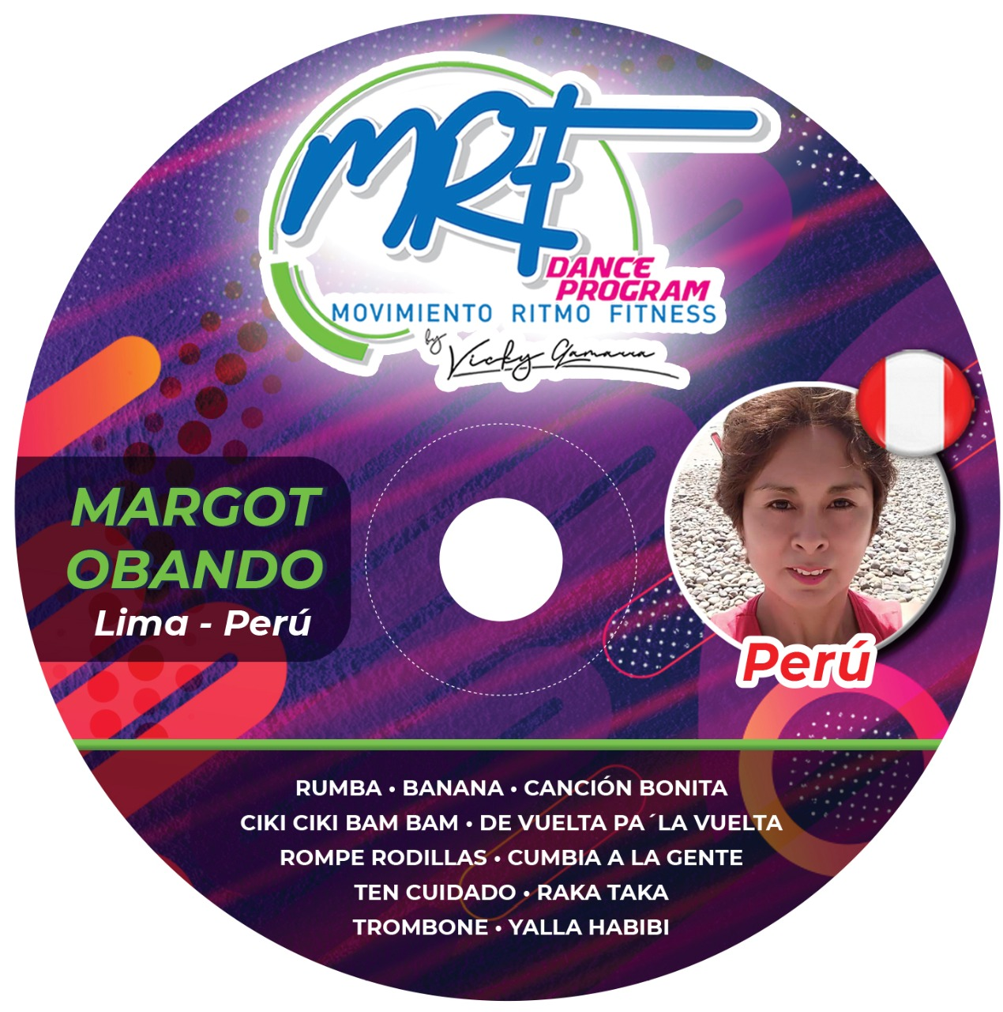
MOVIMIENTO RITMO FITNESS
MRF DANCE PROGRAM is a Peruvian fitness dance School located in Lima, Peru and it is expanding around the world, especially in Latin American countries such as: The United States, Mexico, Ecuador, Colombia, Chile, Argentina, Brasil among others.

Slide 5
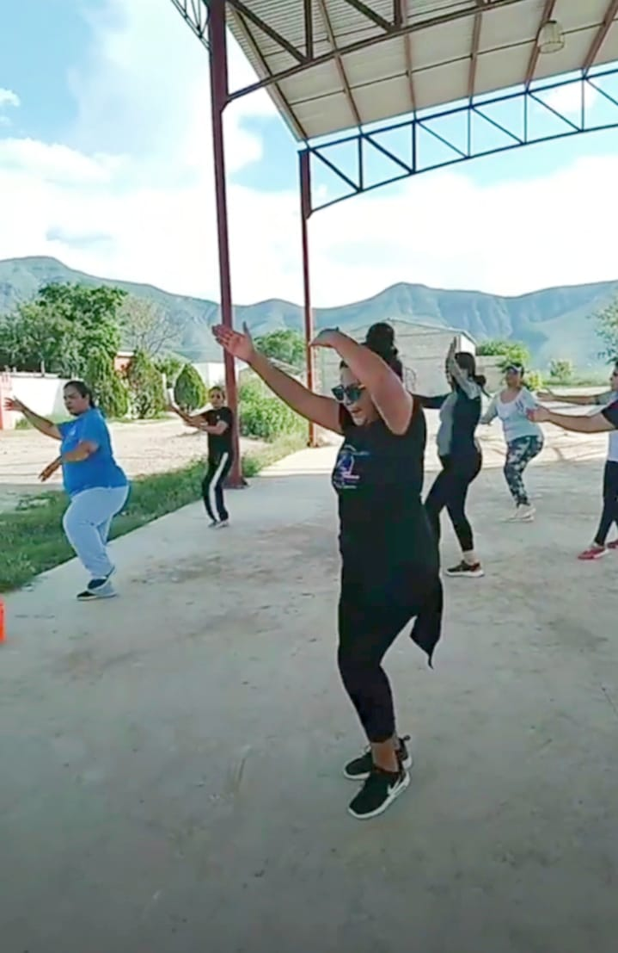
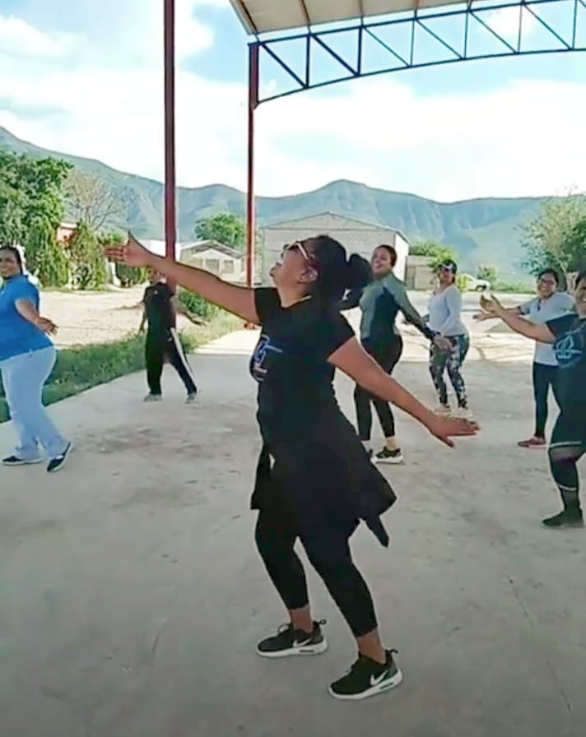
MOVIMIENTO RITMO FITNESS
It is a fitness dance program of Peruvian origin, focused on providing physical and mental well-being through guided movement, of a series of national and international rhythms such as: cumbia, salsa, bachata, merengue, reggaeton, among others, performing cardio training through intermittent interval circuits.
MRF DANCE PROGRAM It is a fitness dance discipline practiced by both men and women, having a special version for the elderly called MOVEMENT RHYTHM FITNESS GOLD.

Slide 6
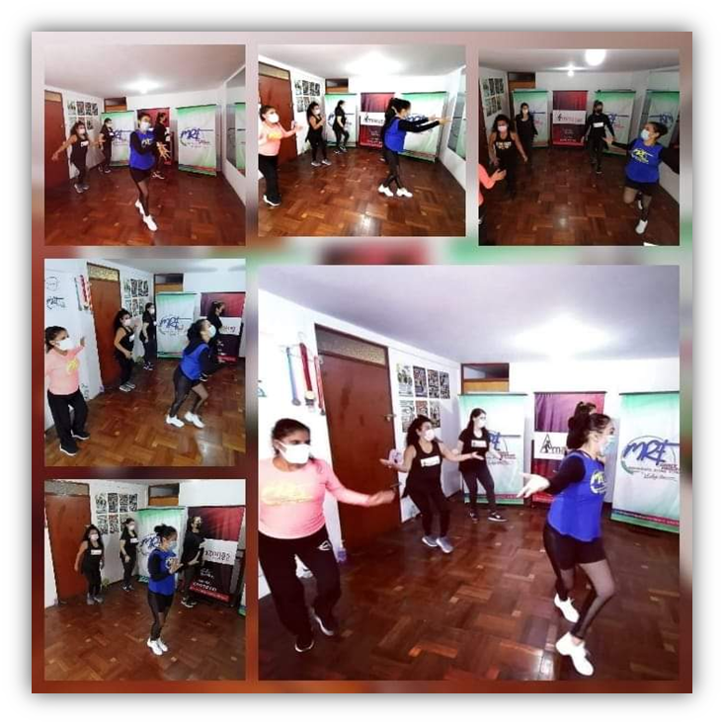
MRF DANCE PROGRAM OBJECTIVES
Train fitness dance professionals.
Improve people's physical condition.
Improve coordination.
Provide physical and mental well-being.
Increase the energy of the participant.
Improve self-esteem and self-confidence.
Improve flexibility and range of motion.
Reduce stress.
Socialize and have fun in class.

Slide 7
MAIN FEATURE OF MRF DANCE PROGRAM
INTERVAL TRAINING
vs
INTENSITY CHANGING TRAINING.

Slide 8
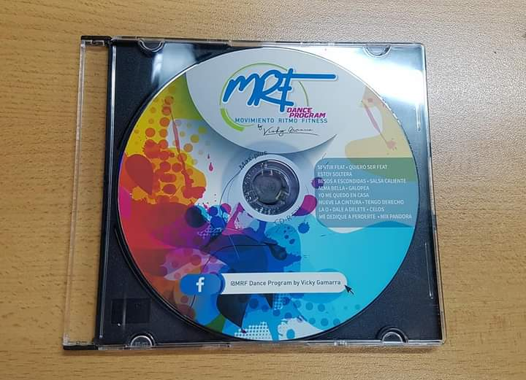
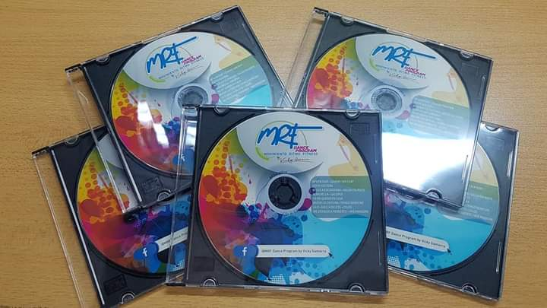
MOVIMIENTO RITMO FITNESS DANCE PROGRAM
MRF DANCE PROGRAM CONCEPT
PERUVIAN FITNESS DANCE PROGRAM BASED ON CARDIO TRAINING THROUGH A CIRCUIT OF INTERMITTENT INTERVALS ACHIEVED BY AN ORIGINAL CHOREOGRAPHIC PROPOSAL AT THE MEDIUM AND HIGH LEVELS, AND BY THE ORDER OF PRESENTATION OF THE SONGS, MOTIVATING ALL THE PARTICIPANTS WITH GREAT JOY AND ENERGY .

Slide 9
MOVIMIENTO RITMO FITNESS DANCE PROGRAM works alternating low and high intensity, doing more effective work than normal cardio in a dance fitness class. MOVIMIENTO RITMO FITNESS DANCE PROGRAM achieves intermittent intervals within the same musical theme as well as in the entire class structure. That is, the musical themes will begin with steps and/or sequences that generate a constant load until the moment of the chorus or ideal spaces to introduce the load or intensity peak. Each song will have peaks of intensity followed by recovery periods within the choreography and these will alternate forming intervals.
PRINCIPLE OF INTERVALS

Slide 10
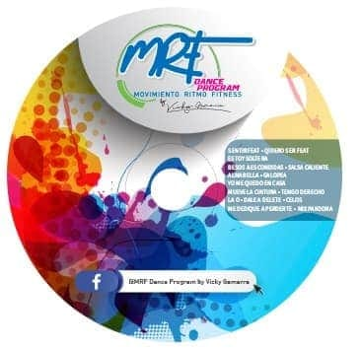
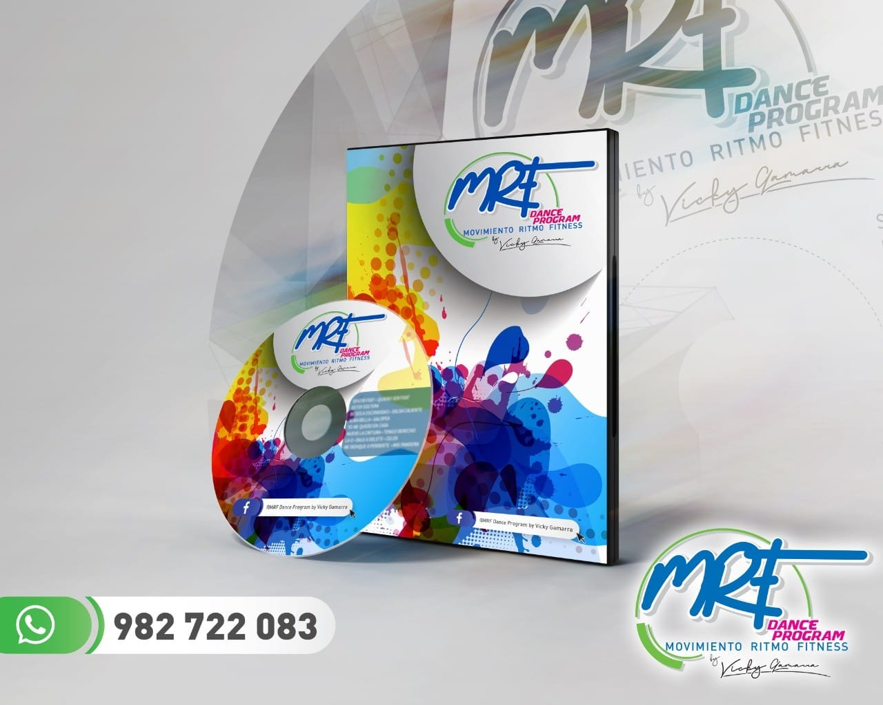
WORK METHODS FOR THE MRF DANCE PROGRAM PROFESSIONAL
MRF AUDIO MIXING (50 minutes of class)
Presentation wedges with the name of the program and instructor
Various sounds and effects
More than 4 intensity peaks
20 to 25 mixed musical tracks
MRF STANDARD (1 class hour)
From 1 to 3 intensity peaks
From 13 to 15 musical themes

Slide 11
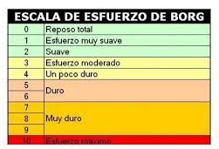
BASED ON THE BORG SCALE
The RPE, known as the perceived exertion scale or Rated Perceived Exertion, it is a scale that allows us to identify the intensity of the exercise based on the sensation of demand or difficulty that we perceive. With this table we can assess both the effort of a specific moment, as well as the requirement of a complete training session.
This method has been used since the 1970s, when Borg first devised it. The original scale was made up of 20 levels of perception.
In 1982 Borg himself decided to simplify the scale and reduce it to 10 levels of dyspnea. The modified Borg scale goes from 0 to 10. The different numbers correspond to terms or phrases that rate the perceived difficulty or effort.
RHYTHM MOVEMENT FITNESS DANCE PROGRAM takes this table as a reference and presents an assessment of perceived effort in fitness dance from level 5 to level 10.

Slide 12
TEACHING METHODOLOGY
The MRF DANCE PROGRAM professional will be able to apply any of these teaching methodologies, according to their target audience (their students).
Based on the identification of the master beat and the parts of the song. There is no established choreography, basic steps and guide songs are used, there is a lot of empathy and musical interpretation.
FREE
PRE-CHOREOGRAPHED
PROGRESSIVE
There is a previous work of choreographic creation, based on counting the times of each block previously rehearsed and prepared in advance.
The existing pre-choreographed work is progressed according to the target audience, that is, the degree of difficulty of the blocks is increased based on the basic choreographic proposal.

Slide 13
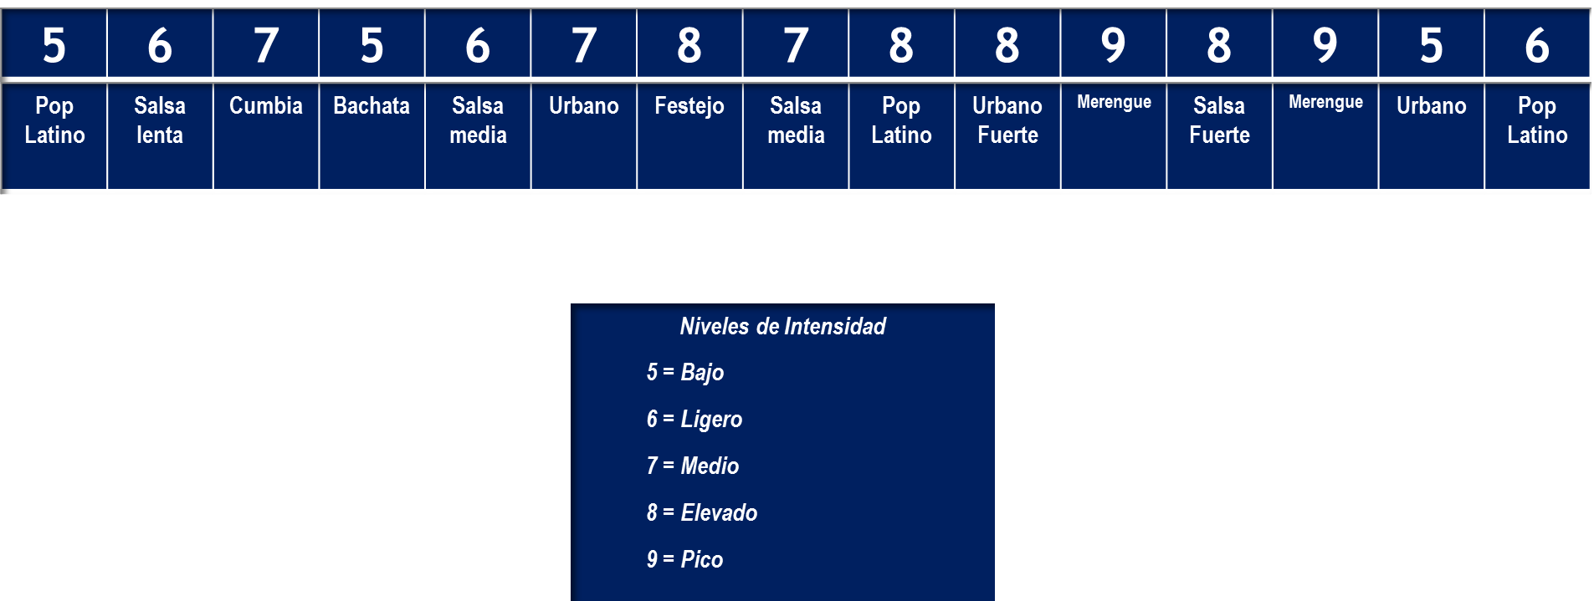
Structure of a class MOVEMENT RHYTHM FITNESS (The order of the musical genres may vary)
LA DOS PRIMERAS CANCIONES SON DE CALENTAMIENTO Y PREPARACIÓN FÍSICA Y PSICOLÓGICA DEL TRABAJO POR VENIR.
LAS DOS ÚLTIMAS CANCIONES SON DE COOL DOWN Y VUELTA A LA CALMA

Slide 14
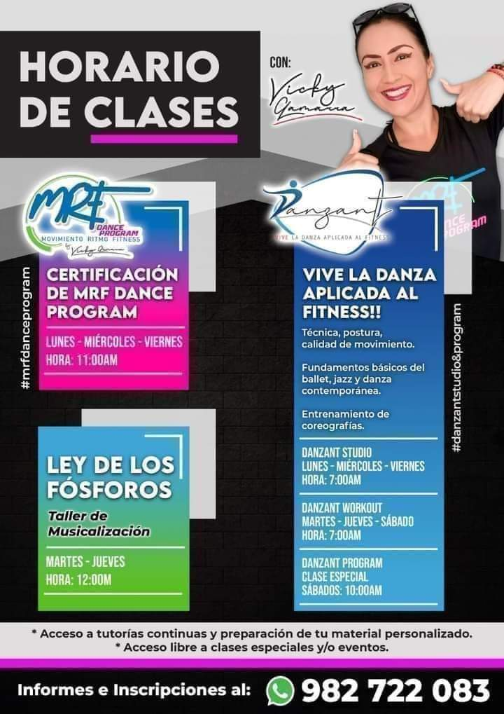
MOVEMENT RHYTHM FITNESS DANCE PROGRAM TRAINING
Basic Steps of Fitness Dance
Theory and Practice of Base Musical Genres
Urban
Latin pop
Salsa
Cumbia
Bachata
Merengue
Reggaeton

Slide 15
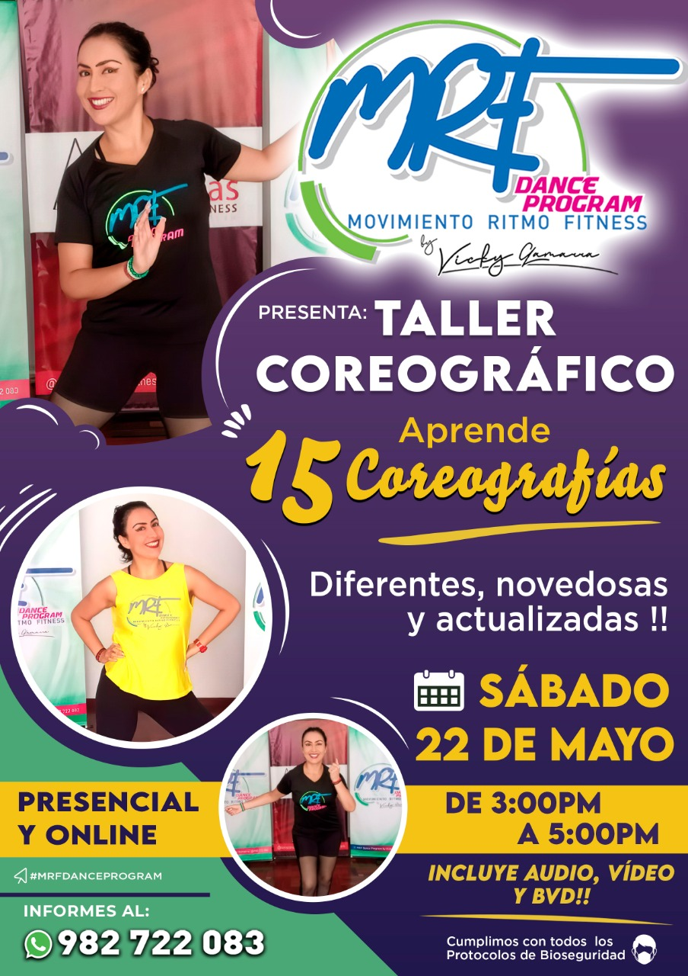
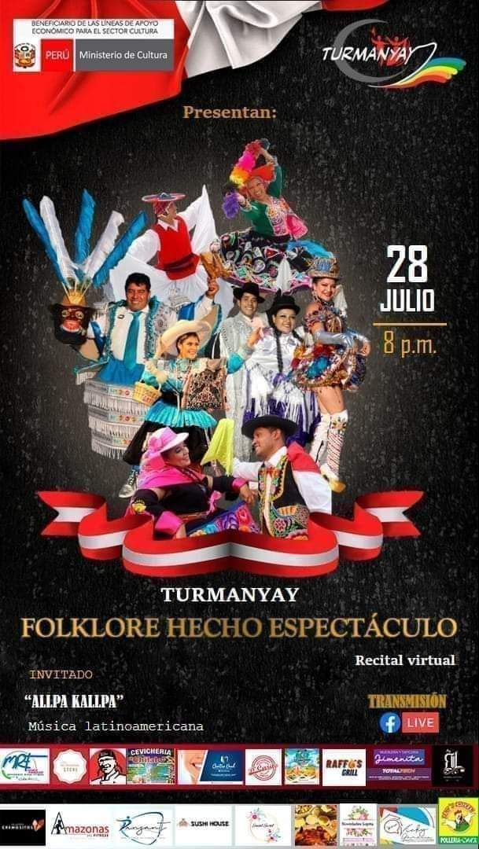
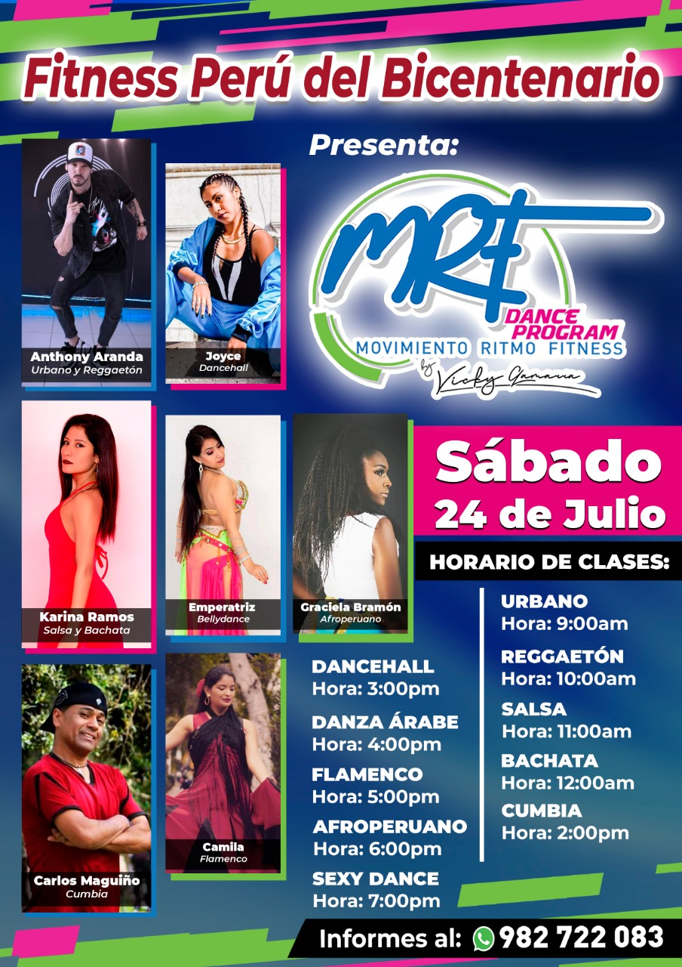
Complementary Musical Genres Workshops
Afro-Peruvian
Disco
Flamenco
Tango
Arabic dance
Sexy Dance
National Folklore

Slide 16
BASIC STEPS OF DANCE FITNESS
Cuatro tiempos
- Chacha.
- Vals.
- Salsa (Toque y regresa).
- Cumbia (Cuarta hacia atrás).
- Palante patrás (Cuarta adelante y cuarta atrás).
- Cruzados (Cuarta cruzada por delante).
- Borrachito.
- Paso en V.
- Dobles.
Seis tiempos
- Mambo alternado.
Un tiempo
- Marcación a un pie.
- Palmas.
Ocho tiempos
- Meneito.
- Vaivén.
- Marcha (Avance y retroceso).
- Chacha desplazado (Avance y retroceso).
- Cubanito.
- Mambo chacha.
Dos tiempos
- Marcha.
- Twist.

Slide 17
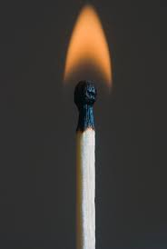
THE LAW OF MATCHES
MASTER BEAT
In MOVEMENT RHYTHM FITNESS DANCE PROGRAM we count in crotchet .
A match (match) is equivalent to 4 musical beats, the red end being the MASTER BEAT (main musical beat). The MASTER BEAT is essential because it indicates the beginning of the action.
We work on 16 count accounts, joining 4 matches to form a fork and recognizing each part of the musical theme: PRELUDE, INTRO, VERSE, CHORUS, PAUSE, DISCHARGE, etc.
Applying THE LAW OF MATCHES optimizes the work time of the fitness dance professional, since in less than a minute they will be able to create a choreography, giving precision to each movement and/or step that they wish to include in their choreographic proposal.
2do tiempo
3er tiempo
4to tiempo
THE MUSICAL FORK
RHYTHM MOVEMENT FITNESS DANCE PROGRAM bases its work on the grouping of 4 matches forming a “musical fork”, which has 16 beats.
TENEDOR MUSICAL

Slide 18
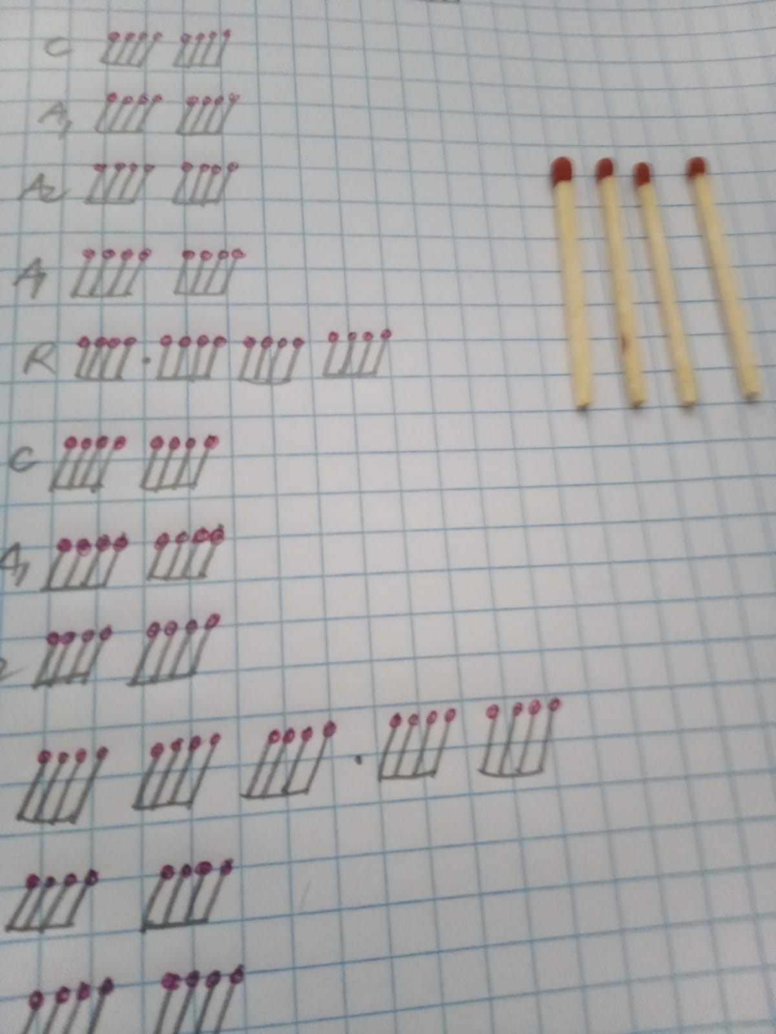
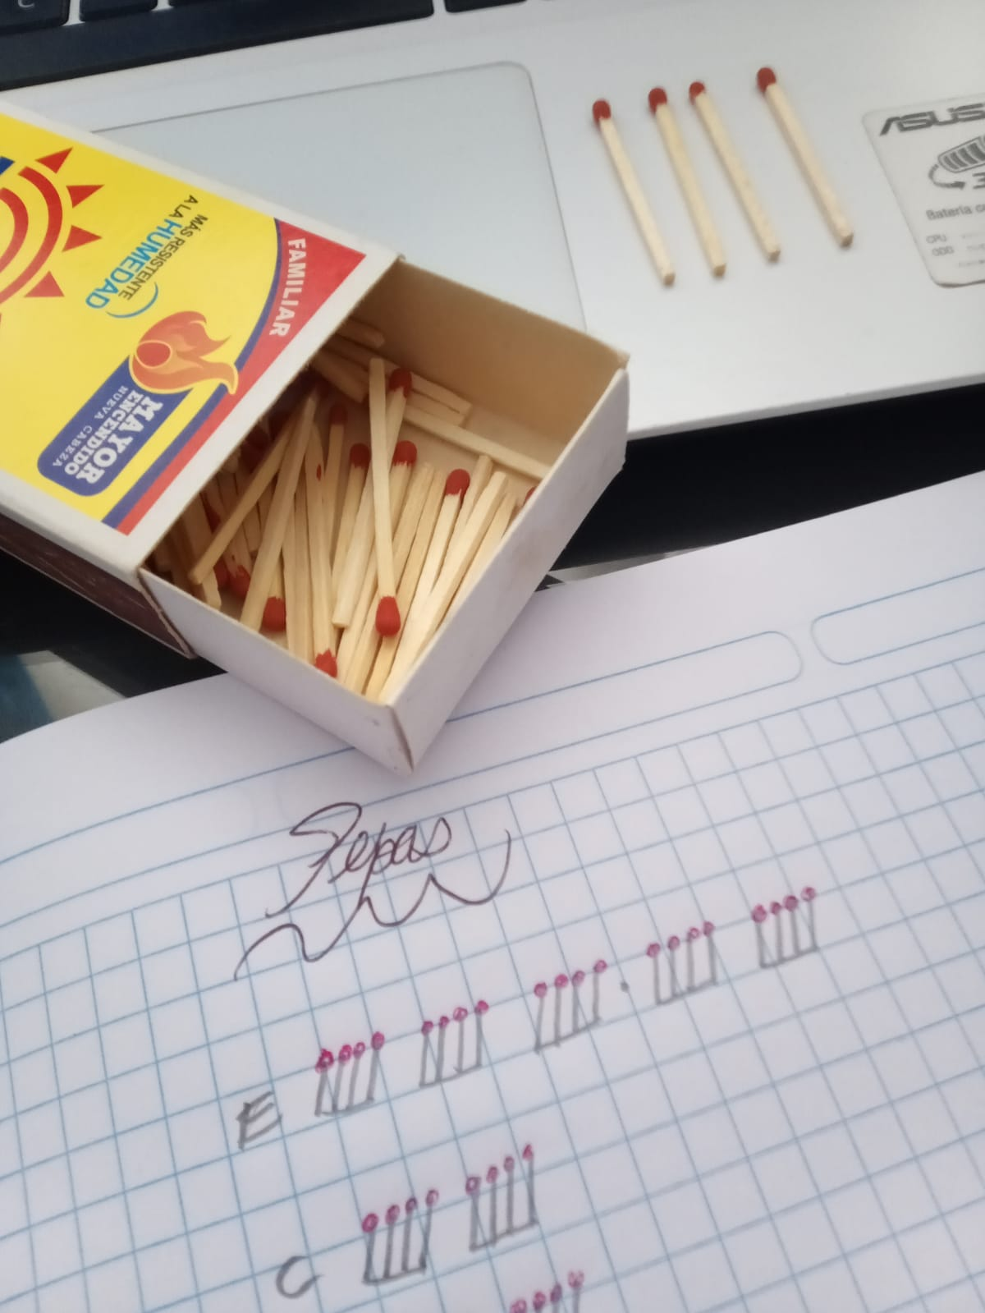
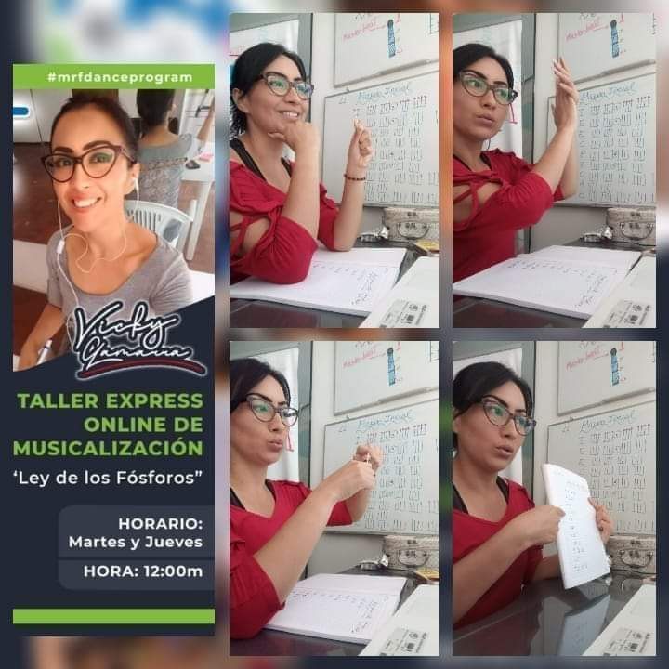
MUSICALIZATION AND CHOREOGRAPHIC CREATION

Slide 19
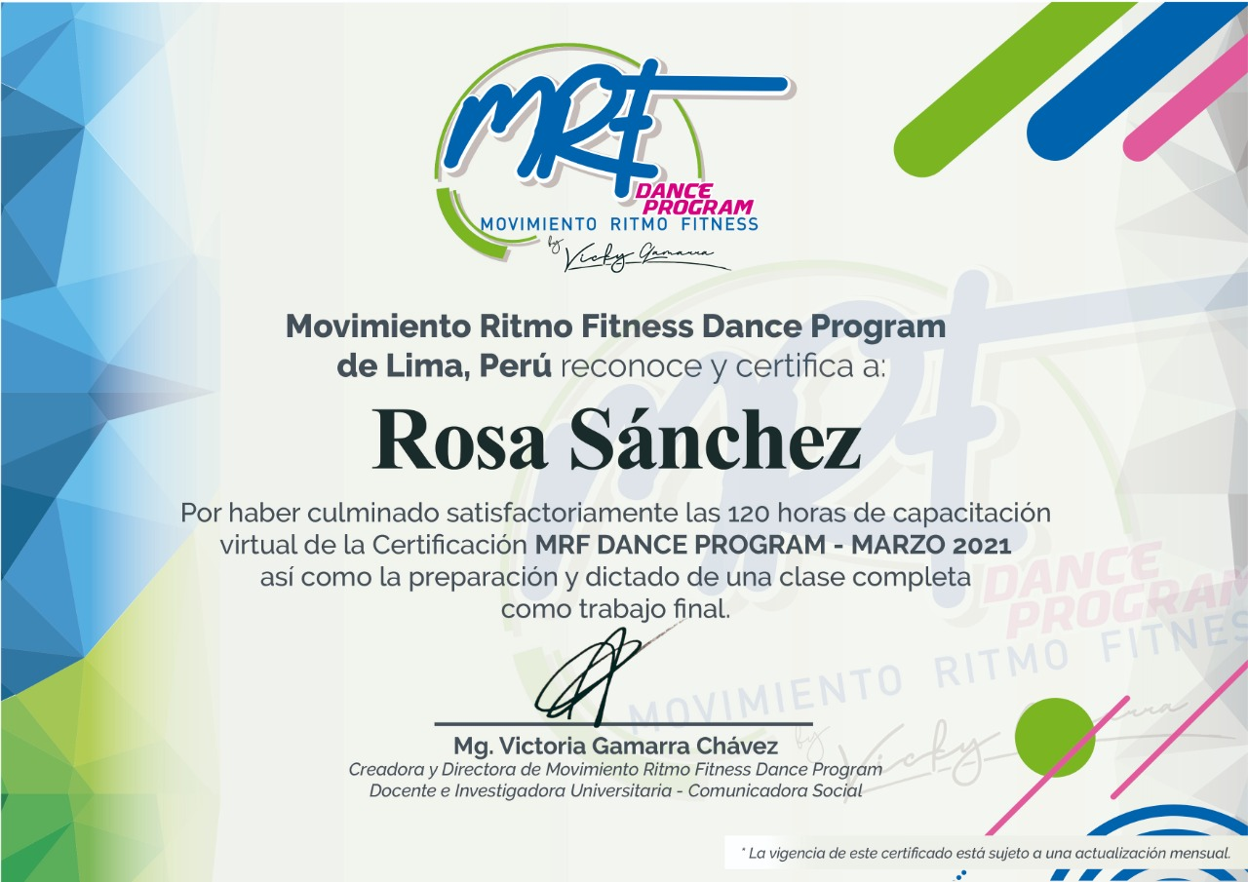
PROFESSIONAL PROFILE MRF DANCE PROGRAM
Punctual
Updated
Fitness
Empathic
Sense of belonging
Respectful
Coach
Professional
Entrepreneur
Certificate
Working market
Private salons
Schools
Gyms
Fitcamps
Parks and/or sports centers
Clubs
Companies

Slide 20
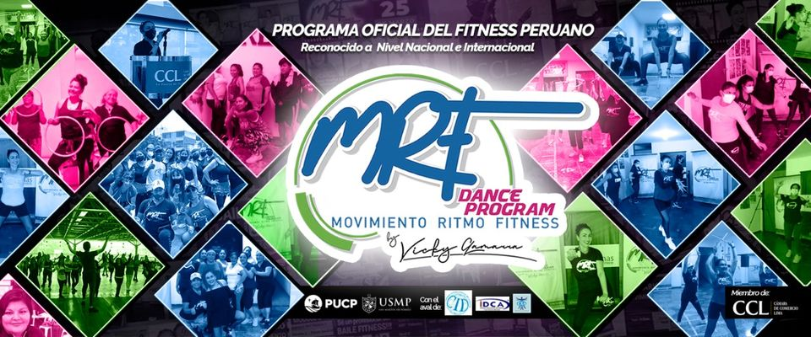
MOVIMIENTO RITMO FITNESS DANCE PROGRAM
Contact us: +51982722083
E-mail: vick19111@hotmail.com
Facebook: Vicky Gamarra
Fb Page. Danzant
Instagram: vicky_gamarra_chavez DANZANT

