Slide 1
UNESCO International Dance Council
60th World Congress of Dance Research
Implicit Bias
In Dance:
A Global Inquiry
Crystal U. Davis
July 5-9, 2023
Athens, Greece
Notes:
I’ve share the Google slides with you so we can see each other while we go through and I can catch any questions or comments that come up as we go. Feel free to post questions in the Zoom chat.
Shared version link: https://docs.google.com/presentation/d/1sNeO-T-HJmeEhC9V70fUQkR8trqztyrWqBe_Vjjgd9w/edit?usp=sharing

Slide 2
Introduction: Sharing your biases
Notes:
I am coming to you live from the ancestral lands of the Piscataway people also known as Takoma Park, MD. Thank you all so much for your cyber-presence here today. I share forward a bit about me because sharing a bit about yourself is a significant way to connect with your students and colleagues. I am a Black able-bodied cis-woman who grew up Southern Baptist in North Carolina. And I have biases. I have a bias for the color blue, the beach instead of the forest, for pants instead of skirts or dresses. In my academic work I gravitate to post-modern dance and dances of the African diaspora. I also privilege embodiment over the written word but with a strong compulsion to write and articulate words as clearly as possible to make sure I am heard. I also have another bias. I like the color blue. These are all conscious biases that I have. Part of sharing your positionality is about helping people understand a bit about your life experiences and possible biases that may have developed from that environment. This helps people better understand where you are coming from in your life experiences when you share.

Slide 3
Explicit Bias vs. Implicit Bias
Notes:
Time check: 10min! In addition to how important it is to share your conscious biases, it is also important to begin the process of learning to be open to discovering your implicit or unconscious biases as well. They are preferences or aversions we hold that either we don’t notice we have or that run counter to how we think of our conscious choices. We can hold implicit biases that are in misalignment with our conscious beliefs and biases.

Slide 4
Implicit Bias: A Breakdown
Implicit social cognition “refers to the unconscious, automatic, or implicit processes that underlie judgements and social behavior. It is a broad area of study that affects self-esteem, concepts of self, social judgement, social cognitive development, goal pursuit, romantic relationships, decision making, prejudice, stereotyping, and social justice.”
Implicit memory “recollections of past experiences influence later performance with no recognition of the past experience and its effect on that later performance.”
Implicit attitude “evaluative associations or characterizations a person holds toward a person or group of people based on past experiences that inform or affect future behavior.”
Implicit bias “a like, dislike, or association that a person does not consciously know they have and cannot articulate.”
(Crystal U. Davis, 2022)
Notes:
Here are the defining features of implicit bias as articulated in social psychology and social justice fields. But what experiences make up our implicit memory?

Slide 5
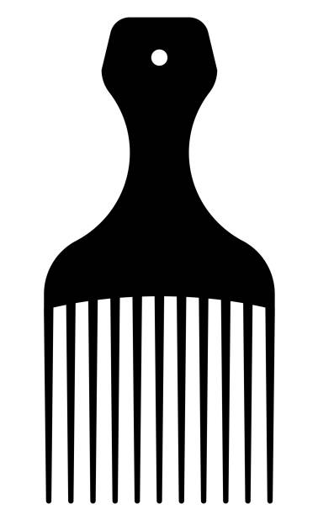
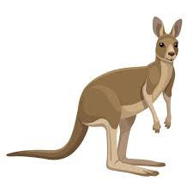
Combs and Kangaroos

Slide 6
Our U.S. Water: In-group/Out-group Orientation
How have we come to know these “in-group/out-group” categories?
Poor | Wealthy
Tall | Short
Gender binary | Gender fluidity/continuum
Colonial Cultures | Indigenous Cultures
Citizen | Non-citizen
Abled | Disabled
Thick-bodied | Thin-bodied
Brain/Intellect/Ideas | Body/Behavior/Action
Notes:
The terms “in-group” and “out-group” are terms used in social science research to distinguish between socially dominant groups and socially marginalized groups no matter the mechanism of marginalization. While this may not be your personal, conscious orientation, you may notice at a quick glance for those from the U.S. or maybe even for those from other places how quickly we can name the societal greater of the two options. It is important to remember this is a gross simplification of the situation. There are intersectional complexities of how these descriptors combine in a society in terms of implicit bias. There has been a significant amount of research in the social sciences on racial bias and gender bias, for example, but not on a combination of the two. There is also regional, local, familial experiences or references that can alter what we think of as common knowledge. It’s important to remember that even in our daily behavior, that behavior and decisions cannot escape the idea that common knowledge is based on socially constructed patterns and messages that a large majority of the society have been exposed to whether it is what they want to believe or consciously believe or not.

Slide 7
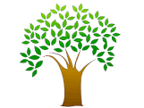
AESTHETICS
KNOWLEDGE
OBSERVATION
O.A.K.

Slide 8
Manifestations of Bias
Gatekeeping
Words
Standards
Favors
Perception
Evaluations

Slide 9
So what’s the good news?
Neural Plasticity research has determined that our brains are far more able to alter or influence these unconscious beliefs than previously thought.
(Eberhardt, 2019)

Slide 10
Feeders of Bias
Negative Effects | Generative Effects
Socialization of insider/outsider orientation | Socialization of unique aspects of cultural belonging
Unaware of bias | Allowing subconscious to guide creativity
Shame and cognitive dissonance | Vulnerability of Moving/Creating with self-critique
Lack of criteria or standards | Avoid comparing or creating to meet external or predetermined expectations
Unintended benefits for maintaining bias | Sharing your dances in the context of money, significance, exposure, or status
Mental distraction | Moving from a complex overlay of elements

Slide 11
Approaches to Bias
Out-group members: Be consistent in articulating and embodying your perspective in in-group dance interactions. Name culturally-specific creative choices, teaching practices, approaches to community as the culturally-specific requirements of the dance form.
In-group members: Be mindful of when you are missapplying your perspective in out-group dance interactions (ex. Bodies, cultures, dance forms, knowledge systems, organizational systems). Your perspective is not universal, but rather the perspective that carries power and privilege.

Slide 12
Change the Frame: Remembering Maxine Greene’s Work
When working in a creative process context outside of your cultural form:
You are the outsider-guest. Conduct yourself as such.
Your opinions and perspectives are not central.
Your perspective is not True.
Frame your discoveries as dialogue, not the final word.
Are you teaching/responding to what is or what could be?
- Orient your classroom to human connection as potential for re-imagining the world as a goal rather than only speaking to the status quo..

Slide 13
Approaches to Disrupting Implicit Bias
Quantitative: Track the numbers
Qualitative: Track the social in-groups and out-groups (intersecting historical, cultural, systemic, and interpersonal)
Embodied: Establish ongoing sites to practice, reflect, and continue unpacking biases
Notes:
1min

Slide 14
Example Reflection Questions
Observation
What are some ways to track bias in observation in order to make it visible for ourselves?
What are ways we can disrupt our biases once we have brought them into our conscious mind?
How can we help colleagues of a different background understand the biases of the genres they do not center?
Who is your support community to help you see, articulate or track your bias?
Aesthetics
What are your goals for aesthetic clarity/consistency? How do you track those in a dance setting?
How do you balance
1) industry/field standards,
2) personal or cultural preferences, and
3) dancer/student clarity of creative concept in your classes?
Epistemology
How do you establish balance between
1) standards in your field of study or in the culture of study,
2) personal dance preferences, and
3) the knowledge that dancers enter dance class with?
What are possible ways to include and distinguish when you are communicating an example or piece of knowledge from the field, from a personal/cultural preference, or an opportunity for dancers to articulate their knowledge?
Notes:
Time check: 50min! 15min timer on group session. Remember these questions do not have to be what you end up addressing in your chat room. You can assign a different focus, for example for the Dance grads, if you would like to start a group to brainstorm ideas of how to design an Anti-racist DANC200 Introduction to Dance course that would be great. These ideas and plans can stay with you all as a group or be shared out to go back to faculty.

Slide 15
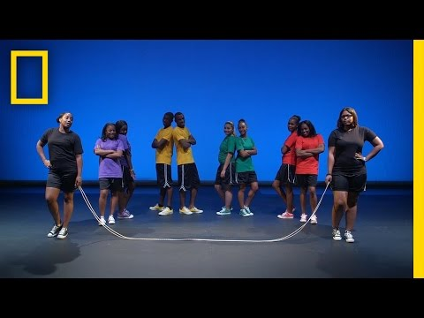
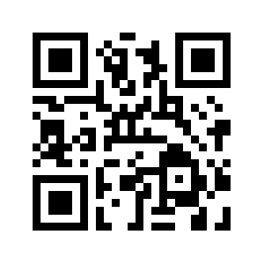
Observation Activity!
Weblink: https://youtu.be/iiEzf3J4iFk
Notes:
Time check: 30min! Share the link with the group: https://www.youtube.com/watch?v=iiEzf3J4iFk&t=51s
Now that we’ve watched this clip, I would like to transition to the ways that observation, along with two other factors show up in teaching your classes and may also show up for you as graduate students navigating TDPS. Observation is an area where bias can run rampant as you can see, particularly for the performance-based studio classes. The unconscious biases or dispositions held in our implicit memories and socialization can affect how we see and what we see.

Slide 16
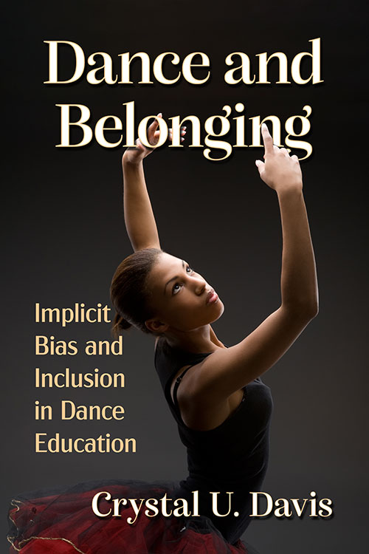
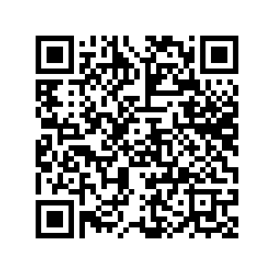
Group Share-out & Questions
Resources Link:
https://docs.google.com/document/d/1-jFXg8J03VMljXtK1WZGAuj2Ro0GUVEYgNlFmWU4h6U/edit?usp=sharing
Where to start: Take the Implicit Association Tests
https://implicit.harvard.edu/implicit/takeatest.html
Dance and Belonging: Implicit Bias and Inclusion in Dance Education
https://mcfarlandbooks.com/product/dance-and-belonging/
Please share any additional feedback at cudavis@umd.edu.
Thank you!
Notes:
Time check: 65min! For anonymous sharing in the Zoom chat, feel free to change your name to anonymize the feedback you post here if you feel more comfortable with that being shared to the faculty or chair. You can also feel free to talk more with me offline if you like.
Bibliography link to share: https://docs.google.com/document/d/1ec-oeplnhnVYAwBwjW0HoBG3c6q2KGRn9jOgslRft5E/edit?usp=sharing
Implicit Association Test link: https://implicit.harvard.edu/implicit/takeatest.html

