Slide 1
REVISITING BALLET HAMLET IN THE AGE OF DIGIMODERNISM TRANSFORMATION OF AN ARCHIVAL RECORDING OF A NEOCLASSICAL BALLET HAMLET INTO A NEW ARTISTIC DANCE VIDEO HAMLET REVISITED
Dr. Svebor Sečak, Associate Professor

Slide 2
Presentation
I am Dr Svebor Sečak, associate professor, national ballet principal of the Croatian National Theatre in Zagreb, where I currently work as the ballet coach. I am the Dean of the Alma Mater Europaea Dance Academy in Slovenia and the President of the Croatian Society of Professional Ballet Artists. I teach ballet education at the University of Zagreb, Croatia.
Furthermore, I am the director and organiser of the International Ballet Competition Slavenska Prix, as well as the organiser and moderator of the dance section of Scientific International AMEU Conferences All About People, and as a member I participate at international congresses of CID UNESCO.
I am a regular member of the European Academy of Sciences and Arts.

Slide 3
Introduction
Today, dance is studied from many analytical perspectives that surpass the fundamental dance methodologies, technical skills and the linear dance history, but include anthropological, philosophical, semiotic, socio-political, feminist and gender perspectives, as well as kinesiology, anatomy and psychology in the context of safe practice and in a wider sense dance studies refer to the relation between education, research, organisation, creation, production and reflection.

Slide 4
Introduction
As a life-long ballet soloist and choreographer my area of interest is ballet and dance, especially canonical literature works used as subject matter for narrative ballets. It is generated by my rich experience in choreographing and dancing leading ballet roles that originate in language-based plays (for example Peer Gynt, Don Quixote, Romeo and Juliet, Hamlet, etc.).

Slide 5
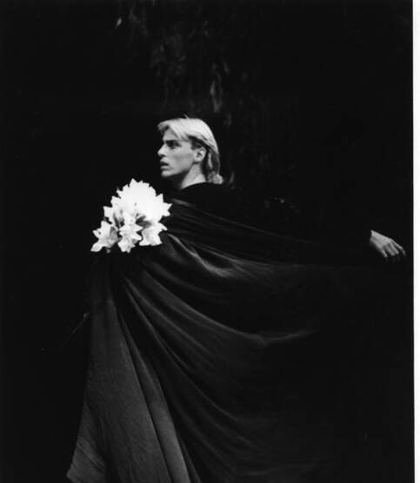
Count Albrecht, Giselle (A. Adam)

Slide 6
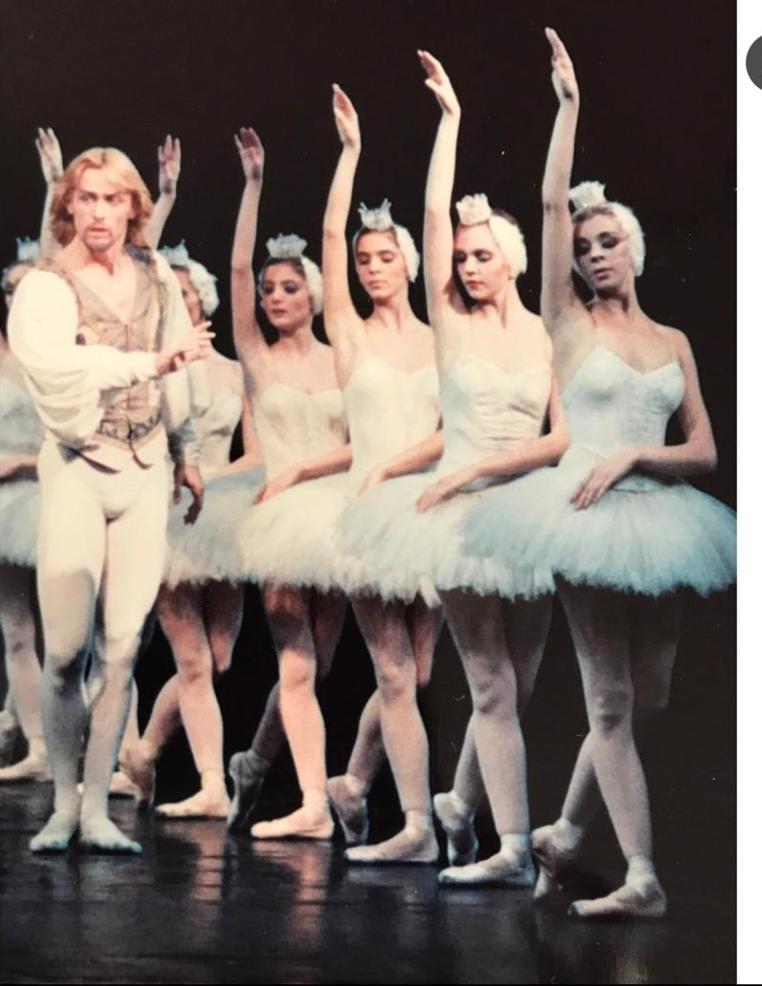
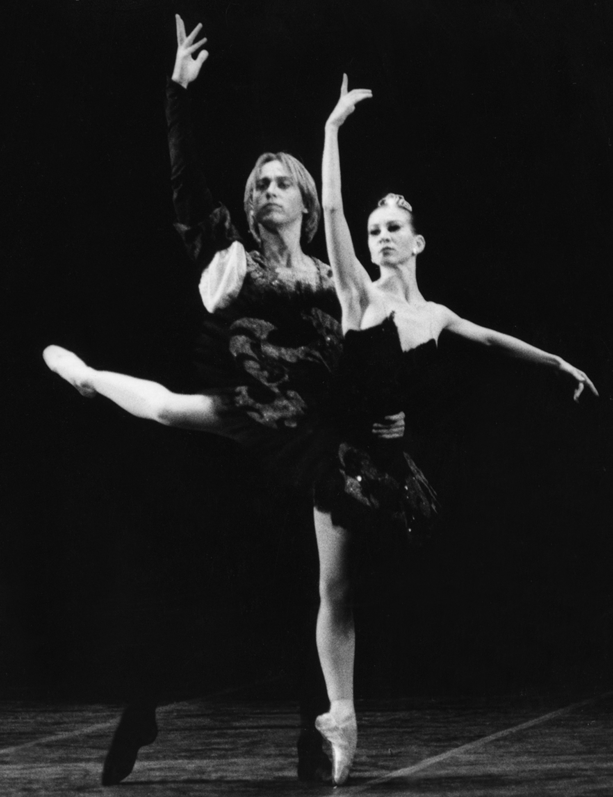
Prince Siegfried, Swan Lake (P. I. Tchaikovsky)

Slide 7
Prince Desiré, The Sleeping Beauty (P. I. Tchaikovsky)

Slide 8
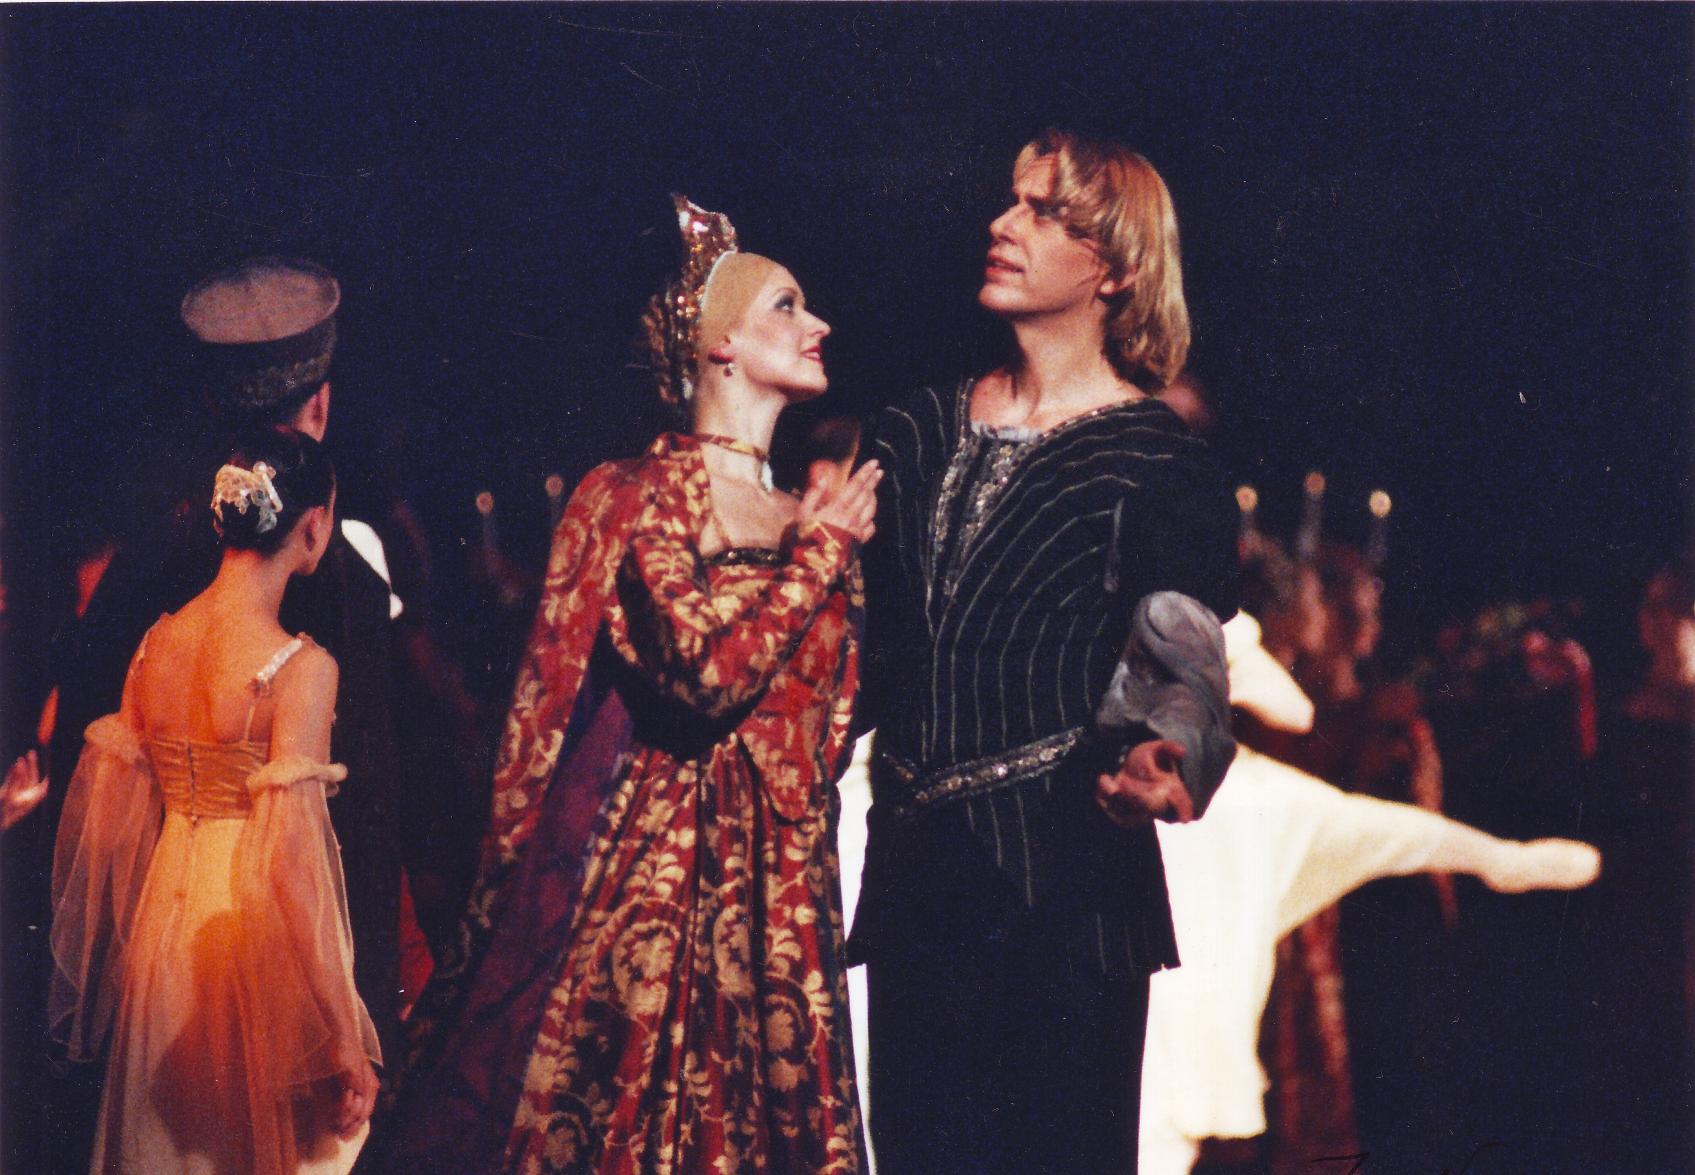
Paris and Tybalt, Romeo and Juliet (S. S. Prokofiev)

Slide 9
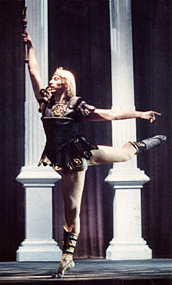
Crassus, Spartacus (A. Khachaturian)

Slide 10
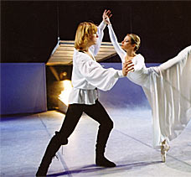
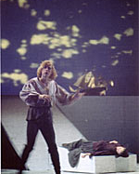
Peer Gynt, Peer Gynt (E. Grieg)

Slide 11
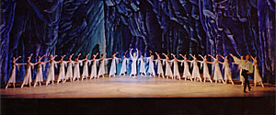
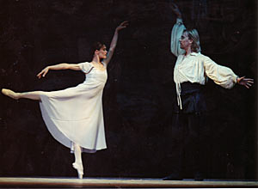
Don Quixote, Don Quixote (L. Minkus)

Slide 12
Caligula, Caligula (A. Khachaturian)

Slide 13
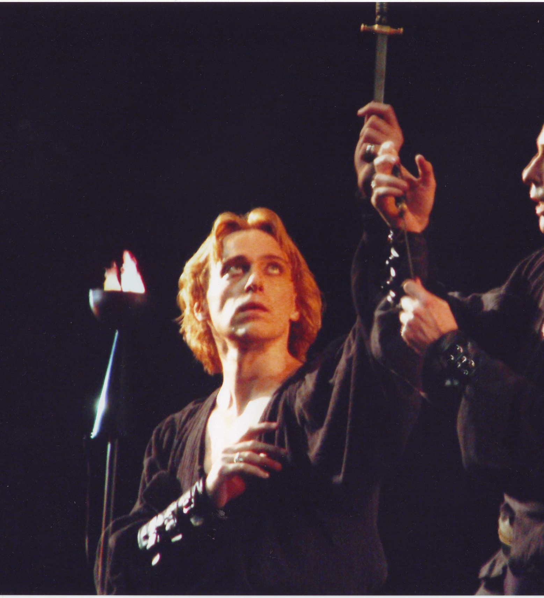
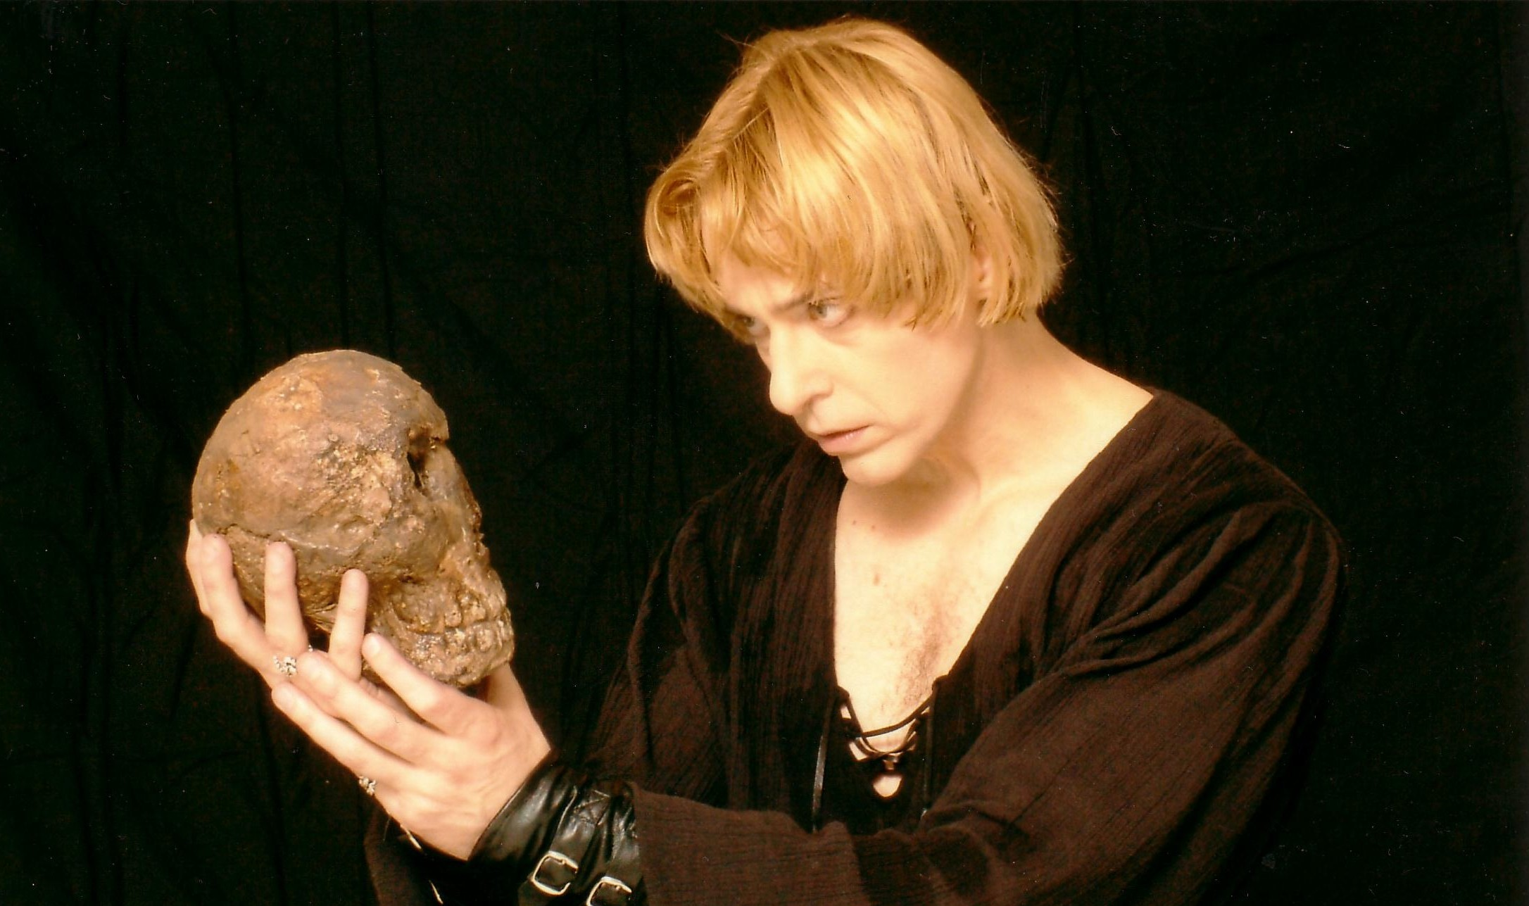
Hamlet, Hamlet (P. I. Tchaikovsky)

Slide 14
PURPOSE AND GOALS
This text is a distillation of the exegesis that is an integral part of my PhD. It shows the transformation of a video recording of my own choreography of ballet Hamlet which premiered at the Croatian National Theatre in Zagreb in 2004, into a contemporary post-postmodern dance video Hamlet Revisited. The goal of the project is to elucidate the transformation of Hamlet to Hamlet Revisited, from a neoclassical choreographic approach to the recent postmodern approach that traverses into a transmodern dance video of an eclectic blend of styles and techniques in accordance with the paradigm of digimodernism.

Slide 15
The post-postmodern paradigm of the 21st century has many names such as metamodernism (Vermeulen and van den Akker 2010, para. 15-16), transmodernism (Dussel cited in Cole 2007, 68-69) which is in accordance with the integral theory of Ken Wilbur (Visser 2003, xii) and fuses modern, postmodern and neoclassical approaches to staging artistic works, as well as digimodernism discussed by Alan Kirby (2009). In postmodernism, one read, watched, listened, as before. Today, one phones, clicks, presses, surfs, chooses, moves, downloads (Kirby 2006:para. 18).
Accordingly, the dance video emerges as a new artistic medium which is different from a documentary recording or a music film, resulting in a new form of art – edited dance that does not exist outside the medium of film and/or video.

Slide 16
METHODS
I created an experimental dance video titled Hamlet Revisited as a separate work of art that lasts approximately 60 minutes. I used the recording of my original Hamlet and some other performances and existing material that I juxtaposed against about 30 minutes of new material choreographed and recorded by myself, as well as my associates.
In the exegesis, I focus on the multimedia presentation of my ideas as a director and choreographer, from the discourse of a ballet artist and choreographer, not a professional filmmaker.

Slide 17
RESULTS
In Hamlet Revisited, the eclectic combination of the old and new material resulted in a transmodern recent work of art. Some of the key postmodern concepts and techniques used are:
intertextuality (Kristeva 1969; Adshead-Lansdale 1999; Allen 2011): is implemented not just as a tool for the analysis but also for the creation of this multi-layered work.
deconstruction (Derrida 1967; Wood and Bernasconi 1985; Lansdale 2010): reveals the underlying multiple layers of the performance.

Slide 18
death of the author (Barthes 1968): is used to question my role as the author, drawing on Derrida and Foucault, positioning myself as the editor of various intertexts emphasising the notion of the plurality of self (Foucault 1969) by postmodern techniques such as fragmentation, repetition and avoidance of a singular narrative

Slide 19
diffuse authorship (Barthes in Auslander 2008, 50): my associates and I established communication on a receptive reader-response basis, thus blending the role of the spectator and the author in creating the new material.
carnival (Bakhtin 1968) which accentuates the blurring of the boundaries between the spectator and the performer
rhizome (Deleuze and Guattari 1987), where there is not just one root or source, in this case text source.
supplement (Derrida in Carlson 1985): in a way I deconstructed ballet Hamlet and re-built it, creating what Derrida calls supplement, resulting in an open-ended work of art, suitable for additional supplementation.

Slide 20
irony: I have used slight doses of irony and a touch of humour
self-reflexivity is evident in the inserted autobiographical elements, thus personalising Shakespeare's ontological themes
simultaneity was used to achieve communication between various styles and approaches. Regarding choreographic syntax Hamlet worked on the principle of mimesis and pathos, while Hamlet Revisited includes parataxis: different intertexts were put together in juxtaposition (Foster 1986, 92-93).

Slide 21
incredulity towards grand narratives (Lyotard 1984): emphasises the importance of particulars as opposed to universals, in this case, by involving individual experience.
mirror: three aspects of the concept of the mirror were applied - theatre as a metaphorical mirror (Lacan 1977b), a real mirror as a set element and the video that can serve as a time-transcending mirror.

Slide 22
psycho-schizoanalysis: from Freud's psychoanalysis (1900) through Jung's archetypes (1968), Hamlet Revisited arrived at the concept of schizoanalysis proposed by Deleuze and Guattari (1983). Their concept of schizoanalysis rejects Freud's concept of the family triangle to avoid the repression and restraint of the psychoanalytic interpretative framework.

Slide 23
Video dancing body: I played with images of the anatomy of the body, juxtaposing it with images of literary texts, music and dance notation sheets, as signs of the process in which dance is created. Today's eclectic repertoire demands a new type of body that Foster calls the 'hired body'—it is a body trained to make a living in dancing. What is important for my work is the notion following the hired body—the video dancing body that is often constructed from the edited tapes of dance movement (Foster 2006, 255).

Slide 24
Dance video: edited dance that does not exist outside the medium, somehow metaphorically imagined as a simulacrum (Baudrillard 1983; Auslander 2008) drawing on Foster (2006).
Techniques such as reverse-motion, multiplication of images, slow-motion, split screen, overlaying X-rays, image scratching and freeze-frame were used.

Slide 25
CONCLUSION
It may be argued that my research proves that the postmodernists’ prescriptive way of creating a work (Banes 1994, 309) can be applied to the re-reading or re-interpreting and transforming recorded ballet works. It proves to be a concept that enhances the possibility of re-considering existing monolithic or readerly texts (Barthes cited in Foster 1986, 259).
In the exegesis, I offer analyses on two levels. I combine a semiotic structural analysis based on description, interpretation and self-evaluation with an intertextual analysis.
The second level leaves the interpretive position open. Such an intertextual approach examines possible constructions of meaning, moving from strict relationships between signs to a multiplication of signifiers, combining structural, semiotic and intertextual analyses.

Slide 26
The complete article on the subject has been published in Journal Monitor in December 2021.
Journal for the Humanities and Social Sciences Monitor has been published by Alma Mater Europaea – Institutum Studiorum Humanitatis since 2001. Its aim is to publish articles pertinent to the fields of the humanities and social sciences, from anthropology to linguistics. The journal publishes articles by professors and students researching a diverse range of topics in various disciplines. This edition, published in December 2021, offers a thematic block dedicated to contemporary dance and video and the changes that digitalisation has brought into the traditional arts. The journal is available at: https://journal.almamater.si/index.php/monitorish/issue/view/32
In the next 10 minutes, I am going to share several video clips from this project; they are taken out of context, but I hope you will get the general idea.

Slide 27
Thank you

Slide 28
BIBLIOGRAPHY
Adshead, Janet. (ed) 1986. „Choreography: Principles and Practice.” Report of the Fourth Study of Dance Conference 4-7 April 1986. Guilford: National Resource Centre for Dance, pp. 63-79.
Adshead, Janet. 1988. Dance Analysis: Theory and Practice. London: Dance Books Ltd.
Adshead-Lansdale, Janet. (ed) 1999. Dancing Texts: Intertextuality in Interpretation. London: Dance Books Ltd.
Allen, Dave. 1993. „Screening Dance.” In Parallel Lines: Media Representations of Dance, eds Stephanie Jordan and Dave Allen. John Libbey & Company, Ltd.
Allen, Graham. 2011. Intertextuality, 2nd ed. London: Routledge.
Armstrong, Philip. 2003. „Watching Hamlet watching: Lacan, Shakespeare and the mirror/stage.” In Alternative Shakespeare, ed. T. Hawkes. Oxon: Routledge.
Auslander, Philip. 2008. Theory for Performance Studies. New York: Routledge.
Bakhtin, Mikhail. 1968. Rabelais and His World. Massachusetts: The Massachusetts Institute of Technology.
Bakhtin, Mikhail. 1984. Problems of Dostoevsky's Poetics. Minneapolis: University of Minnesota Press.
Banes, Sally. 1987. Terpsichore in Sneakers: Post-Modern Dance. Middletown, Connecticut: Wesleyan University Press, .
Banes, Sally. 1994. Writing Dancing in the Age of Postmodernism. Hanover: University Press of New England.
Barthes, Roland. 1968. Image, Music, Text, tr. and ed. S. Heath. New York: Farrar, Straus and Giroux.
Baudrillard, Jean. 1983. Simulations. New York: Semiotext(e) Inc.
Betts, Jean. 1994. Ophelia Thinks Harder. New Zealand: The Plax Press.
Benjamin, Walter. 1968. Illuminations. New York: Schoken Books.

Slide 29
BIBLIOGRAPHY
Bixler, Litza. 1999. „The Absurd World of Philippe Decouflé.” In Dancing Texts: Intertextuality in Interpretation, ed. Janet Adshead-Lansdale. London: Dance Books Ltd.
Brannigan, Erin. 2011. Dancefilm Choreography and the Moving Image. Oxford: Oxford University Press, Inc.
Bremser Martha and Lorna Sanders. 2011. 50 Contemporary Choreographers, 2nd edn. London: Routledge.
Burt, Ramsay. 1995. The Male Dancer: Bodies, Spectacle, Sexualities. New York: Routledge.
Calderwood, James L. 1983. To Be and Not To Be. Negation and Metadrama in Hamlet. New York: Columbia University Press.
Carlson, Marvin. 1985. “Theatrical Performance: Illustration, Translation, Fulfillment, or Supplement?”, Theatre Journal, (37): 5-11.
Chisholm, Mike. 2003. “Now Screening.” Dance UK News. 51: 9-10.
Cohen, Selma Jean. (ed) 1992. Dance as a Theatre Art. Princeton Book Company Publishers.
Cole, Mike. 2007. Marxism and Educational Theory: Origins and Issues. London: Routledge.
Copeland, Roger and Marshall Cohen. (eds) 1983. What is Dance? Oxford: Oxford University Press.
Counsell Colin and Laurie Wolf. (eds) 2001. Performance Analysis: An introductory coursebook. London: Routledge.
Daly, Ann. 2002. „Tanztheater: The Thrill of the Lynch Mob or the Rage of a Woman?” Critical Gestures: Writings on Dance and Culture. Middletown, Connecticut: Wesleyan University Press.
Daly, Ann. 2006. „Classical Ballet: A Discourse of Difference.” In Meaning in Motion New Cultural Studies of Dance, ed J.C. Desmond. Durham and London: Duke University Press.
Deleuze, Gilles and Félix Guattari. 1983. Anti-Oedipus: Capitalism and Schizophrenia. Minneapolis: University of Minnesota Press.
Deleuze, Gilles and Félix Guattari. 1987. A Thousand Plateaus: Capitalism and Schizophrenia. Minneapolis: University of Minnesota Press.

Slide 30
BIBLIOGRAPHY
De Marinis, Marco. 2006. Razumijevanje kazališta. Zagreb: Biblioteka Sintagma.
Deren, Maya. 1967. „Cine-Dance”, Dance Perspectives, 30, Summer.
Derrida, Jacques. 1967. Of Grammatology. Paris : Les Editions de Minuit.
Derrida, Jacques (ed) 1985. David Wood & Robert Bernasconi, „Letter to a Japanese Friend.” In Derrida and Différrance. Warwick: Parousia Press.
Desmond, Jane C. (ed) 2006. Meaning in Motion: New Cultural Studies of Dance. Durham and London; University Press.
Elam, Keir. 2002. Semiotics of Theatre and Drama, 2nd edn, London and New York: Routledge.
Fish, Stanley. 1980. Is There a Text in this Class? The Authority of Interpretive Communities. Cambridge: Harvard University Press.
Foster, Susan. 1986. Reading Dancing. Berkeley and Los Angeles: University of California Press.
Foster, Susan. 1996. Choreography and Narrative. Bloomington, Indiana: Indiana University Press.
Foucault, Michael. 1969. “What is an Author?” Retrieved from http://www.movementresearch.org/classesworkshops/melt/Foucault_WhatIsAnAuthor pdf
Freud, Sigmund. 1900. The Interpretation of Dreams, Sioux Falls: NuVision Publications.
Hawkes, Terence. 1977. Structuralism & Semiotics. Berkeley and Los Angeles: University of California Press.
Hidalgo, Juan Carlos. 1999. “The Split 'I' in Celestino Coronado's Hamlet”. Universidad de Sevilla.
Hutcheon, Linda. 1988. A Poetics of Postmodernism. New York and London: Routledge.
Jenkins, Harold. (ed) 1982. Hamlet. The Arden Shakespeare. Methuen & Co. Ltd.
Jones, Ernest. 1976. Hamlet and Oedipus. W.W. Norton & Company, Inc.

Slide 31
BIBLIOGRAPHY
Jowitt, Deborah. 2011. „Introduction.” In 50 Contemporary Choreographers, 2nd edition, eds Martha Bremser and Lorna Sanders. London: Routledge.
Jung, Carl. 1968. Collected Works of C. G. Jung. Archetypes of the collective unconscious. vol. 9, Part 1, 2nd edn. Princeton University Press.
Kirby, Allen. 2009. Digimodernism: How New Technologies Dismantle the Postmodern and Reconfigure Our Culture. London: The Continuum International Publishing Group Ltd.
Kristeva, Julia. 1980. „Word, Dialogue and Novel.” In Desire in Language: A Semiotic Approach to Literature and Art, ed. L. Roudiez. Columbia University Press.
Lacan, Jacques. 1977a. Ecrits: A Selection, trans. Alan Sheridan. London: Tavistock.
Lacan, Jacques. 1977b. „ Desire and the Interpretation of Desire in Hamlet”, trans. James Hulbert. Literature and Psychoanalysis. The Question of Reading: Otherwise, 55/56: 11-52.
Lacan, Jacques. 1988. The Seminar of Jacques Lacan, vol.1: Freud's Papers on Technique 1953-1954, trans. John Forrester. Cambridge: Cambridge University Press.
Lansdale, Janet. 2010. „A tapestry of intertexts: dance analysis for the twenty-first century.” In The Routledge Dance Studies Reader, eds Alexandra Carter & Janet O'Shea. London: Taylor and Francis.
Lehmann, Hans-Thies. 2006. Postdramatic Theatre. London and New York: Routledge.
Littler, W. 1991. „Thinking dancer's choreographer”, The Toronto Star. February 17 1991:C.
Lyotard, Jean François. 1984. The Postmodern Condition: A Report on Knowledge. Manchester: University Press.
Munz, Alexander. 2015. „Defocus” in SAFE Project Newsletter. Retrieved from http://www.thesafeproject.net/en_home.html

Slide 32
BIBLIOGRAPHY
Pavis, Patrice. 1993. Languages of the Stage. New York: Performing Arts Journal Publications.
Pavis, Patrice. 2006. Analysing Performance. Theater, Dance and Film. Michigan: University of Michigan Press.
Rorty, Richard. 1980. Philosophy and the Mirror of Nature. Oxford: Blackwell Publishers.
Saussure, Ferdinand. 1959. Course in General Linguistics, trans. Wade Baskins. The Philosophical Library, Inc.
Sečak, Svebor, 2020. „Intertextual Dance Analysis.” In Proceedings Book on AMEU Dance Academy Events 2018/2019, ed. Svebor Sečak, 147-155. Maribor: Alma Mater Press.
Sečak, Svebor, 2021. „Dancefilm.” In Proceedings Book with Peer Review on Professional Contributions on Dance, ed. Svebor Sečak, 8-13. Maribor: Alma Mater Press.
Smith-Autard, Jacqueline. 2002. The Art of Dance in Education. London: A & C Black.
Vermeulen, Timotheus and Robert van den Akker. 2010. „Metamodernism.” Journal of Aesthetics and Culture, vol.2.
Wharton, Robert. 2005. „There Are No-Mothers-In-Law in Ballet: 'Doing' Shakespeare in Dance.” Shakespeare Bulletin, 23: 7-22.
Whorten, W.B. 1998. „Drama, Performativity, and Performance.” PMLA 113.5, pp. 1093-107.
Worton, Michael. 1999. „Foreword.” In Dancing Texts: Intertextuality in Interpretation, ed. Janet Adshead-Lansdale. London: Dance Books Ltd.
Woitas, Monika. n.d. „Léonide Massine - The Impact of Leonide Massine on 20th Century Ballet.” Retrieved from http://massine-ballet.com/html/synopsis.php.

