Slide 1
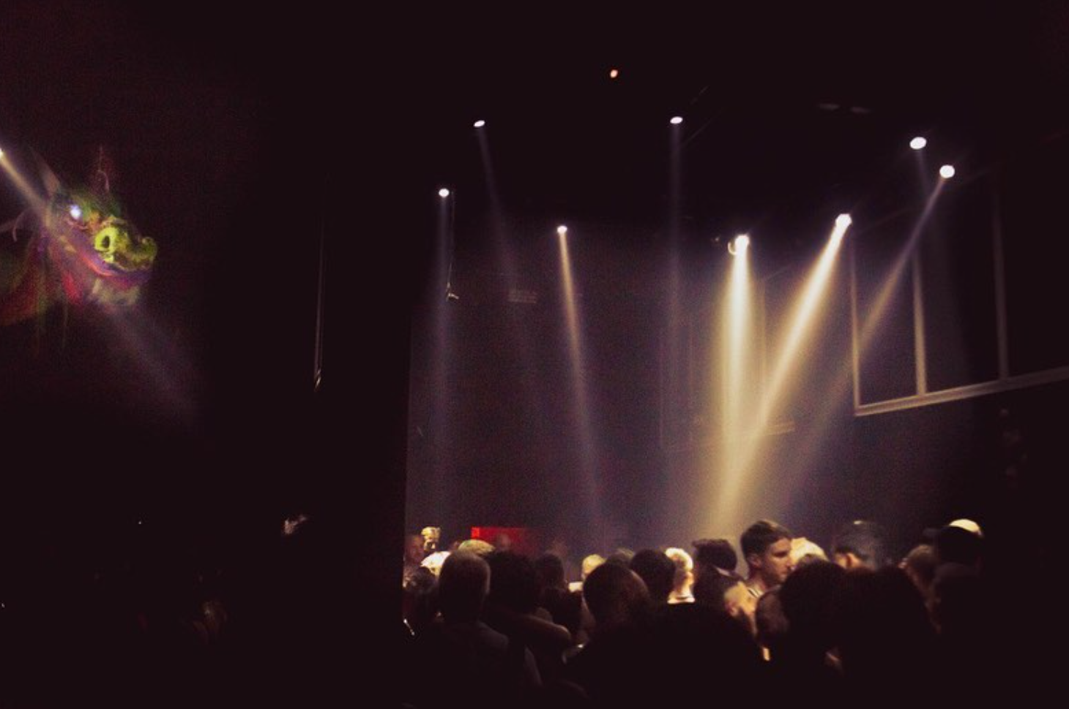


A body changed
Body transformations, movement, and space on queer techno-dance floors
Juan Sebastián Gómez-García
World Congress of Dance Research
Athens, 2023
Master’s thesis in Choreomundus, International
Master’s in Dance Knowledge, Practice and Heritage
Supervisor: Dr. Chi-Fang Chao
Tutor: Prof. Georgiana Gore
July, 2023

Slide 2
Contents
The field
Methodological approaches and ethical considerations
Definitions
Body-space
Queer techno-dance floors
Shaping forces and body transformations
Dancing queer
Conclusions

Slide 3
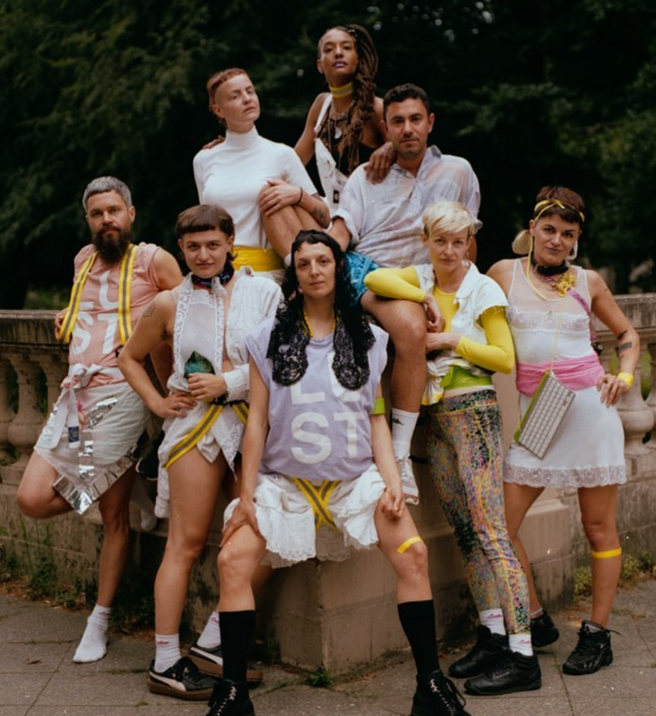

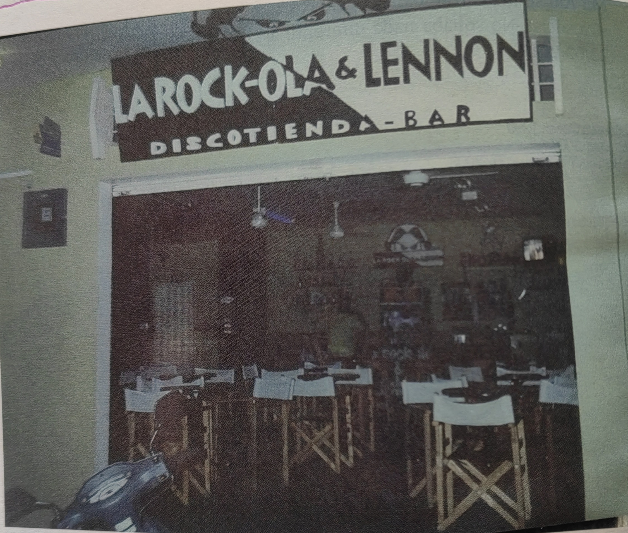
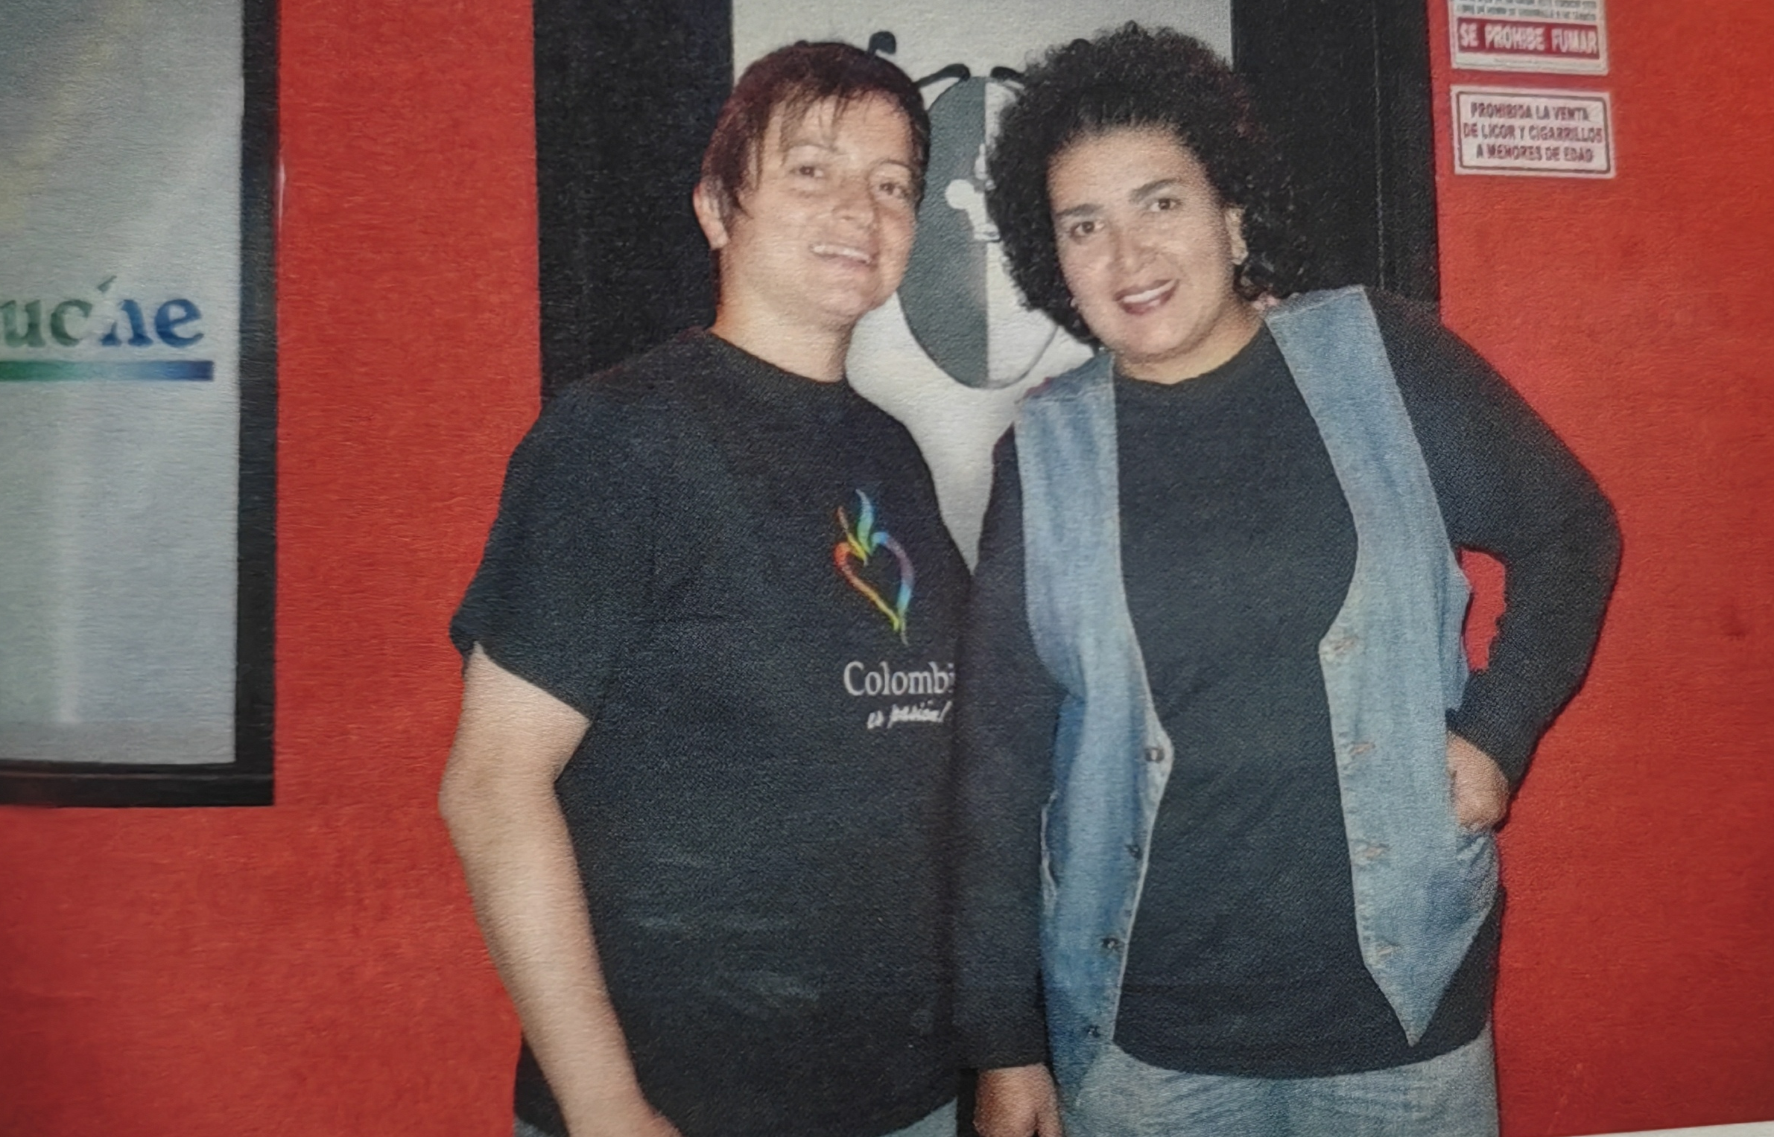
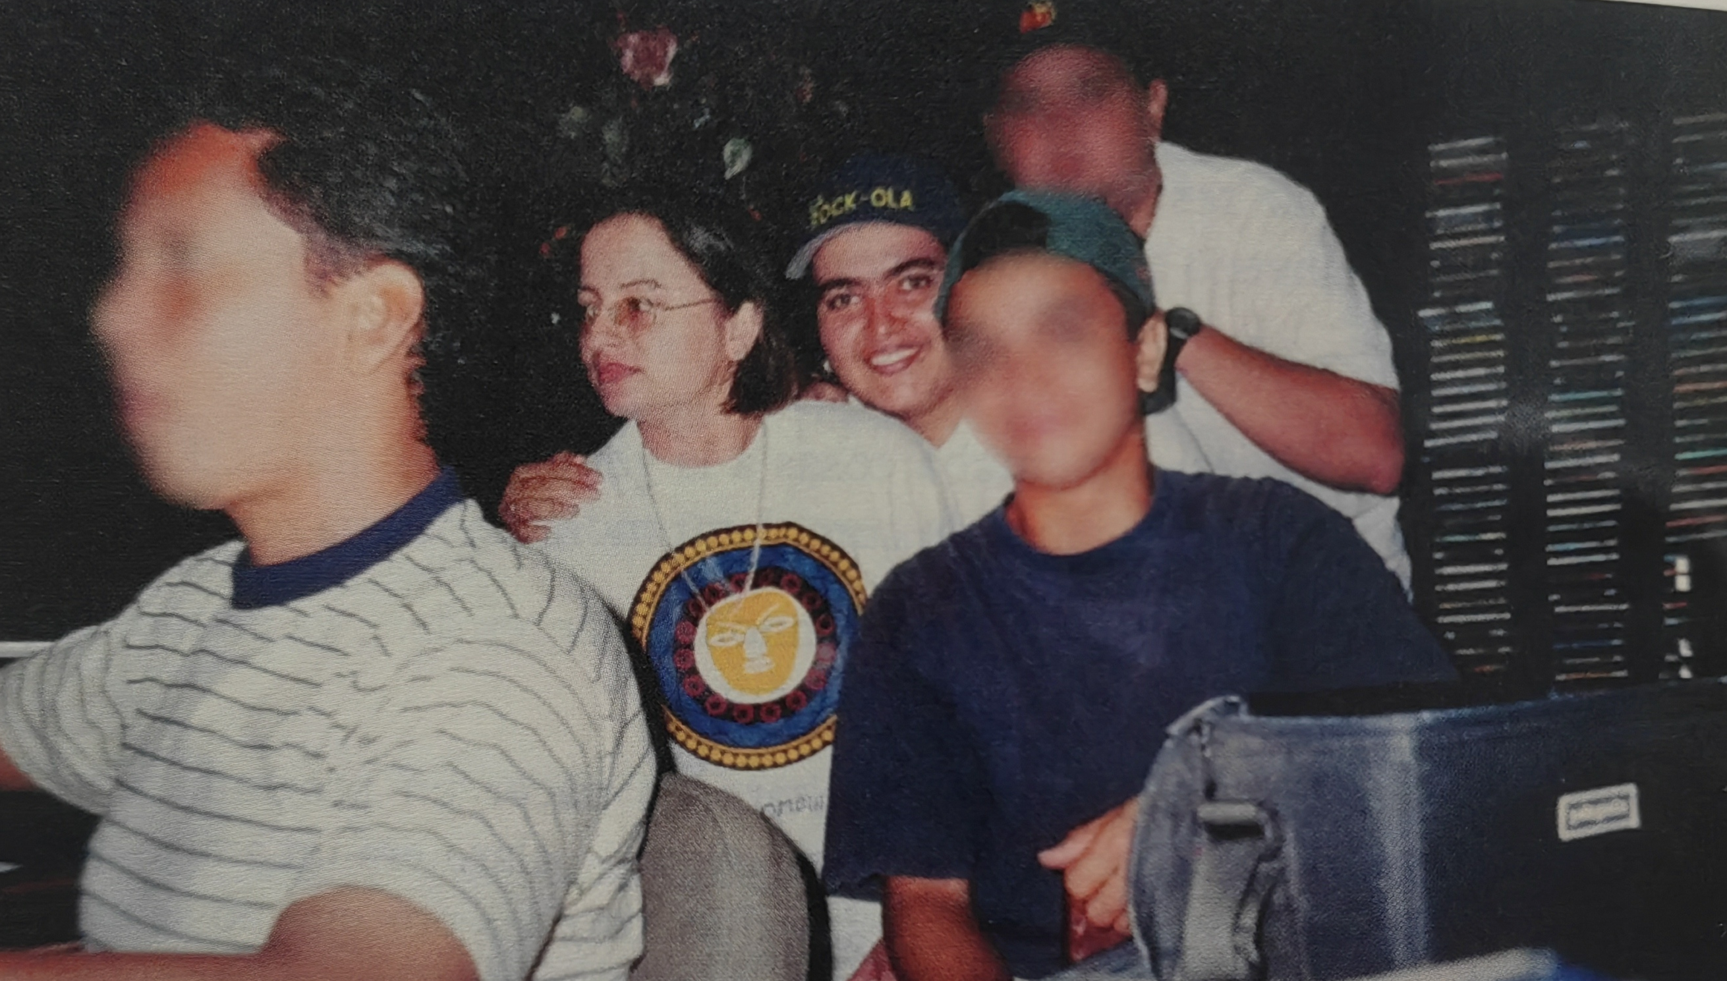
The field as a journey
Experience as how the body interacts with spaces, people and objects.
Queer rave-making in Berlin
Spaces: Parties, venues, events, afterparties
Roles: Club-goer, friend of the scene, worker
After
Inside
A body was changing
Before
Show
ICH and the politics of techno
Organising memories, field notes and doing further interviews
Re-arranging space-time
Homoparental family and queer safe spaces in Colombia
Notes:
Queer nightlife narrated as the “sociospatial coordinates of a travelled phenomena” (Adeyemi et. Al)
Time wraps like a rope (Ingold), past and present experiences informed each other.
3

Slide 4






Methodological approaches and ethical considerations
Improvisation and play (Barz and Cheng)
Intimacy and emotional attachment
Disoriented methods
Methods-making in situ
Blindness, opacity, darkness
Hapitc, sensual and affective.
Sexuality studies
Music and dance as the means for pleasure and desire
(Barz and Cheng)
Exposing
Control and surveillance
Focus on historically invisibilised social groups

Slide 5
Definitions
Queerness
Queer/Queered/Queering
As deviating (Ahmed).
An act of doing, transformation or transitioning.
A way of living one’s body that rejects normativity (Croft).
Dissidence and non-conforming
Techno-space
Electronic Dance Music (EDM) and rave scenes.
The assemblage of music, matter and sound (Khaleli) that has suspended and liminal properties.
Enhanced social interaction.
Queer space
Social and physical spaces sustain an imagined community (historically and structurally marginalised).
Scenes: Subcultural capitals (Thornton) are shared and negotiated.
Inscribed in international webs of discourses, activism and performative styles.
Identity as a feeling of self-recognition and social belonging that can be expressed through kinaesthetic, performative and political elements.
Queer techno-dance floors

Slide 6
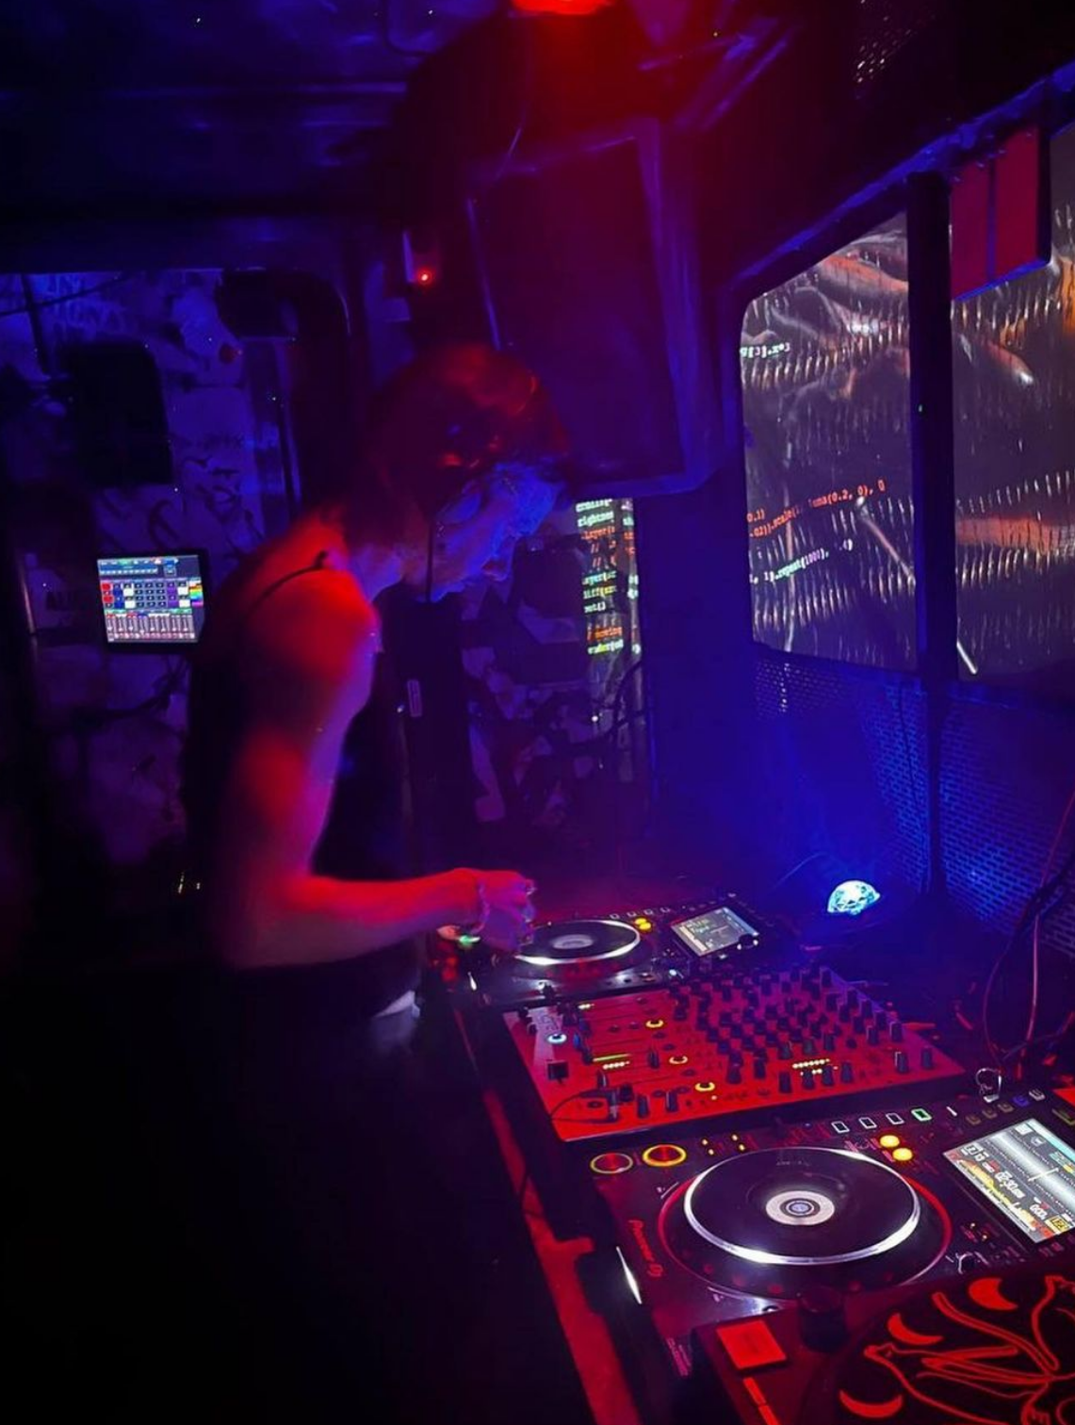
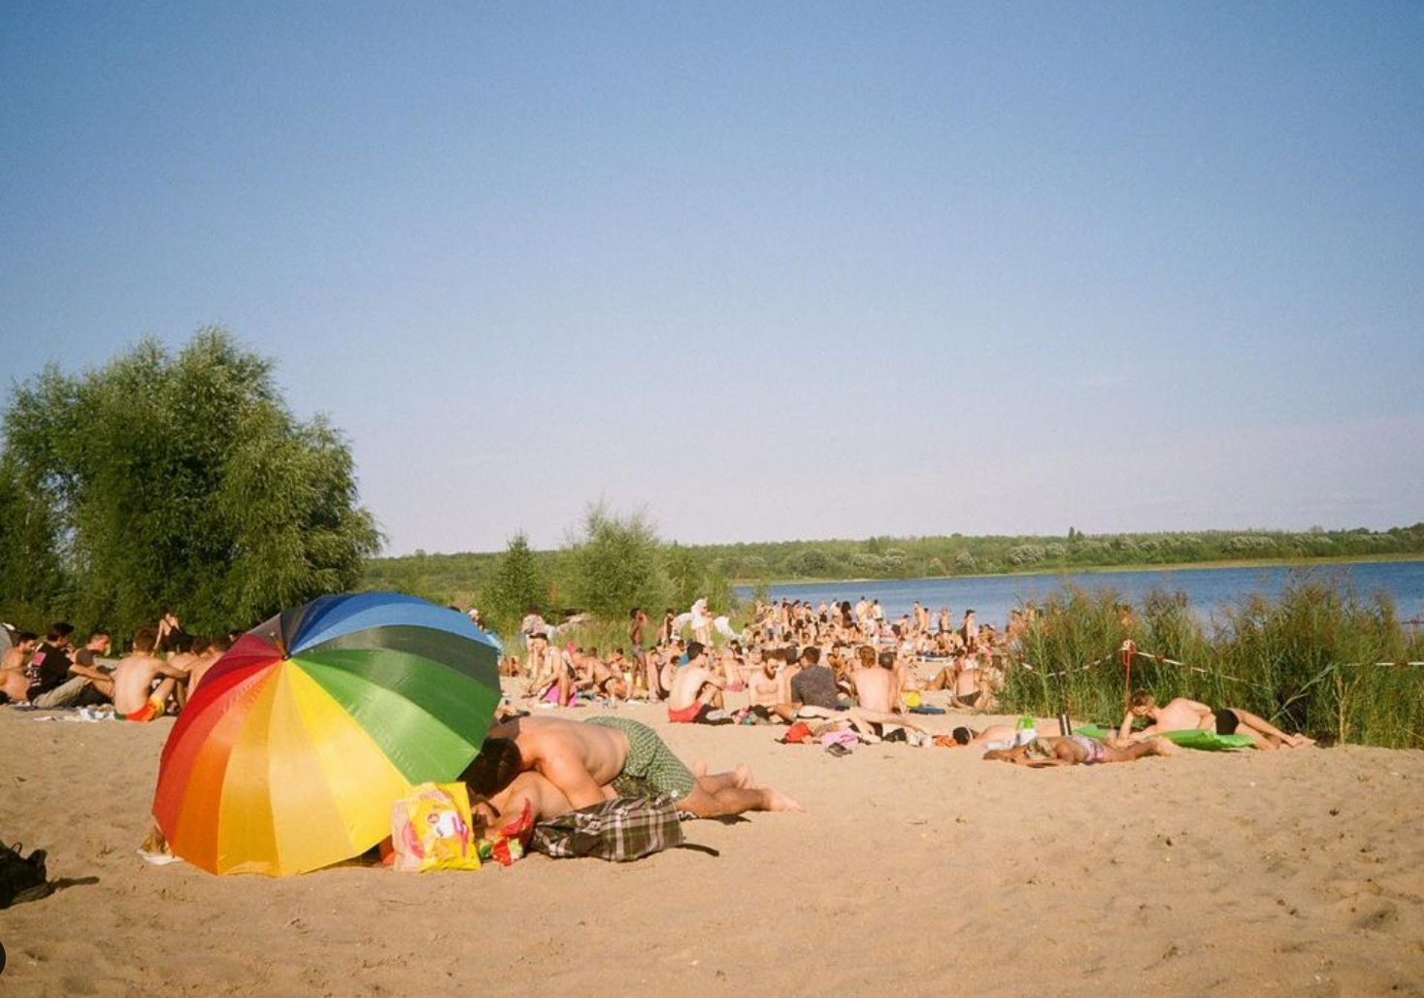
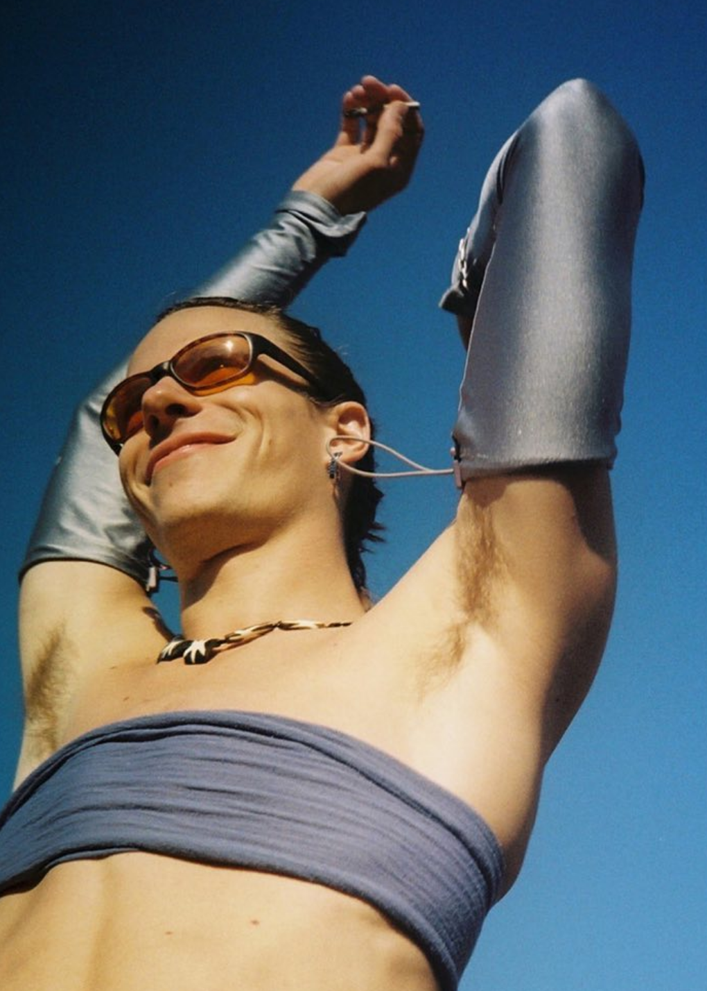
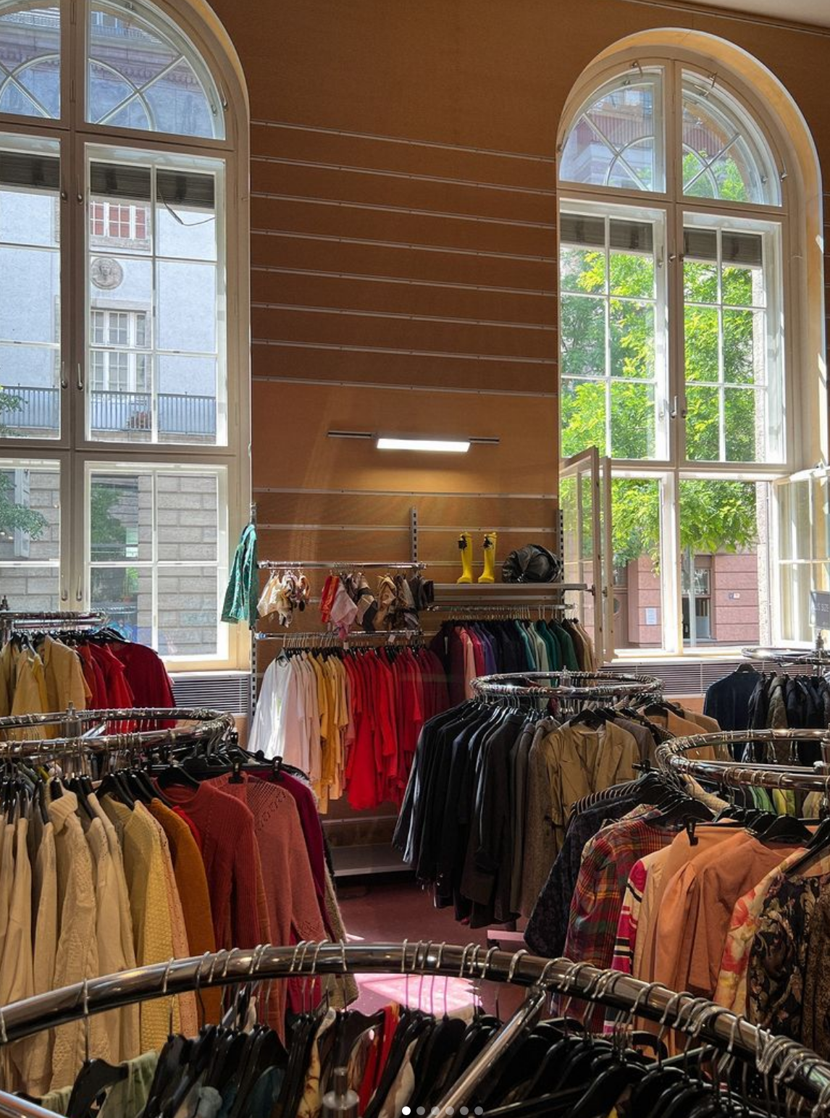
Phenomenological approach
Fieldwork making
Experience is shaped by how the body is directed towards spaces, people and objects.
As queer bodies interacting with each other, understanding the other meant understanding myself.
Feeling of not belonging
Bodily urgency
Migration
Experience is transported through space (city, social spaces, QTDF)
Body transformations
Recognition of a body-who-was
Embracing a new self
Life experience comprises taking paths, lines and turning points (Ahmed).
A line represents lived experience as a process (Ingold).
Becoming the shape of the line as a performative process (Ahmed).
Body archives lived experiences (Lepecki).
Spatially defined and curated.
Where bodily matter can expand (Ahmed).
Performing identity as materialising it (Butler).

Slide 7

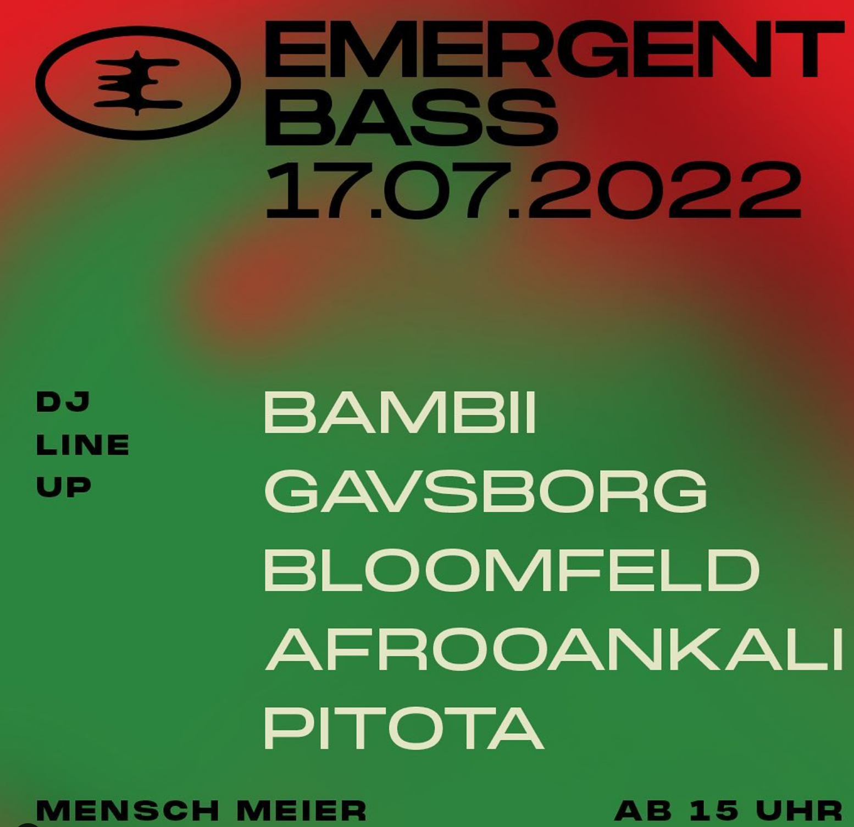
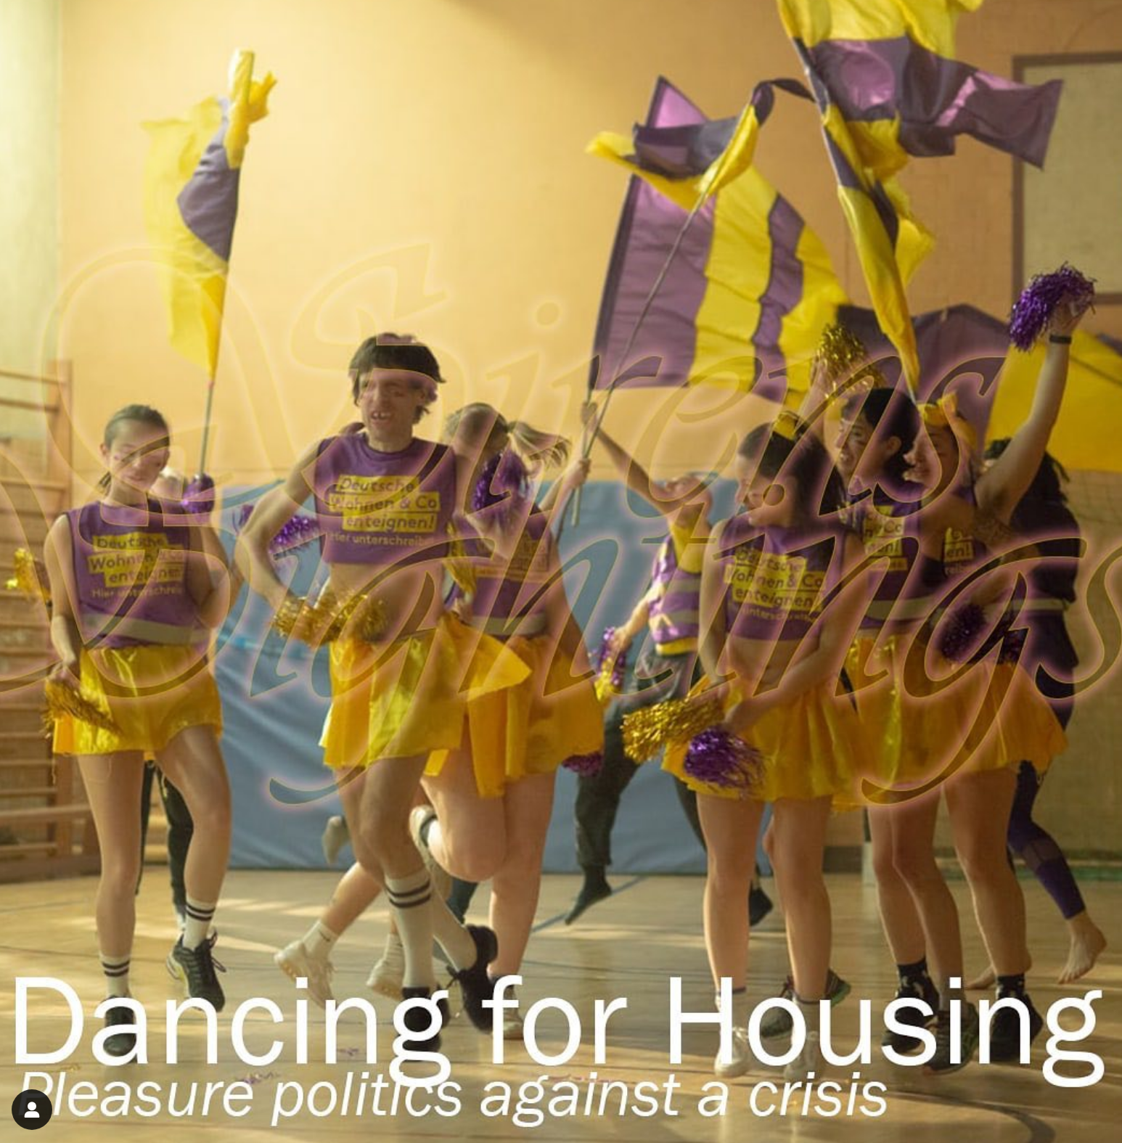
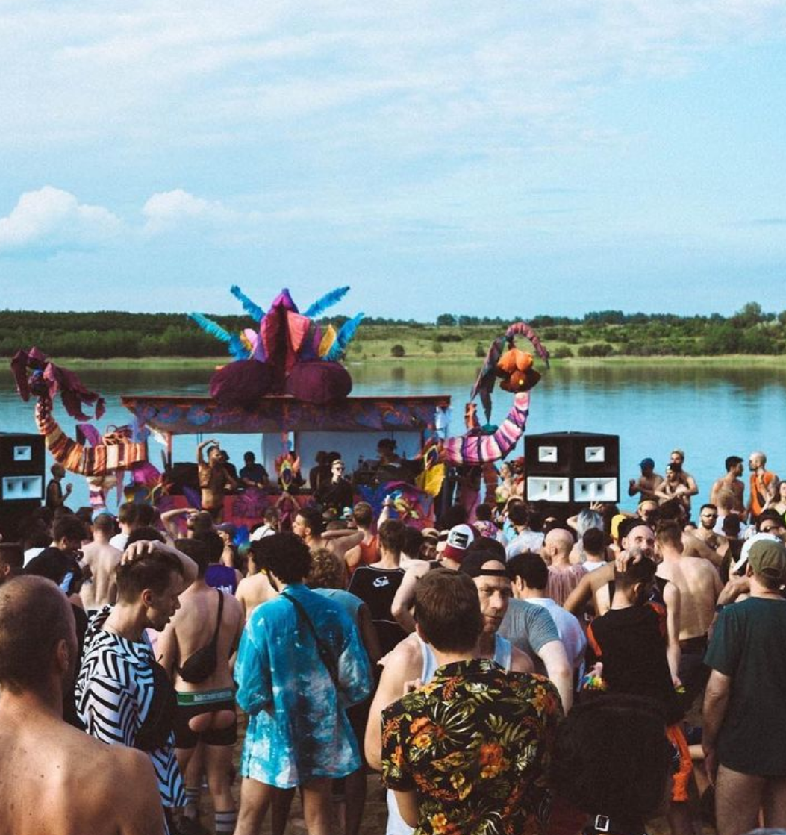
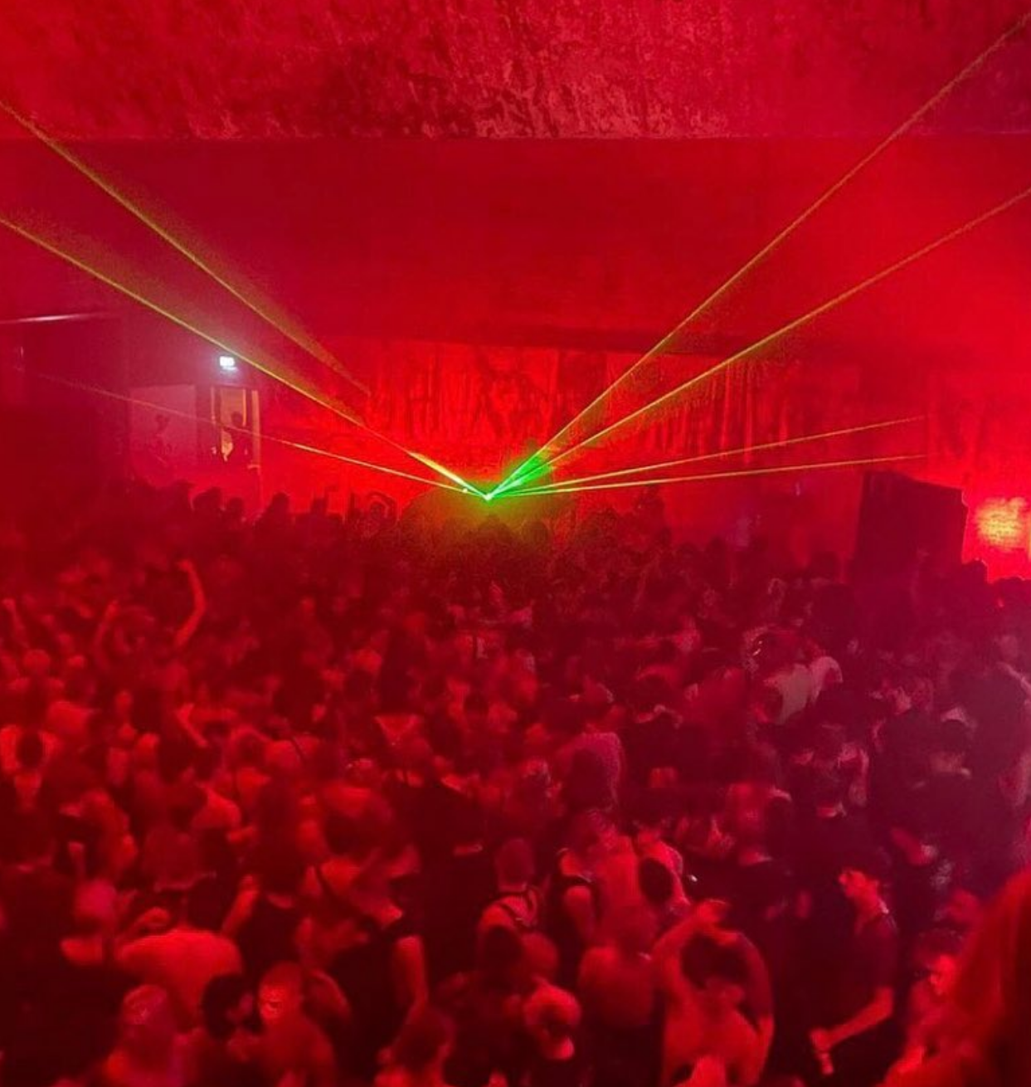
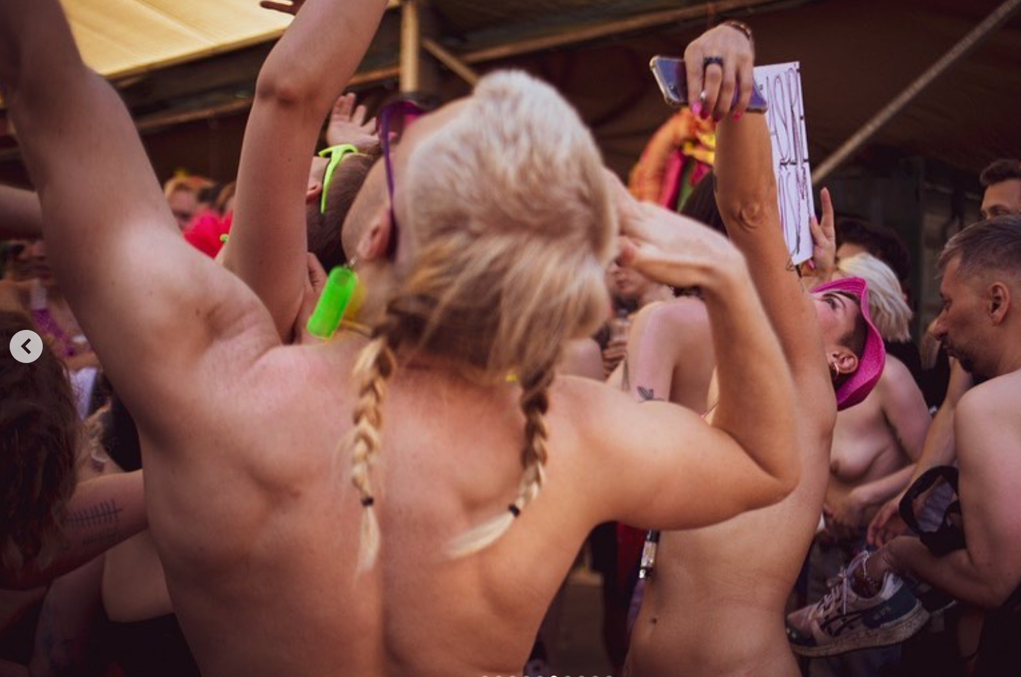
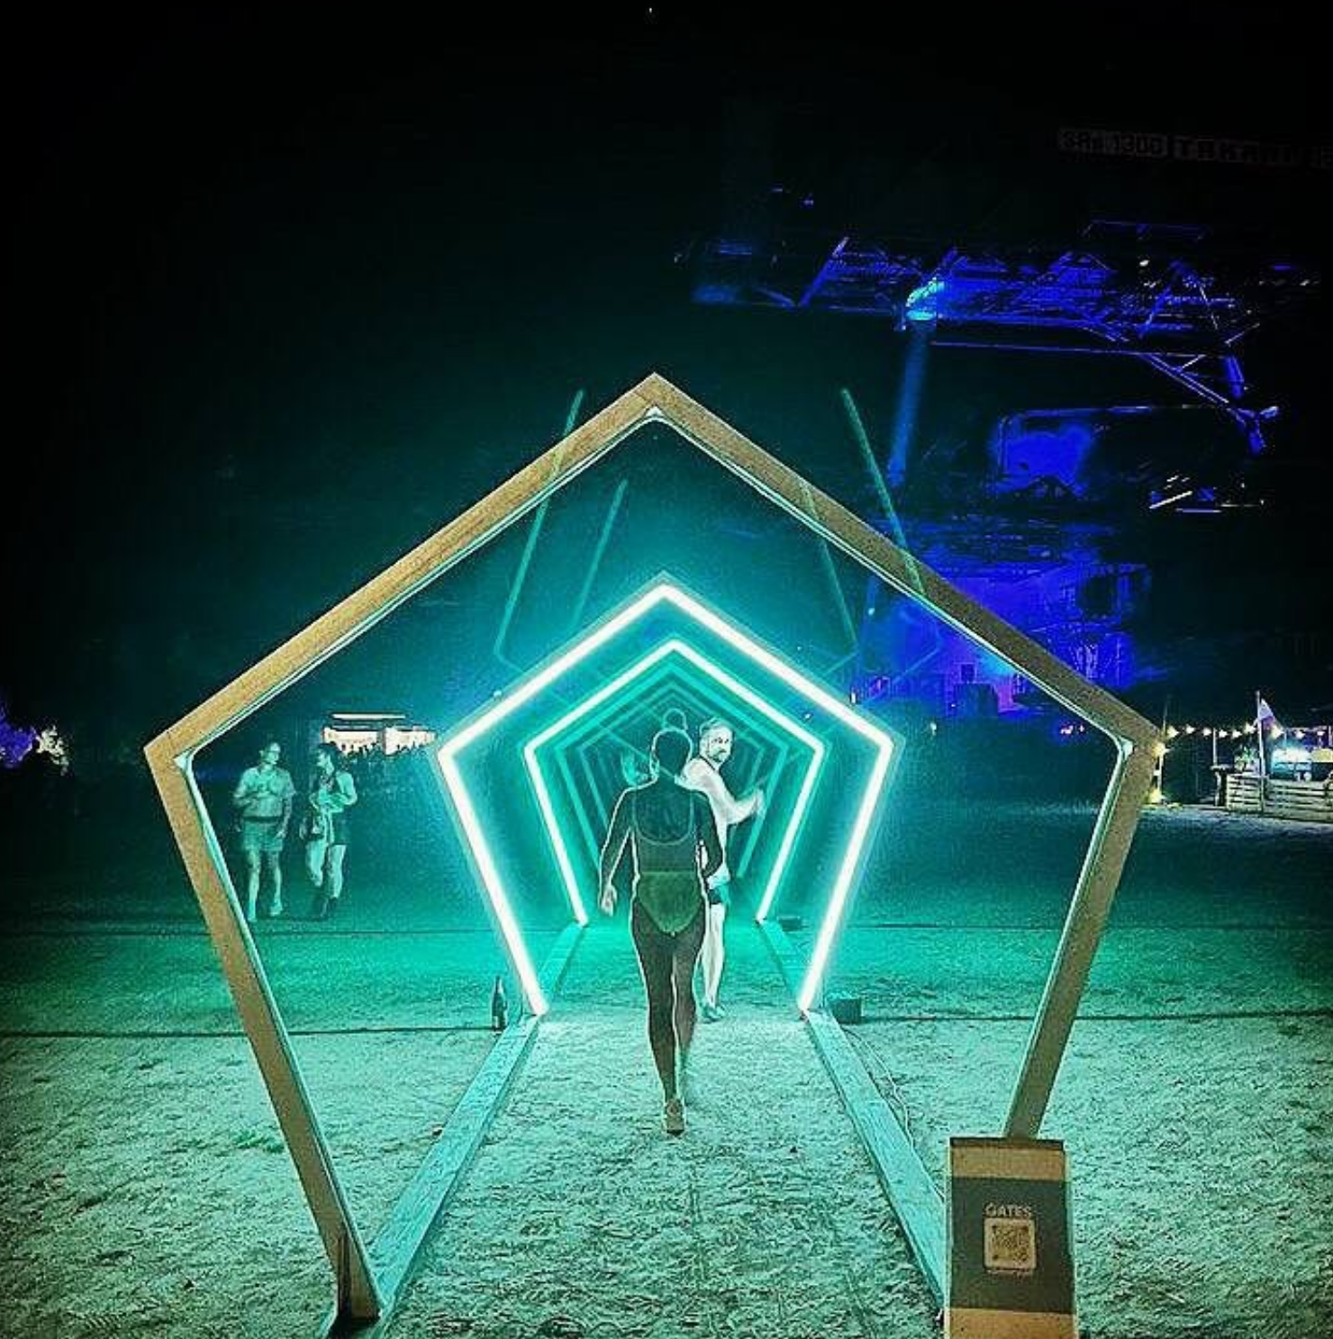
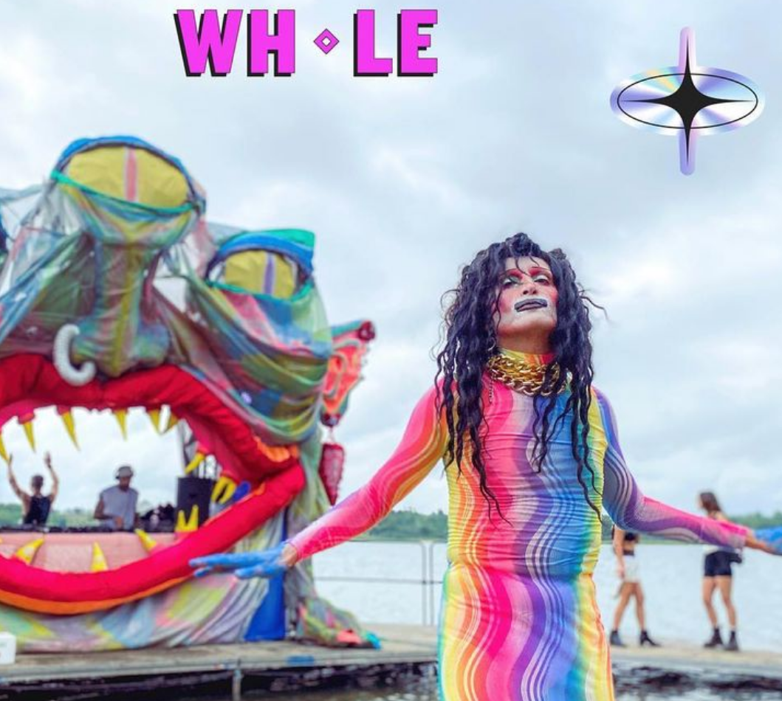
Body - Space
Queer socialisations, appropriations and creation of space:
Venues
Parties
Events
Festivals
Performativities
Kinaesthesias
Affects
Sexuality
Space
(Physical and Social)
Body
(Identity)
Notes:
Identity is taken is how it feels and not how it is. Relates to own agency on feelings of belonging and differentiation but also comprises the affiliation to already agreed social categorisations.
Space is socially constructed (Goffman) and sustain imagined communities (Anderson)
7

Slide 8




Queer techno-dance floors
Nightspaces / Nighttime / Counterculture
Nightlife culture
Social and physical:
Techno-space’s assemblages
Suspension
(Wanda and marum)
Parallelism
QTDF
Political:
Queer space (Furman and Mardell).
Queer rave-making (Lecken)
Other ways of social organisation
Safety
Escape and release
Collective becoming and lasting
Dance floor experiences (Bollen)
as body and life transformations?
Urban neoliberalisation
Surveillance and control
Feelings of burnout
Discriminations and segregations
Dissident identity performativities materialise and exceed the temporal and spatial boundaries of the nighttime.
Queer socialisations inside QTDF are transported to the outside world as collaboration and support networks.
Daily life
Daytime / Normative space

Slide 9




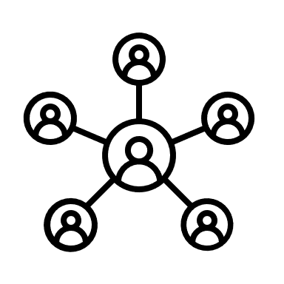

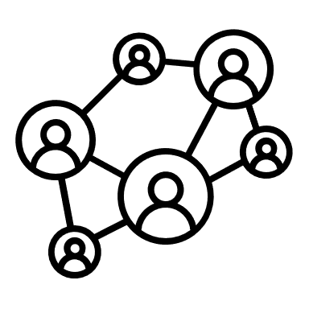
Shaping forces
Can be
Navigated and mobilised
Spatially curated
Sought for
Encountered
Experimented with
Queer politics, feminism, socialist activism, futurism
Sonic
Visual
Affects
Social
Hormonal-chemical
Professional / Collaborative
Pleasure
Kinaesthetic
(gestures, movements and dancing styles)
Affective, sexual-erotic
Body transforms as it aligns
Body takes shape
Well-being
Performative
Political

Slide 10
Body transformations
Intra/Inter/Trans-personal (vibe)
Shared kinaesthesias (Bollen)
Political negotiations of space
Community-making
Alignements of kinaesthetic, performative and political body elements (Ahmed)
Desired and materialised (Butler)
Repetition, rejection, appropriation, exploration (Bollen)
Sustaining surfaces through physical and social curations
Safety (Awareness work)
Affective enhancement
Parallelism/Suspension
Feelings and affects
Space (Physical and Social)
Body / Identity
Political subjectivities
Queer politics
Anti-normative forms of action on non-normative lines.
Notes:
Identity is taken is how it feels and not how it is. Relates to own agency on feelings of belonging and differentiation but also comprises the affiliation to already agreed social categorisations.
Space is socially constructed (Goffman) and sustain imagined communities (Anderson)
10

Slide 11
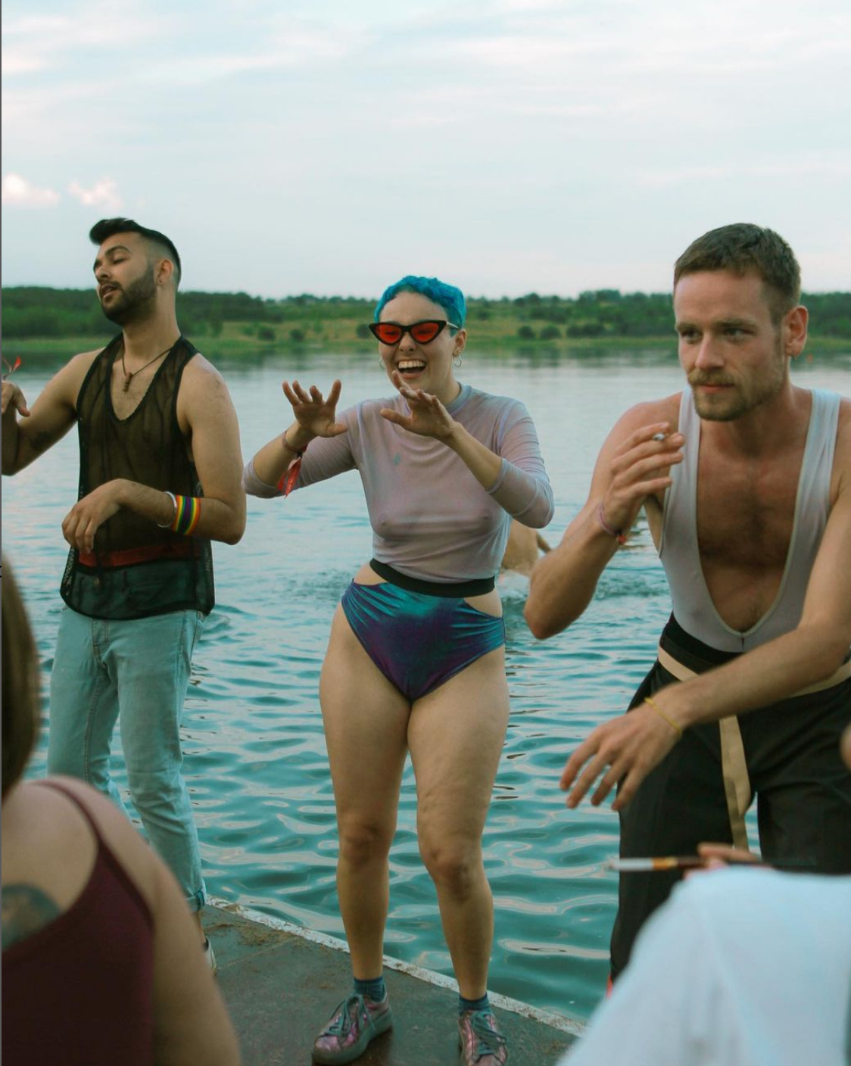
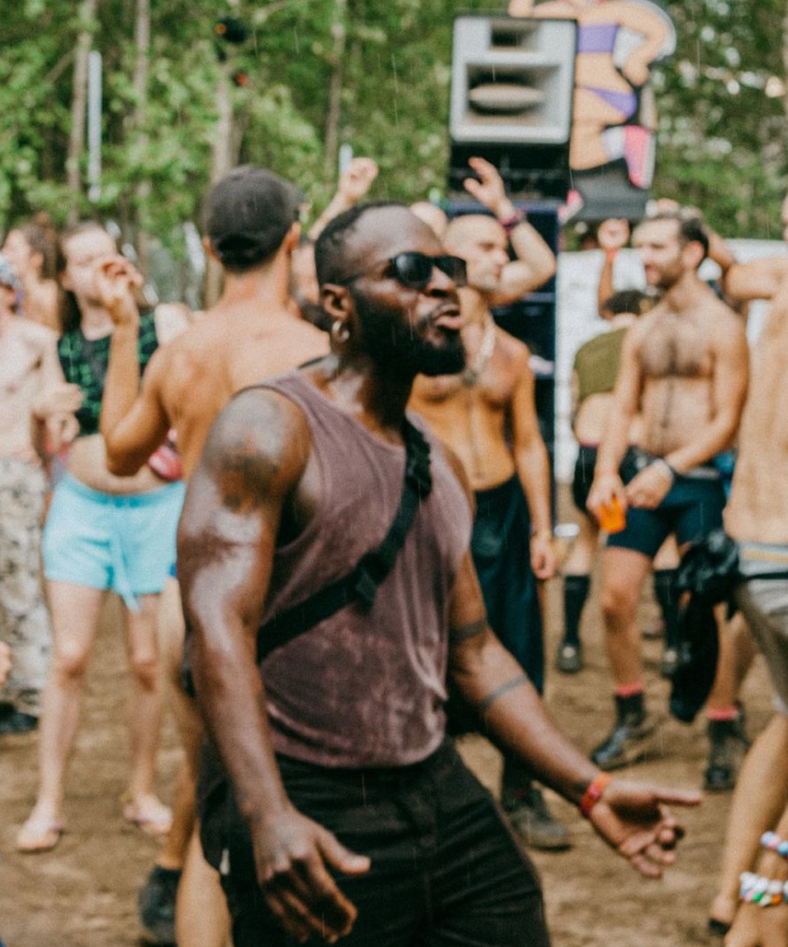
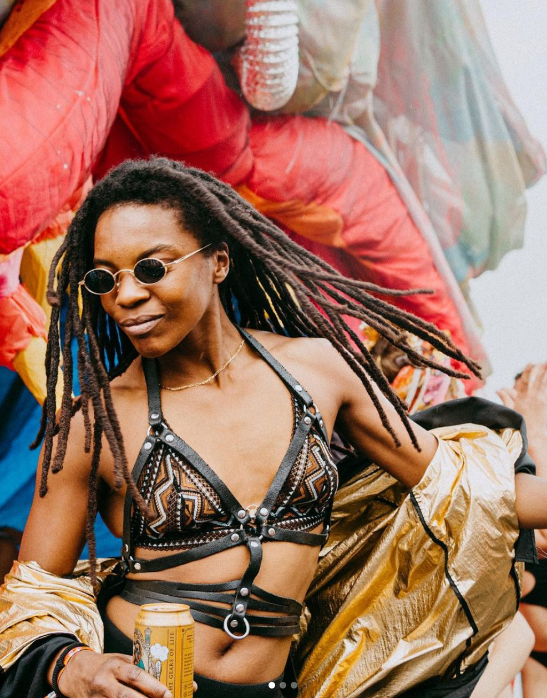
Dancing queer
Dancing queer is not queers dancing
Exploration, re-contextualisation and re-distribution of gendered performativities and kinaesthesias
Bodies can materialise kinaesthetically and performative queer identifications
Dancing queer is a political bodily stance that serves to reclaim one’s body through kinaesthetic and performative acts, which for many bodies, become a way for desired identities to take shape.

Slide 12

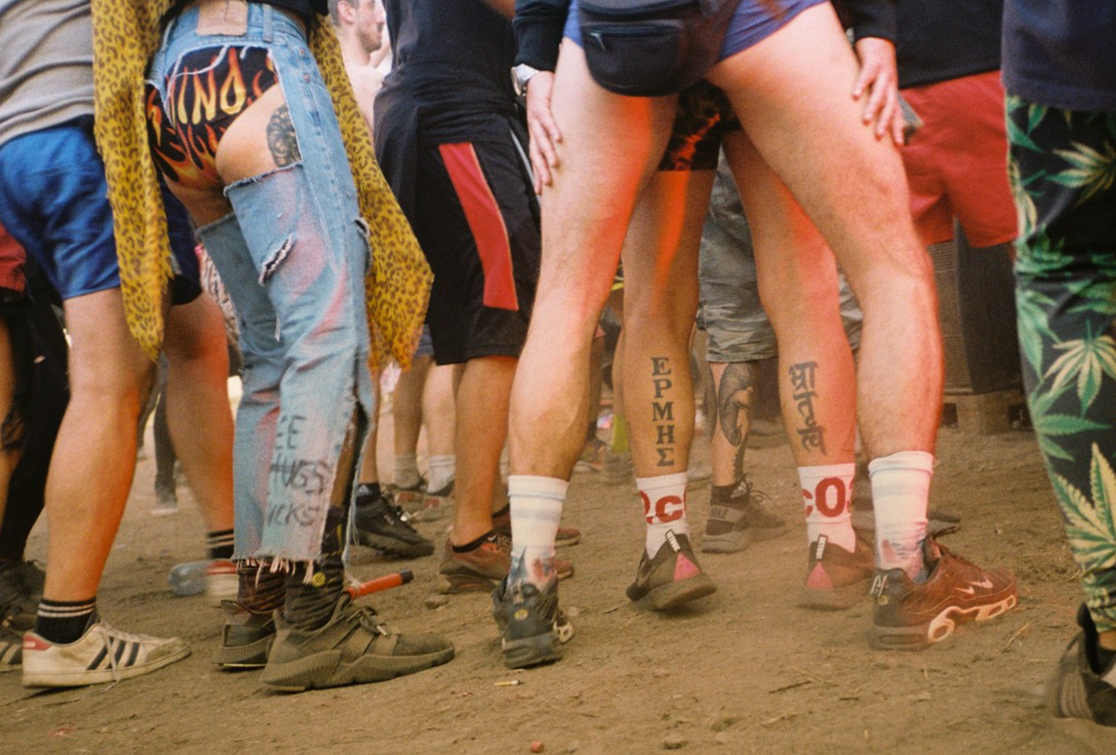

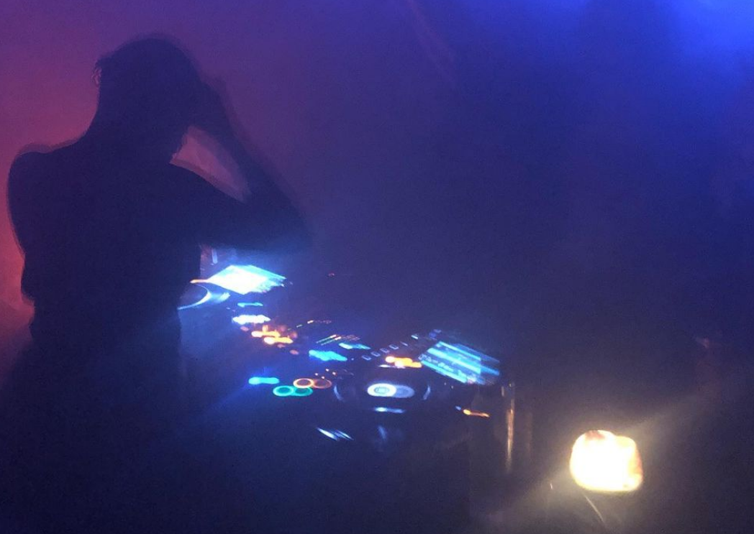
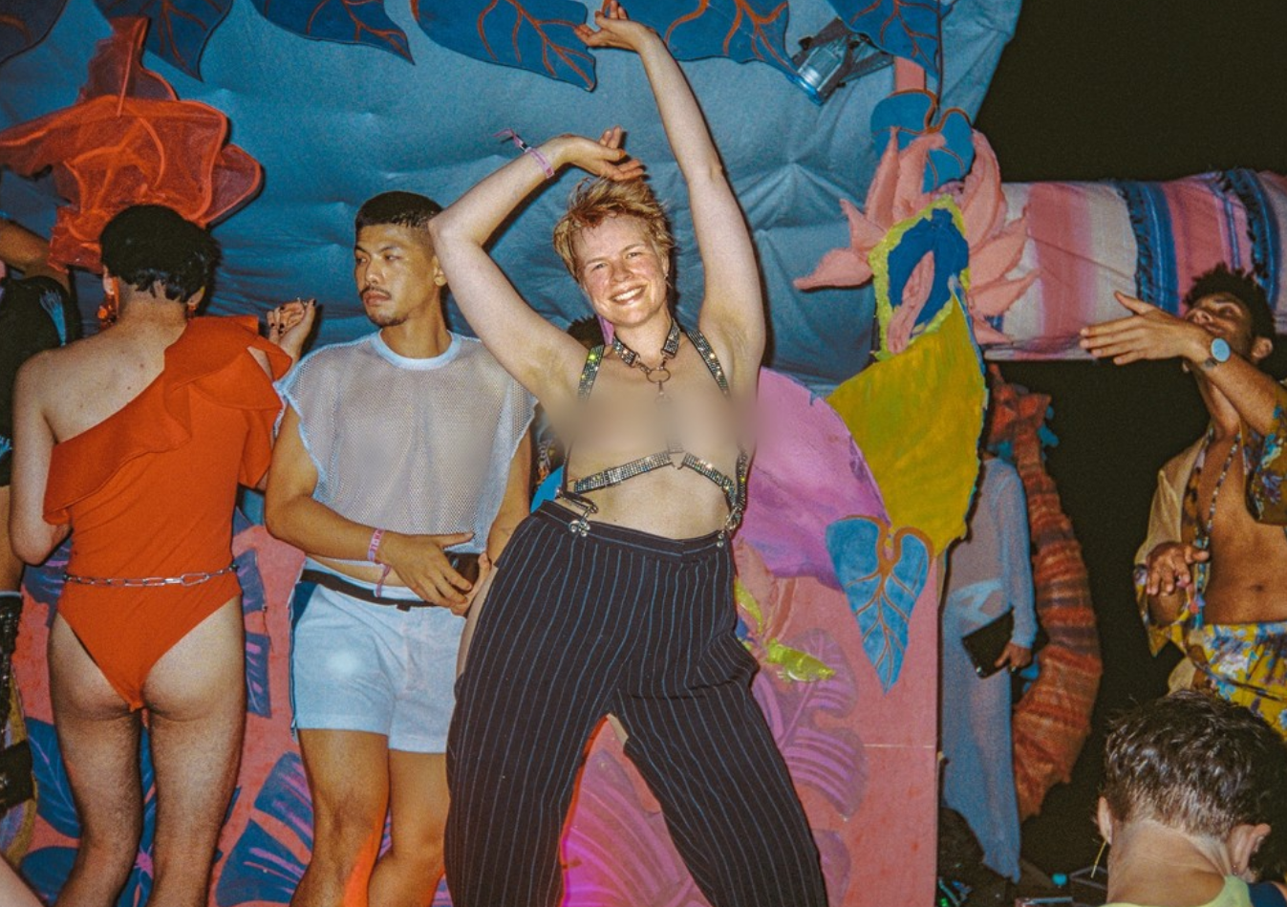
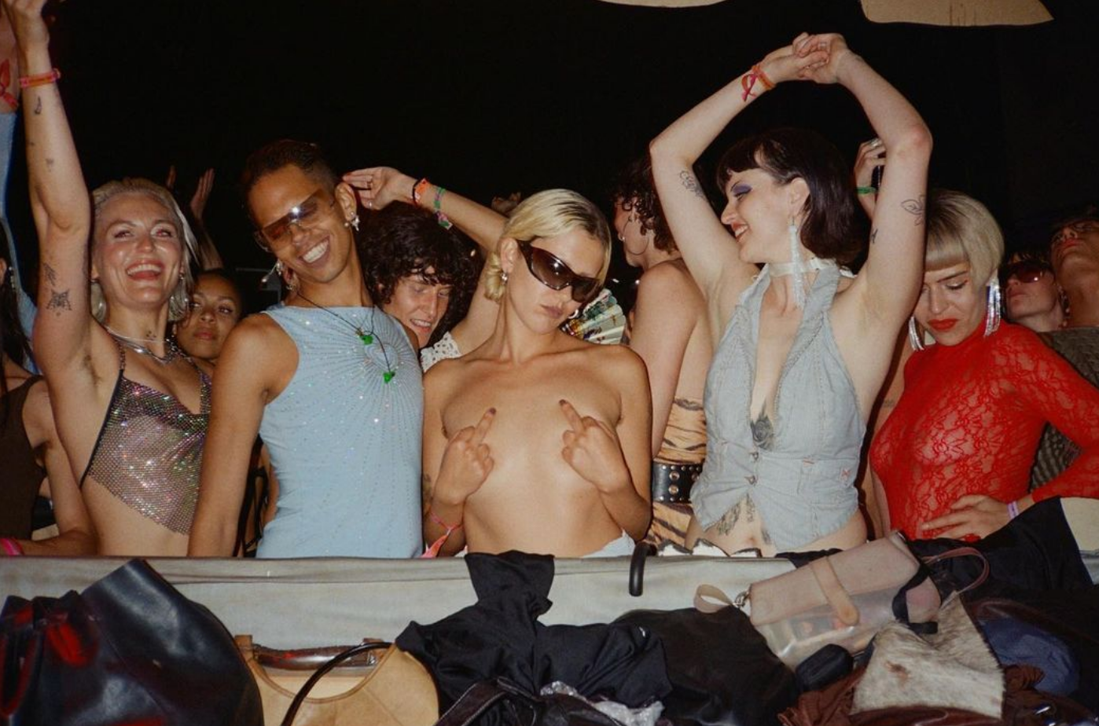
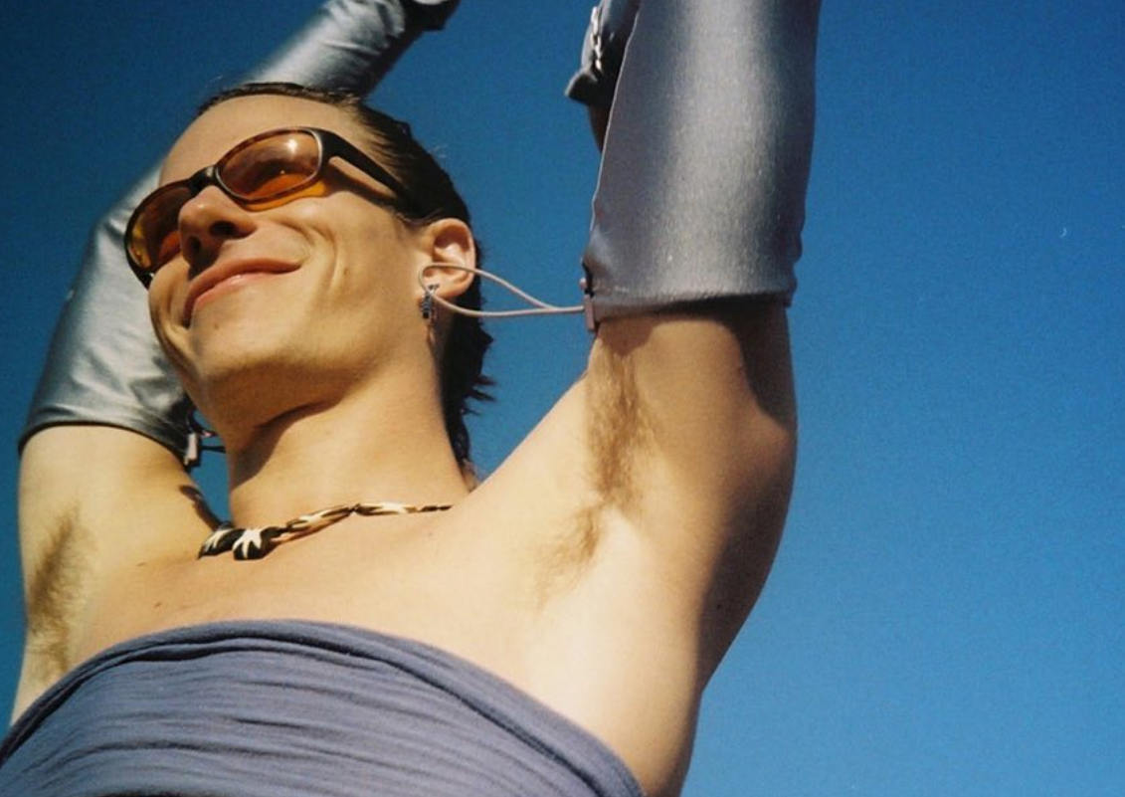
Conclusions
QTDF sustain the creation and exploration of political subjectivities and other ways of social organisation through the socio-physical spatial conditions of the techno-space and the political directions of queer spaces.
QTDF can shape different dimensions of the body through different social and spatial forces that are curated, facilitated, mobilized and negotiated under the umbrella of queer politics.
QTDF’s transformative experiences exceed the spatial and temporal boundaries of the party, as they are often related to more general aspects of daily life’s uses and meanings of one’s body. In this sense, body transformations can be life transformations.
Dancing queer is a way of holistically conveying and aligning body, identity and space, allowing dissident, non-conforming and marginalised performativities and kinaesthesias to take place.
Finding one’s path in life can be understood as the alignment between different bodily/identitarian aspects that, in the case of the politics of queer nightlife, can translate into a state of pleasure and the politics of collective becoming and lasting.
Politics of queer becoming and queer lasting create and sustain communities that take dance and pleasure as the means to create counter-spaces within the culture to bodily exist while addressing broader socio-political conjunctures.
When the body feels aligned, the shapes it acquires give a strong feeling of well-being that many queer bodies tend to hold as a means for the long-lasting materialisation of what everyone feels is our place in the world and the world we would all long to become real.

Slide 13
How adaptation works when transformed bodies can no longer find sustaining social and physical spaces?
How transformed bodies can transform bigger spaces as they inhabit different and unknown paths in life?

Slide 14
Bibliography
Adeyemi, K., Khubchandani, K. and Rivera-Servera, R.H. (2021) Queer Nightlife. University of Michigan Press. Available at: https://doi.org/10.3998/mpub.11700274.
Ahmed, S. (2006) Queer Phenomenology: Orientations, Objects, Others. Duke University Press. Available at: https://muse.jhu.edu/book/70074.
Barz, G. and Cheng, W. (2019) Queering the Field. Sounding Out Ethnomusicology. Oxford University Press.
Bollen, J. (1999) ‘Queer kinaesthesia : on the dance floor at gay and lesbian dance parties Sydney, 1994-1998’, University of Western Sydney [Preprint].
Butler, J. (2011) Bodies That Matter. On the Discursive Limits of Sex.
Croft, C. (2017) Queer Dance. Edited by C. Croft. Oxford University Press. Available at: https://doi.org/10.1093/acprof:oso/9780199377329.001.0001.
Diprose, R (1994) ‘Performing body-identity’, Writings on Dance, 11(12), pp. 7–15.
Furman, A.N. and Mardell, J. (2022) Queer Spaces. London: RIBA Publishing. Available at: https://doi.org/10.4324/9781003297499.
Gregory F. Barz and Timothy J. Cooley (2008) Shadows in the Field: New Perspectives for Fieldwork in Ethnomusicology.
Khaleli, J.A. (2021) Queering the Urban Politics of Transformation? Lisbon’s Techno-Spaces between Precarization and Self-Empowerment.
Olaveson, T. (2003) ‘“Connectedness’’ and the rave experience”’, in Rave, Culture and Religion. Routledge, pp. 83–104.
Williams, R. (2008) ‘Night spaces: Darkness, deterritorialization, and social control’, Space and Culture, pp. 514–532. Available at: https://doi.org/10.1177/1206331208320117.
Zebracki, M. (2016) ‘Embodied techno-space: An auto-ethnography on affective citizenship in the techno electronic dance music scene’, Emotion, Space and Society, 20, pp. 111–119. Available at: https://doi.org/10.1016/j.emospa.2016.03.001.

Slide 15
Further readings
Foucault, M. (1986) ‘Of Other Spaces’, Diacritics, 16(1), pp. 22–27.
Gaillot, M. (2004) Multiple Meaning Techno: An Artistic and Political Laboratory of the Present. Dis Voir.
Gamboa, E. (2021) ‘Pedagogies of the Dark. Making Sense of Queer Nightlife’, in Queer Nightlife, pp. 91–100.
Garcia, L.-M. (2013) ‘Editor’s Introduction: Doing Nightlife and EDMC Fieldwork’, Dancecult, 5(1), pp. 3–17. Available at: https://doi.org/10.12801/1947-5403.2013.05.01.01.
Goffman, E. (1959) The Presentation of Self on Everyday Life.
Ingold, T. (2007) Lines. A brief history. Routledge. Available at: https://doi.org/10.4324/9780203961155.
Lefebvre, H. (1974) ‘La production de l’espace’, L’Homme et la société, pp. 15–32.
Redhead, S. (1995) Rave Off: Politics and Deviance in Contemporary Youth Culture.
Rooke, A. (2009) ‘Queer in the Field: On Emotions, Temporality, and Performativity in Ethnography’, Journal of Lesbian Studies, 13(2), pp. 149–160.
Thornton, S. (1995a) club cultures. Music, Media and Subcultural Capital. Polity Press.

Slide 16
Thank you.

Slide 17
Kinaesthetic and spatial negotiations and mobilisations
How much and when people dance alone or together?
Everyone’s right to the space
Negotiations of power or how much the body can expand (Ahmed)
Interpersonal level:
Shared kinaesthesias and
kinaespheric reach (Bollen)
Transpersonal level:
Feeling of togetherness or connectedness (Olaveson).
Vibe
Grouping as place-making sustains divergent performativities and kinaesthesias
Intrapersonal level:
Conversations with oneself
Margins within the dance floor
Sonic, visual, kinaesthetic, affective, and pleasurable influences are spatially determined and can be spatially curated.
Are collectively shared and interchanged.
Fluxes of people as a process of finding safe and comfortable locations within the dance floor

Slide 18
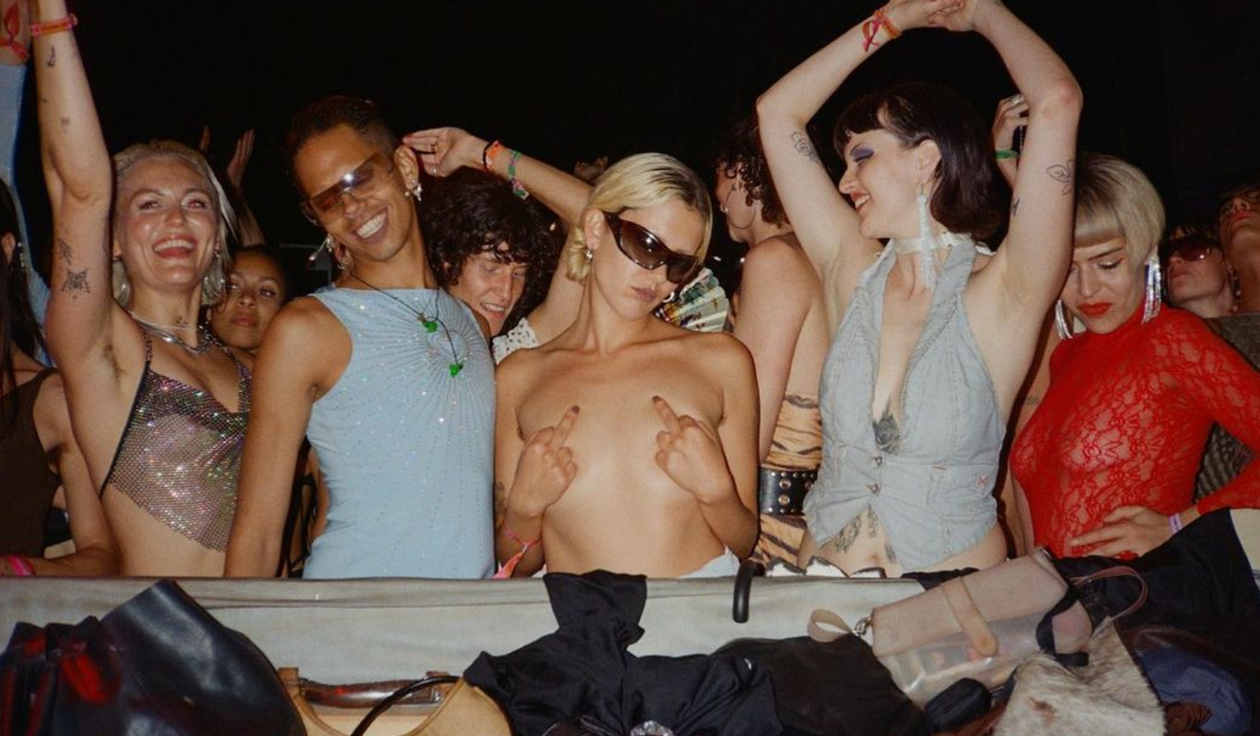
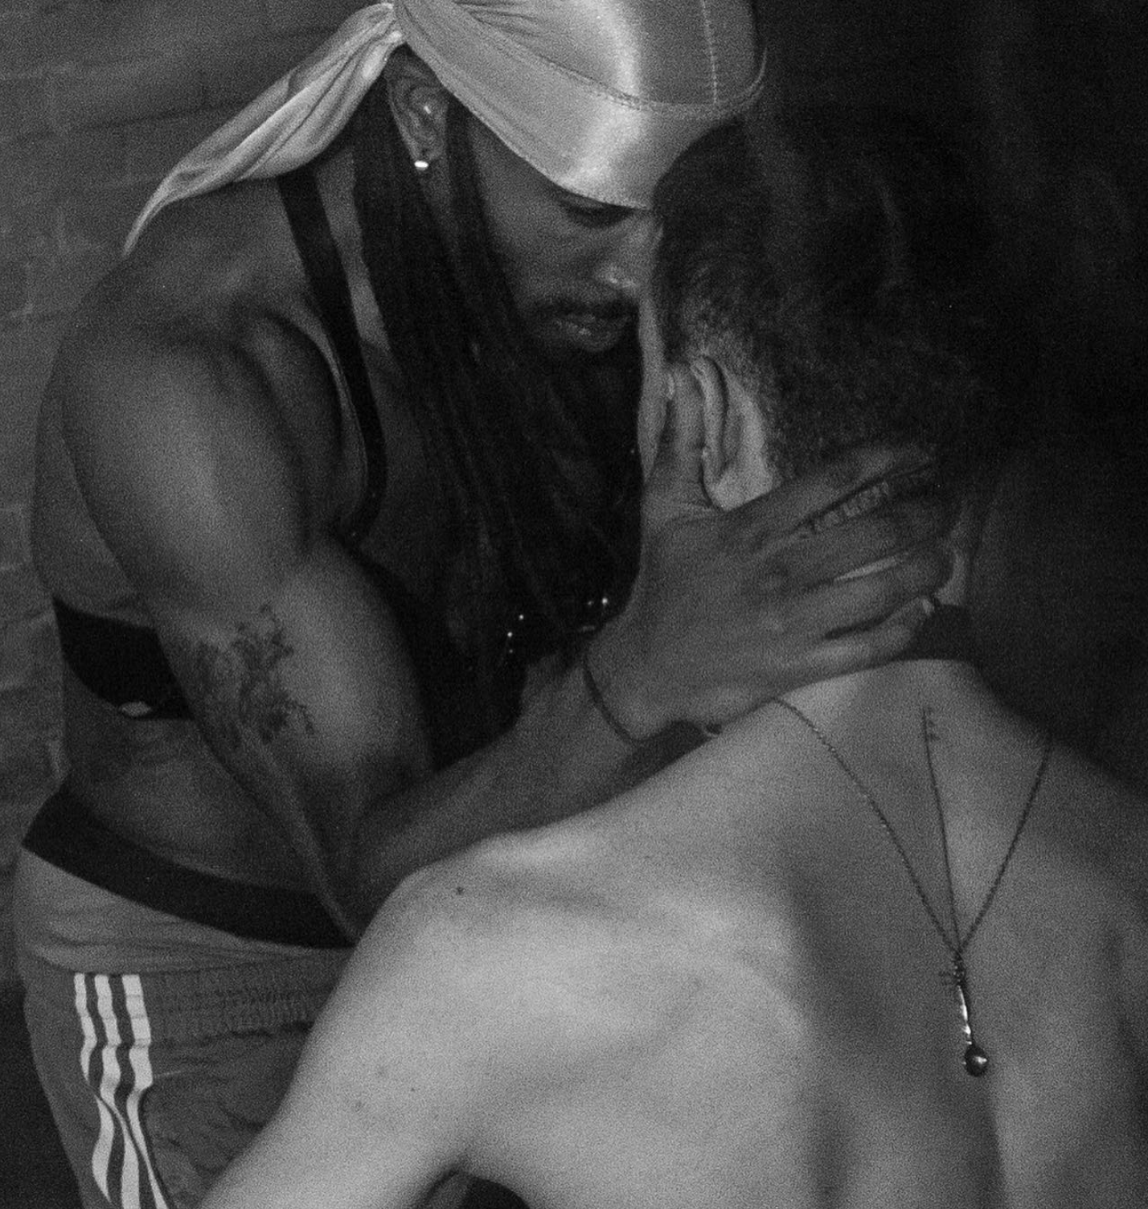
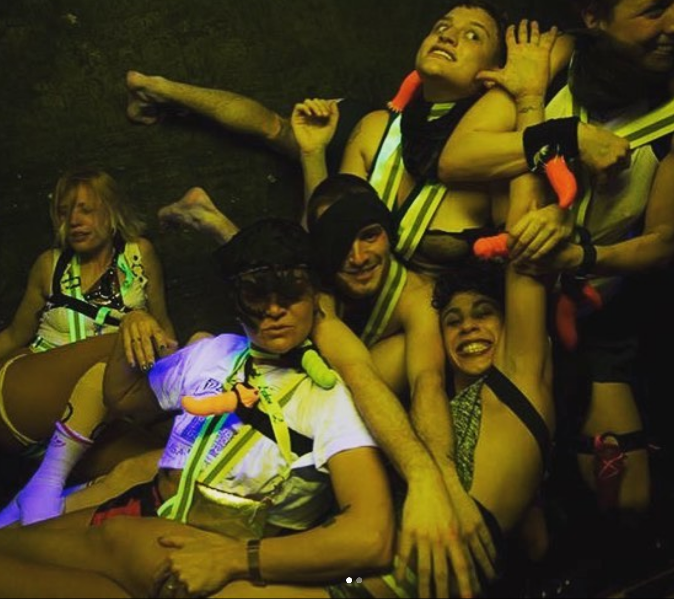
Political negotiations and mobilisations
Where and how people feel better dancing?
Sex-positive and drug-positive spaces.
Differences and commonalities.
Divergent and diverse sexualities are practiced.
Terrain for learning conflict resolution and boundaries setting.
Solidarity and re-distribution.
Femmes to the front aims for
the spatial re-distribution of historically marginalised performative, kinaesthetic and identitarian ways of living and presenting the body
Deconstructive force.
Awareness work:
Good consent and harm-reduction as values of learning self and collective care
A reflexive process of learning everyone’s right to be respected and the interaction with the others in a non-instrumental way (Wanda).
Agency and empowerment.
Domination of cisgendered gay male body interactions of hypersexualisation of the body and hooking-up culture.
Disciplinary force.

Slide 19
Further conclusions
QTDF offer the socio-spatial conditions under which dissident and non-conforming bodies can take shape and materialise.
The exchange of kinaesthetic and performative elements mediates body transformations in QTDF. Although they can be studied from an interpersonal approach, a transpersonal one is closer to understanding the emergent properties of the feeling of collectivity or the vibe.
Dancing queer means that bodies can explore and find themselves in suspended spaces and kinaesthesias that escape hegemonic body politics of control and surveillance, which for non-conforming and dissident bodies, sometimes become the only space and time where their identity and their desired social configurations can happen.
A phenomenological perspective serves to understand the relationship between body transformations and space as it explains how experience shapes the body as it interacts with different spaces, people and objects and takes different paths and turning points in life.

